Slide 1

Amendment Application for 2BM-ULU2030 Blue Star Gold Corp. Ulu Project, Nunavut
Presentation by the Kitikmeot Inuit Association
Cory Barker, John Roesch
March 10, 2026
On-line Meeting with NWB

Slide 2
Presentation Outline
KIA’s Mandate
Overview of KIA’s role in the Ulu Project
KIA’s review of Ulu reclamation security
KIA’s request to the NWB to hold all security for type B water licence

Slide 3
KIA’s Mandate
The KIA’s mandate is Kitikmeot Inuit lands and resources, and to protect and promote the social, cultural, political, environmental and economic well-being of Kitikmeot Inuit.
KIA administers land tenure on Inuit Owned lands in the Kitikmeot region and works to ensure Kitikmeot Inuit interests are reflected in land and resource development in the region.
KIA is a Designated Inuit Organization (DIO) under the Nunavut Land Claim Agreement.
Affected communities:
Closest: Kugluktuk

Slide 4
KIA’s Role in the Ulu Project
KIA represents the Inuit Beneficiaries of the Nunavut Agreement and is the Regional Inuit Association (RIA) for the Kitikmeot
KIA promotes appropriate development in the interest of all Inuit
Projects must balance economic development with social development
Must also protect the land, wildlife and Inuit lifestyles
KIA is a consistent participant in regulatory processes
Nunavut Impact Review Board (NIRB), Nunavut Water Board (NWB), and Nunavut Planning Commission (NPC)
Environmental assessments, water quality concerns, monitoring, closure and reclamation, etc.

Slide 5
KIA’s review of Ulu reclamation security
From 2024 to 2025, KIA had conducted a review of reclamation security requirements for the Interim Closure and Reclamation Plan (ICRP) for the Ulu Project in conjunction with Blue Star Gold Corp.
This included a site visit and desktop review of security because of progressive reclamation undertaken at site.
Current reclamation security is $2,629,327
$1,685,542 is held by CIRNAC
$943,835 is held by KIA
KIA’s updated security estimate was $1,740,400
Blue Star’s updated security estimate was $1,688,854
Both KIA and Blue Star Gold Corp agree to a security amount of $1,714,627

Slide 6
KIA’s request to the NWB to hold all security for type B water licence
CIRNAC’s security is a legacy issue predating Nunavut and IOL.
The Ulu mine site was part of the Type 1 water licence held for the Lupin mine site in the Northwest Territories.
The Ulu mine site was sold separately and was eventually acquired by Blue Star Gold Corp.
The Ulu mine site is entirely on IOL managed by KIA.
KIA successfully obtained from Blue Star security for the site in 2019 and 2020.
The Ulu Project operates under a Type B water licence in Nunavut and CIRNAC does not hold security for any other project in Nunavut operating under a Type B water license.
In both 2015 and in 2020, KIA had requested to the NWB that KIA retain all security for the Ulu Project.
KIA is again requesting that KIA hold all the security for the Ulu Project for $1,714,627.

Slide 7
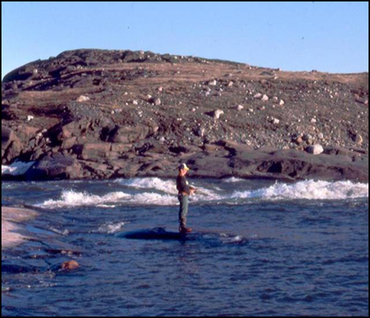
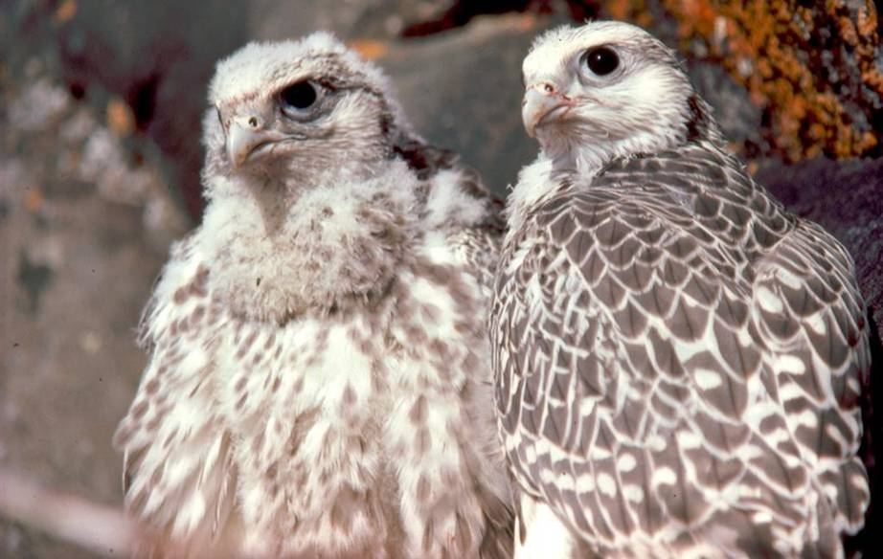
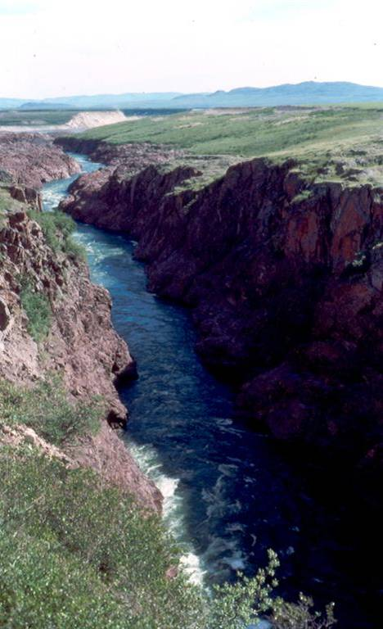
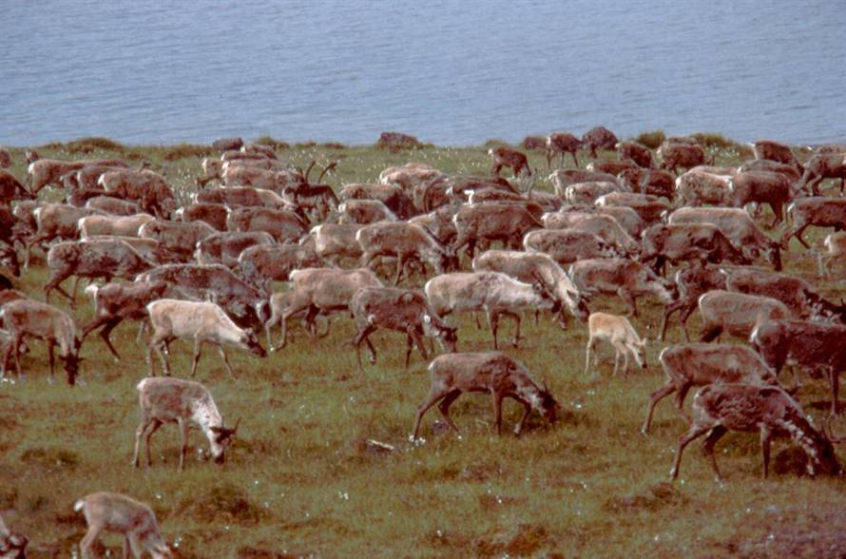
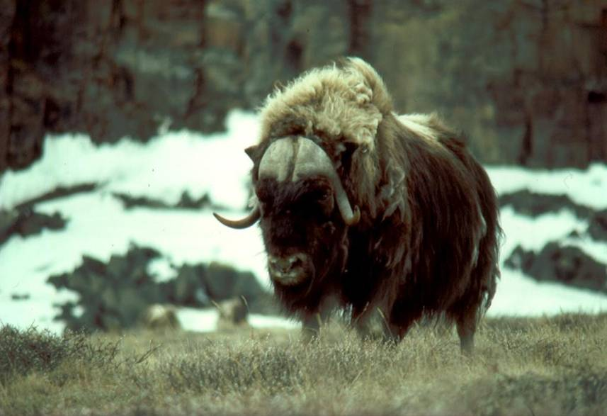
Thank you

