Slide 1

Nunavut Water Board
Public Meeting
Water Licence Renewal and Amendment
Arviat
3AM-ARV----

Slide 2
Existing Licence

Slide 3
Water Licence:
3AM-ARV---
This application is for the renewal and amendment of the expired 3AM-ARV1015 licence.
Date of Licence Issuance: August 23, 2010
Expiry of Licence: August 31, 2015
Short Term Renewal: June 16, 2015
Short Term Expiry: February 27, 2016
Scope of Licence:
This Licence allows for the use of Water and disposal of Waste including operation of a
Water Supply Facility, Solid Waste Disposal Facility, Hazardous Waste Storage Area,
Bulky Metals Area, and Sewage Disposal Facility.

Slide 4
Water Licence:
3AM-ARV---
In the absence of an active licence Arviat has continued to:
Report quantities of water withdrawn &wastewater deposited
Improve the management of solid waste
Understand studies to improve water and waste infrastructure
Conduct monitoring program sampling
Engage in regular communication with the CIRNAC Inspector on compliance issues
Completed Projects:
Additional raw water reservoir cell
Upgraded water treatment plant
Ongoing Projects
Upgrade and expansion of the wastewater lagoon
Upgrade and expansion of the solid waste site

Slide 5
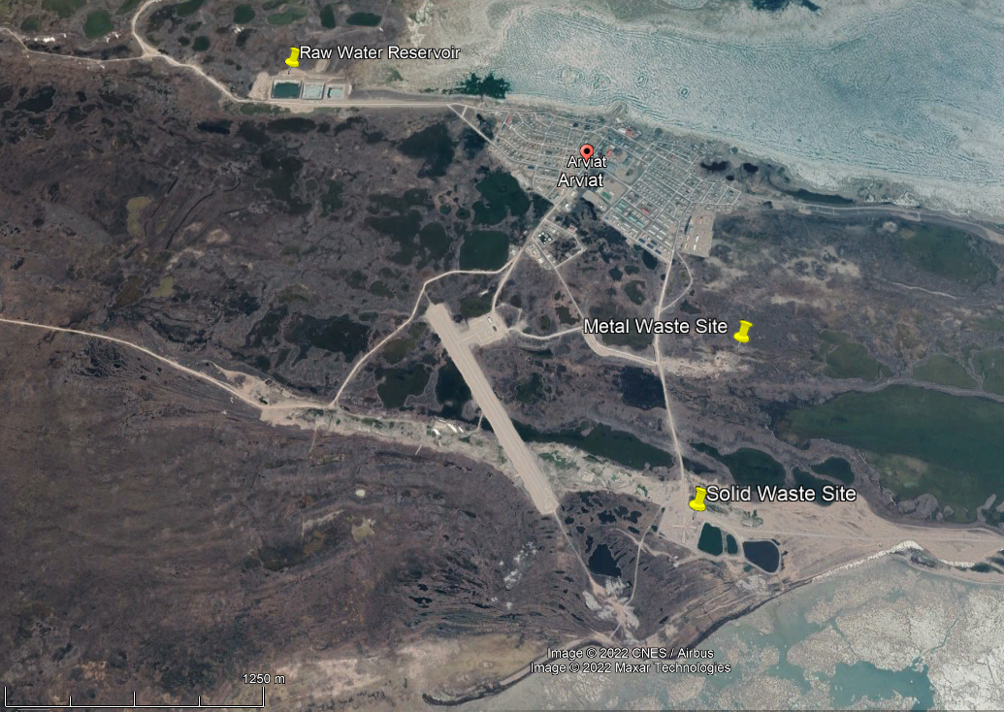
Infrastructure

Slide 6
Background
Wolf Creek is the domestic water supply for the Municipality of Arviat, approximate population of 2,657 (2016 Census)
The watershed is frozen for seven to nine months a year; therefore, a 3- cell raw water reservoir with capacity 235,393 m³ must be adequately supplied through an 8 km transmission line prior to freeze-up each year. The first cell of the reservoir was built and has been in use since 1988, the second cell was constructed in 1998, and the third cell in 2019.
The Wolf Creek 2019 Hydrologic Assessment report indicated that only 0.2% of water is being diverted for the reservoir resupply which is below the Fisheries and Oceans Canada limits to preserve fish passage.

Slide 7
Background
A passive lagoon has received wastewater since 2005. The 37,960 m³ lagoon acts as a holding cell during the frozen month and effluent freely flows out upon thaw. Most of the effluent treatment is attributed to the wetland treatment area.
The 7.3-hectare wetland treatment area directs effluent flow away from the municipality and towards Hudson Bay at the end of the wetland.
A new 2-cell lagoon project is underway that will upgrade the current lagoon and construct an adjoining cell. The new capacity is sized to accept wastewater for 10-12 month for the next 20 years. It will also be sized to hold sludge for the lifespan of the asset.
2 legacy abandoned lagoon cells adjacent to the active lagoon cells require remediation.

Slide 8
Background
Arviat’s primary solid waste site has been in use since 1977 with an area 160 x 200 within the fenced containment berms. The metal waste area has an approximate area of 40,000 m²
A metals shredder was purchased by the municipality in 2017. Since operation, approximately 25% of the metals have been shredded. Non-polluted shredded metal is used as cover on the landfill site with gravel.
Arviat has a summer-long clean up program, inclusive of 12 summer hires and 25 students. They have also partnered with the local mining company to back-haul hazardous waste to southern Canada for proper disposal.
There is an ongoing solid waste improvement project managed by CGS. Pending federal funding approval, the abandoned lagoon cells will be evaluated for suitability to be remediated and upgraded to act as an extension to the current landfill.

Slide 9
Sampling Program
Station | Description | Frequency | Request
ARV-1 | Raw water supply at Wolf River prior to treatment. | Monthly | Change to Wolf Creek
ARV-2a | Effluent from the discharge point of the Solid Waste Disposal Facility. | Monthly during the months of May to August and prior to discharge of accumulated impacted water. Acute Toxicity Annually | Remove acute toxicity testing
ARV-2b | Effluent from the discharge point of the New Solid Waste Disposal Facility. |  | Remove the reference to a new solid waste facility
ARV-3 | Raw Sewage at truck offload point. | Not Active | Re-activate and add a point where effluent discharges from new lagoon to wetland

Slide 10
Sampling Program
Station | Description |  | Request
ARV-4 | Effluent from the discharge point of the Sewage Disposal Facility (end of Wetland). | Quality Monthly during the months of May to August. Acute Toxicity Annually | Remove acute toxicity testing
ARV-5 | Discharge from the Bulky Metal Waste Area. | Monthly during periods of observed flow. | N/A
ARV-6 | Discharge from the Hazardous Waste Storage Area.
ARV-7 | Water level in Wolf River. | Monthly during periods of open water. | Remove resupply

Slide 11
Sampling Program
Station | Description |  | Request
ARV-8 | Water level in Sewage Disposal Facility lagoon. | Monthly during Thawed conditions. | Remove
ARV-9 | Run-off from Solid Waste Disposal Facility | Monthly | N/A
ARV-10 | Effluent from the Final Discharge Point of the Hydrocarbon Impacted Soil Storage and Treatment Facility | To be determined in accordance with Part D, Item 10 | Remove
ARV-11 | Effluent discharge from dewatering contaminated soil areas. | To be determined in accordance with Part D, Item 14 (c) | Remove

Slide 12
Regulatory Review

Slide 13
ECCC Comments
01. Monitoring Program Compliance Point ARV-4
CGS Response:
CGS accepts this recommendation and is petitioning that ARV-4 be established at the recommended location downstream in the wetland in an area accessible by municipal staff.

Slide 14
ECCC Comments
02. Project Timelines
CGS Response:
CGS will provide an updated timeline for the wastewater and solid waste projects.
CGS expects to have confirmation of funding for both projects by April 2022, which will allow a more definite schedule to be prepared and submitted to NWB for distribution. Until then, anticipated schedules can be provided.

Slide 15
ECCC Comments
03. Abandonment and Restoration Plans
CGS Response:
There is no plan to close the solid waste disposal area or the bulky metals area. The business case recommended that both areas remain in use indefinitely, and expansion take place.
An investigation of the abandoned lagoon cells to assess their potential to be remediated and re-used to expand the current solid waste will be included in the next phase of the solid waste project, pending the funding approval by the federal government.

Slide 16
ECCC Comments
04. Lagoon Desludging
CGS Response:
It was determined that since the lagoon cell is expected to be decommissioned, desludged, remediated, and upgraded in 2024, desludging in 2021 would provide minimal benefit compared to the labor required for the undertaking.
A new OM plan containing a sludge management plan that includes assessment and disposal techniques, as well as a disposal location, will be prepared by the design consultant and contractor for the new 2-cell lagoon.

Slide 17
ECCC Comments
05. Additional Monitoring Stations
CGS Response:
The licensee agrees that a monitoring station at the point of discharge from the lagoon should be included in the new license.
However, this station should not be considered a compliance point and no effluent limits should be imposed at this point since it represents only partially treated effluent.

Slide 18
ECCC Comments
06. Duplicate Sampling
CGS Response:
The QA/QC Plan will be updated to include information on the frequency of replicate/duplicate samples in the sampling program.

Slide 19
CIRNAC Comments
01. Solid Waste Site Capacity
CGS Response:
Beginning in 2018, the Municipality began shredding depolluted metal waste to increase capacity at the site. The metal was then used as cover material for the landfill which resulted in compaction that drastically increased the capacity.
The Municipality also partnered with the local mine to have hazardous waste backhauled.
Pending federal funding approval, CGS will undertake a study in 2022/23 to determine how to further improve capacity of the current solid waste site and evaluate the feasibility of expanding into the abandoned lagoon cells after proper remediation.

Slide 20
CIRNAC Comments
02. Lagoon Design Parameters
CGS Response:
Lagoon-wetland systems do not function to achieve treatment goals prior to discharging into the wetland. The wetland treatment area is a significant component of the treatment facility. The 2-cell lagoon system will be sized to retain wastewater for 12 months for a 20-year design life
Effluent will be decanted into the wetland treatment area in late summer once the wetland has had the opportunity to develop and runoff has passed through. Currently the effluent is benefiting from dilution rather than treatment, potentially resulting in lower effluent concentrations, but in reality, not better-quality effluent.
The pumping rate will be determined during design to optimize both drawn down time and effectiveness off the wetland treatment but it will be below the recommended maximum of 2500 m3/day to preserve the health of the marine receiving environment.

Slide 21
CIRNAC Comments
03. Lagoon Effluent Parameters
CGS Response:
The licensee is requesting that the effluent parameter limits at the end of the wastewater treatment facility be changed to cBOD/TSS of 100/120 mg/L. This error in the OM Plan will be fixed in the newer version.

Slide 22
CIRNAC Comments
04. Lagoon Liner
CGS Response:
In the event that the liner is damaged resulting in a leak, the effluent will passively exfiltrate into the wetland treatment area, which is downgrade from the lagoon, in the same way that it does with the current permeable lagoon.
The new lagoon will use the same wetland as the current lagoon therefore no additional land will be contaminated.
In addition, the effluent samples taken, and lagoon water levels will be monitored in order to detect evidence of a leak. Repairs to the liner will be completed if there is a leak.

Slide 23
CIRNAC Comments
05. Removal of Inactive Monitoring Stations
CGS Response:
A “hydrocarbon impacted storage facility” was never constructed and does not exist therefore ARV-10 and ARV-11 do not exist.
Having inactive compliance points listed in the monitoring station program table is unnecessarily cumbersome for operational staff and provide no benefit.
Historical information on previous compliance points is stored on the Nunavut Water Board FTP site and therefore should not be included in active licenses. The licensee agrees with removing these stations from the licence.

Slide 24
CIRNAC Comments
06. Sludge Disposal
CGS Response:
A new OM plan will be prepared by the design consultant and contractor for the new 2-cell lagoon. The plan will contain a sludge management plan that includes assessment and disposal techniques, as well as a disposal location.
The upgraded lagoon will be sized to accommodate 20 years of sludge accumulation.
Effluent samples as well as visual inspection will indicate if sludge accumulates more than anticipated, and appropriate methods to remove and dispose of the sludge will be included in the new, upgraded lagoon Operation and Maintenance plan.

Slide 25
DFO Comments
01. Fish Screen
CGS Response:
Information on the fish screen has been requested from the staff involved with the resupply. If the fish screen does not meet DFO requirements actions will be initiated to replace it.

Slide 26
Renewals and Amendments for the Water License
Request | Justification
Licence Term: 10 years | This amendment includes upgrades to the water supply, wastewater disposal, and solid waste disposal infrastructure. The water consumption is not expected to exceed the reservoir capacity in the next 10-years.
Maximum Annual Water Withdrawal: 235,393 m³ | The reservoir capacity 235,393 m³ will be sufficient to supply the municipality until at least 2034 based on design calculations.

Slide 27
Renewals and Amendments for the Water License
Request | Justification
Changes to the Sampling Program | The water source is named Wolf Creek
 | Acute toxicity was removed from other Nunavut municipal water licences due to being deemed inappropriate for northern jurisdictions by the regulators.
 | ARV-3 to test at the outlet of the lagoon to monitor treatment efficacy.
 | Remove ARV-7 as the hydrology study demonstrated Wolf Creek can support the resupply which is 0.22% of flow.
 | Remove ARV-8 since level is monitored annually by the lagoon’s ability to maintain 1 m freeboard
 | Remove ARV-10 and ARV 11 because they do not exist.

Slide 28
Renewals and Amendments for the Water License
Request | Justification
Effluent Parameters at the end of the wetland-treatment-area | Change CBOD limit to 100 mg/L and Total Suspended Solid limit to 120 mg/L; levels are based off of the multi year Nunavut based lagoon-wetland treatment research.
Remove references to “Hydrocarbon Impacted Soil Storage and Treatment Facility” and “New Solid Waste Disposal Facility” | These facilities do not exist.

Slide 29
Renewals and Amendments for the Water License
Request | Justification
Remove requirement for annual geotechnical engineer inspection | Hiring a geotechnical engineer to conduct an annual inspection is not practical and is not supported by the Dam Safety Guidelines (CDA, 2013).
Remove prescriptive recommendations on how to carry out reclamation of abandoned facilities | Licenced professionals will dictate appropriate remediation activities

Slide 30
Renewals and Amendments for the Water License
Request | Justification
Remove ARV-7 | The hydrology study was done on Wolf Creek indicated the annual reservoir resupply uses 0.22% of the flow. DFO allows up to 10% withdrawal. The licensee requests that this condition be removed since the licensee has demonstrated the water source can support the annual reservoir resupply.
Remove ARV-8 | The Level is monitored, by staff and the CIRNAC inspector through the lagoon’s ability to maintain 1 m freeboard.

Slide 31
Renewals and Amendments for the Water License
Request | Justification
Remove requirement for weekly inspection of Monitoring Program Stations | This requirement is inconsistent with other NWB issued water licences. The monitoring stations are regularly monitored, multiple times a week, during regular municipal operations and sampling begins when flow is present. Preparing a weekly report is too high of a burden on staff.
Change sampling “May-August” to “Monthly during thawed conditions” | Thaw typically does not occur until June or July and freeze-up may be as late as September or October depending on the year.

Slide 32
Renewals and Amendments for the Water License
Request | Justification
Remove acute lethality testing | ECCC has recognized that this test is not practical for remote northern communities and it has been removed from other licences.
Remove the requirement to submit paper copies | Electronic submission is standard practice.

Slide 33

The End

