Slide 1
Hamlet of Arviat Renewal Application for Type “A” Water Licence 3AM-ARV----
Nunavut Water Board Public Hearing
May 31 – June 1, 2022

Slide 2
Presentation Outline
Role and Responsibilities
Contributions to the Water Licence Application Review
Technical Review Comments
Summary of Next Steps
Conclusion

Slide 3
Roles and Responsibilities
Crown-Indigenous Relations and Northern Affairs Canada’s (CIRNAC) responsibilities, mandate, and obligations are in alignment with the following:
Crown-Indigenous Relations and Northern Affairs Act
Nunavut Agreement
Nunavut Land Claims Agreement Act
Nunavut Waters and Nunavut Surface Rights Tribunal Act and the associated regulations
Nunavut Planning and Project Assessment Act
Territorial Lands Act and the associated regulations
Arctic Waters Pollution Prevention Act

Slide 4
Contributions to Water Licence
Application Review
CIRNAC made the following submissions to the Nunavut Water Board regarding application for Type “A” Water Licence 3AM-ARV---- by Hamlet of Arviat
Completeness Check for Type “A” Water Licence Application:
November 30, 2021
Technical Review Comments for Type “A” Water Licence Application: January 20, 2022
Reply to Government of Nunavut Department of Community and Government services (GN-CGS) Response on Completeness Check and Technical Review Comments for Type “A” Water Licence Application: March XX, 2022

Slide 5
Technical Review Comments
I. Over Capacity of the Solid Waste Management Facility
(R-01) CIRNAC recommended that the Licensee provide the detailed steps that it plans to take to address the overcapacity issue at the solid waste management facility (SWMF) until such time as a new facility can be constructed.
Resolved:

Slide 6
Technical Review Comments
II. Lagoon Effluent Discharge Rate
(R-02) CIRNAC recommended that Licensee should clarify:
The retention time of the effluent in the lagoon to achieve treatment goals before manual discharge by pumping.
The pumping rate from the lagoon discharge point to the wetland treatment area.
Resolved.

Slide 7
Technical Review Comments
III. Effluent Parameters change Request
(R-03) CIRNAC recommended that the licensee clarify the change in parameters being requested in the two documents and update the documents accordingly.
Resolved with commitment

Slide 8
Technical Review Comments
IV. Lagoon Seepage Control
(R-04) CIRNAC recommended that Licensee provide a detailed plan on how it intends to prevent seepage of the effluent into ground water in the event that localized thawing of the permafrost damages the impermeable liner.
Resolved with commitment.

Slide 9
Technical Review Comments
V. Monitoring Program Stations ARV-3, ARV-10 and ARV-11
(R-05) CIRNAC recommended that the licensee provide rationales as to why:
the stations are being listed as “inactive”, and;
the Licensee is requesting that ARV-10 and ARV-11 monitoring stations be deleted from the licence.
Resolved:

Slide 10
Technical Review Comments
VI. Sludge Management Plan
(R-06) CIRNAC recommended that the Licensee update section 6 of its sewage treatment facility operation and maintenance plan to include acceptable methods of sludge disposal as required by the water licence.
Resolved with commitment.

Slide 11
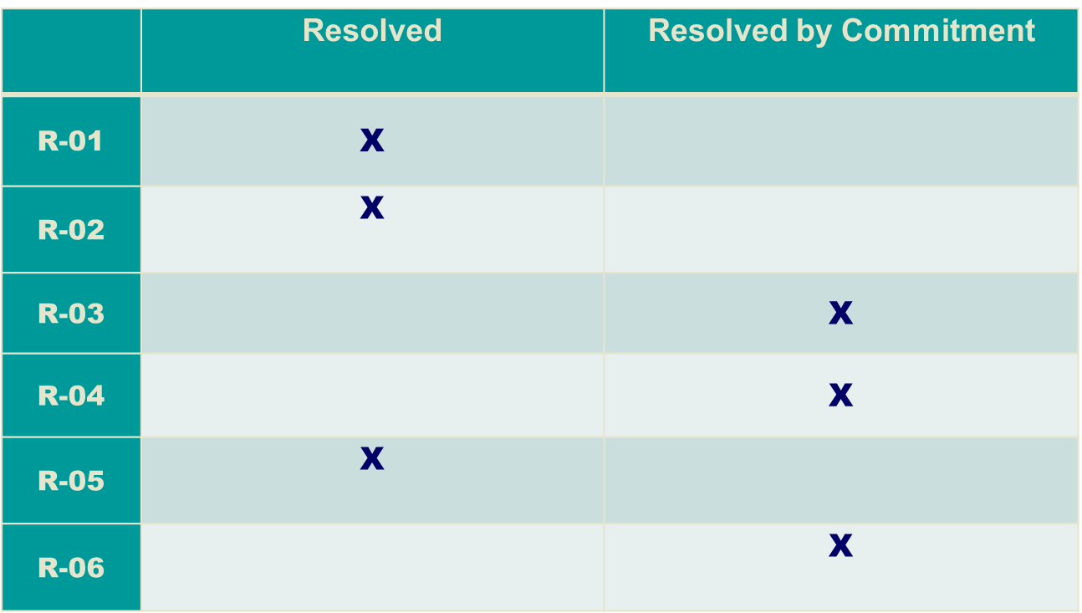
Status of Technical Review Recommendations

Slide 12
Summary of Next Steps
  Resolved issues requiring further action are:
  (R-03): The Licensee commits to updating operation and maintenance (OM) plan to reflect BOD and TSS change request as 100 mg/L and 120 mg/L respectively.
  (R-04): The licensee commits to monitoring leaks via water levels in the wetland area and immediate repair liners.
  (R-05): The Licensee commits to including the sludge management plan that will contain assessment and disposal techniques, as well as a disposal location into the new OM plan.

Slide 13
Conclusion
CIRNAC will continue to work through the water licence application review process with the aim of protecting Nunavut’s inland water resources while promoting sustainable development.

Slide 14
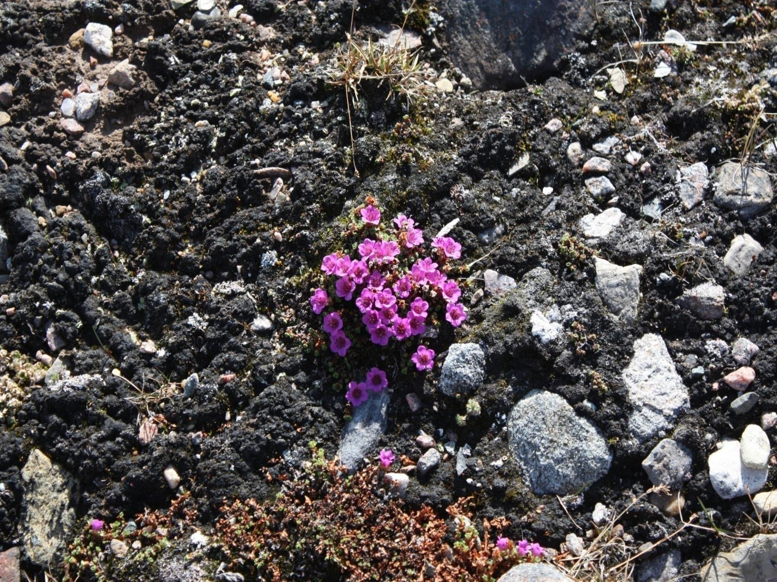
Qujannamiik
Thank you
Merci
ᖁᔭᓐᓇᒦᒃ

