Slide 1

Nunavut Water Board Technical Meeting
Water Licence Renewal and Amendment
Chesterfield Inlet
3AM-CHE----

Slide 2
Existing Licence

Slide 3
Water Licence: 3AM-CHE---
Date of Licence Issuance: May 15, 2015
Expiry of Licence: May 14, 2023
Scope of Licence:
This Licence allows for the use of Water and the deposit of Waste for a Municipal undertaking classified as per Schedule 1 of the Regulations at the Hamlet of Chesterfield Inlet.
This application is for the renewal of the existing licence and an amendment to change to a Type A licence to reflect that the annual resupply of the raw water reservoir exceeds 299 m^{3/}day. All water use and waste disposal activities remain the same as in the existing licence.

Slide 4
Background
First Lake is the domestic water supply for the Municipality of Chesterfield Inlet, approximate population of 437 (2016 Census)
The watershed is frozen for seven to nine months a year; therefore, a raw water reservoir must be adequately supplied prior to freeze-up each year. There is no change to the resupply operations at First Lake.
Chesterfield Inlet currently uses up to 2000 m^{3/}day for approximately 14 days to fill the reservoir.
The reservoir was built and has been in use since the early 1990s.

Slide 5
Water Supply Infrastructure

Slide 6
Background
The sewage treatment facility is located approximately 2.2 km west of the community.
The facility was upgraded in 2010 and is comprised of two truck discharge areas, two sewage detention cells, and a wetlands area with a series of four small ponds and two flow diversion berms.
The wetlands encompass an area that is approximately 10.4 hectares. Effluent flows 800 to 1000 metres through the wetlands from the sewage detention cells to the marine environment of Finger Bay on Hudson Bay.

Slide 7
Wastewater Disposal Infrastructure

Slide 8
Background
Chesterfield Inlet’s solid waste disposal facilities consist of a fenced disposal area for municipal solid waste (MSW), a separate bulk metal disposal area approximately 200 m south of the fenced MSW area, and two drum storage areas, approximately 150 m and 270 m southeast of the MSW area.
A decommissioned landfill is present between the fenced MSW area and the bulk metal disposal area, at the head of the sewage treatment wetland.
The Hamlet collects solid waste from community buildings five days a week with a garbage truck and transports the waste to the MSW disposal facility, located 2.2 km west of the community. The MSW disposal facility covers an area approximately 24,000 m2 and is situated adjacent to and north of the sewage disposal facility.

Slide 9
Solid Waste Disposal Infrastructure

Slide 10
Sampling Program
Station | Description | Frequency
CHE-1 | Raw Water supply intake at First Lake | Daily, Monthly, Annually
CHE-2 | Runoff from the Solid Waste Disposal Facility | Daily, Monthly, Annually
 |  | Once per month in May, June, July and August during periods of observed flow
CHE-3 | Effluent from the Sewage Holding Cell 1 | once per month in May, June, July and August during periods of observed flow
CHE-3a | Effluent from Sewage Holding Cell 2
CHE-4 | Final Discharge Point for Effluent from the wetland treatment area prior to Finger Bay

Slide 11
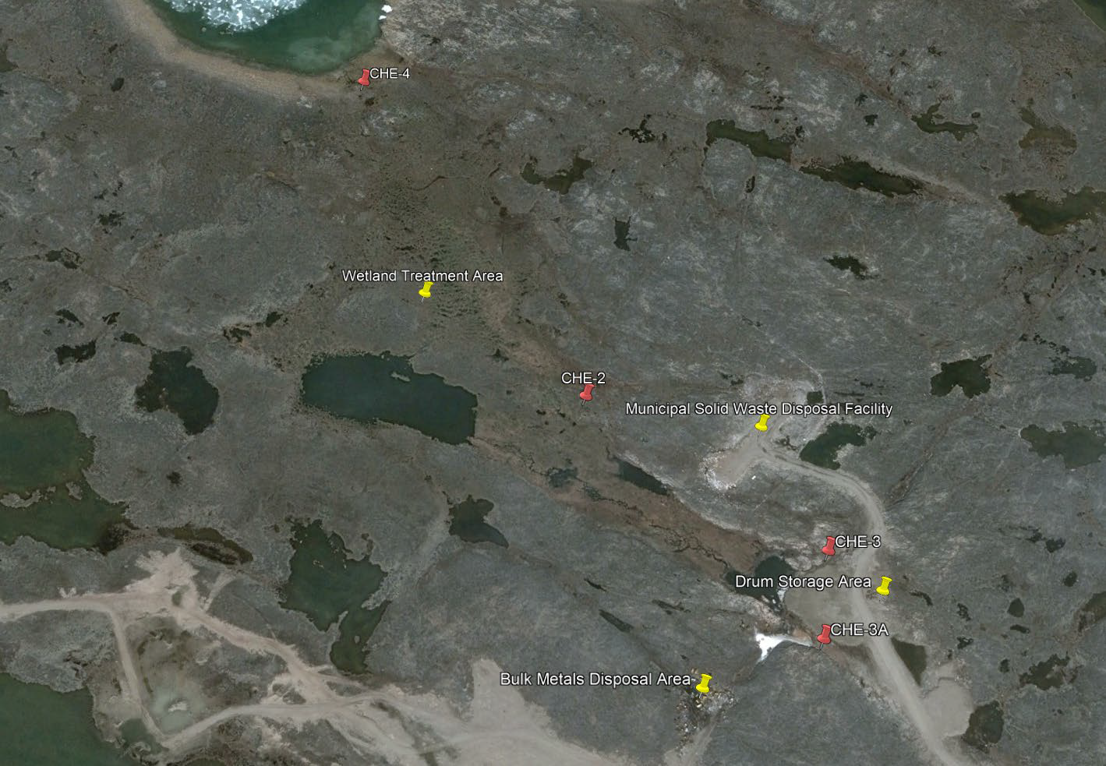
Sampling Program

Slide 12
Regulatory Review

Slide 13
ECCC Comments
01. Sludge Management
CGS Response:
The sludge level is observed through visual inspection during the annual inspection and has not been identified as a compliance issue in the reports.
GN-CGS is seeking funding to upgrade the wastewater treatment facility, and this will include a sludge management plan.

Slide 14
ECCC Comments
02. Runoff Collection
CGS Response:
Runoff from the Solid Waste Facility is not collected. Monitoring location CHE-2 monitors free flowing runoff from the Municipal Solid Waste Facility prior to entering the Wetland Treatment Area. There has been no indication that leachate has caused a negative impact on the wetland historically based on sampling results, but monitoring stations will continue to be monitored in the future.

Slide 15
CIRNAC Comments
01. Abandonment and Restoration Plans
CGS Response:
Abandonment and Restoration plans are developed by third parties hired by GN-CGS at the time the plan is required, as they are site and asset specific.

Slide 16
CIRNAC Comments
02. Inspection Reports
CGS Response:
CGS is currently undertaking a project to identify the type of inspection, frequency of inspection, and the appropriate professional with the specific training to undertake the inspections for assets authorized under the municipal water license. This report is expected to be complete in 23/24 and will be provided to NWB for distribution.

Slide 17
CIRNAC Comments
03. CHE-1 Daily Volumes
CGS Response:
GN-CGS will report the daily volumes pumped from First Lake during the annual resupply in the annual report.

Slide 18
CIRNAC Comments
04. CHE-1a
CGS Response:
Monthly volumes are currently reported in the annual report based on billing records from the community. Given that the pump house draws water for consumption from an engineered reservoir and not a natural water source, GN-CGS will report based on resupply volumes going forward, rather than withdrawal at the pump house.
Sewage disposal reported in the annual report will continue to correlate with monthly water usage based on billing records.

Slide 19
CIRNAC Comments
05. Landfarm Use
CGS Response:
The landfarm is not currently in use by the Municipality for remediation of contaminated soils. A letter of authorization will be requested from the owner in the event that use of the landfarm by the municipality is required.

Slide 20
Renewals and Amendments for the Water License
Request | Justification
Licence Term: 10 years | There is no change in municipal operations and water use is not expected to increase beyond the current annual limit within the next 10 years, based on population projections.

Slide 21
Renewals and Amendments for the Water License
Request | Justification
Maximum Daily Water Withdrawal: 2000 m³ | The watershed is frozen for seven to nine months a year; therefore, a raw water reservoir must be adequately supplied prior to freeze-up each year. There is no change to the resupply operations at First Lake, or the required annual volume of water required.

Slide 22
Renewals and Amendments for the Water License
Request | Justification
Removal of requirements that are not practical or are no longer applicable. This includes: Submission of paper documents Aligning submission deadlines with the annual report Daily waste disposal reporting | A justification for these items was submitted with the licence application.

Slide 23
Thank You

