Slide 1
Hamlet of Coral Harbour Application for Type “A” Water Licence 3AM-COR----
Nunavut Water Board Technical Meeting
December 7-8, 2021

Slide 2
Presentation Outline
Role and Responsibilities
Contributions to the Water Licence Application Review
Technical Review Comments
Summary of Next Steps
Conclusion

Slide 3
Roles and Responsibilities
Crown-Indigenous Relations and Northern Affairs Canada’s (CIRNAC) responsibilities, mandate, and obligations are in alignment with the following:
Crown-Indigenous Relations and Northern Affairs Act
Nunavut Agreement
Nunavut Land Claims Agreement Act
Nunavut Waters and Nunavut Surface Rights Tribunal Act and the associated regulations
Nunavut Planning and Project Assessment Act
Territorial Lands Act and the associated regulations
Arctic Waters Pollution Prevention Act

Slide 4
Contributions to Water Licence
Application Review
CIRNAC made the following submissions to the Nunavut Water Board regarding application for Type “A” Water Licence 3AM-COR---- by Hamlet of Coral Harbour:
Technical Review Comments for Type “B” Water Licence Renewal and Amendment Application: August 4, 2021
Completeness Check and Technical Review Comments for Type “A” Water Licence Application: October 13, 2021
Reply to GN-CGS Response on Completeness Check and Technical Review Comments for Type “A” Water Licence Application: November 3, 2021

Slide 5
Technical Review Comments
I. Daily Water Withdrawals
(R-01) Subject to the approval of the Board, CIRNAC recommends that in the interim, until a meter can be installed, that reporting the average monthly withdrawal is acceptable.
Resolved:

Slide 6
Technical Review Comments
II. Reporting Daily Waste Disposal
(R-02) CIRNAC recommends that the licensee should:
Clarify how they are producing monthly estimates;
Update their solid waste disposal, operation and maintenance plan, and QA/QC plan to incorporate daily discharge monitoring methods which are actionable.
Resolved by Commitment:

Slide 7
Technical Review Comments
III. Paper Copies of Annual Reports
(R-03) CIRNAC recommends that the NWB should remove the submission of paper copies / documents as part of the licence conditions.
Defers to NWB:

Slide 8
Technical Review Comments
IV. Sewage Disposal and Sludge Management Plan
(R-04) CIRNAC recommends that the NWB approve the operation and maintenance plan for the sewage disposal facilities submitted by the Licensee and remove the condition to provide a separate sludge management plan.
Defers to NWB:

Slide 9
Technical Review Comments
V. Engineer Inspection of Facilities
(R-05) CIRNAC recommends that the NWB should keep the licence condition requiring inspection of engineered facilities by a professional Engineer.
Resolved by Commitment:

Slide 10
Technical Review Comments
VI. Timeline for Submission of Geotechnical
Inspection Report
(R-06) CIRNAC recommends that the NWB consider this request to modify this licence condition.
Defers to NWB:

Slide 11
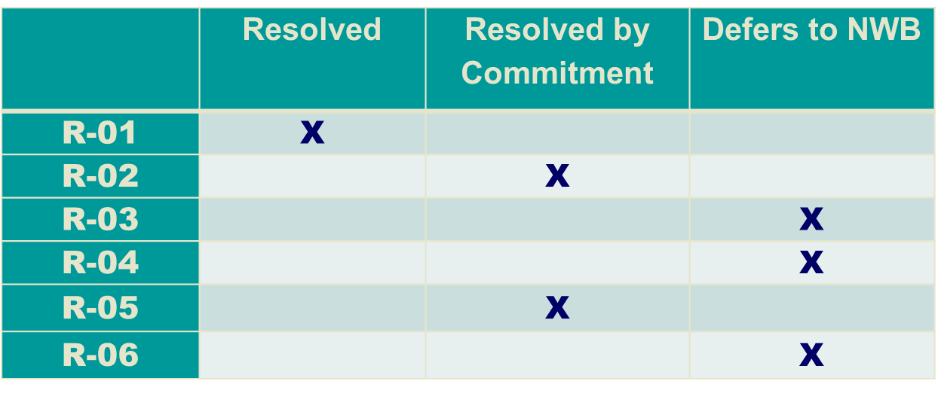
Status of Technical Review Recommendations

Slide 12
Summary of Next Steps
  Resolved issues requiring further action are:
  (R-02): The Licensee Commits to Update the Operation and Maintenance (OM) Plan with:
  a). Description of daily sewage discharge estimates
  b). Description of daily solid waste discharge estimates
  (R-05): The Licensee continue to provide Inspection Reports for engineered facilities by a professional Engineer.

Slide 13
Conclusion
CIRNAC will continue to work through the water licence application review process with the aim of protecting Nunavut’s inland water resources while promoting sustainable development.

Slide 14
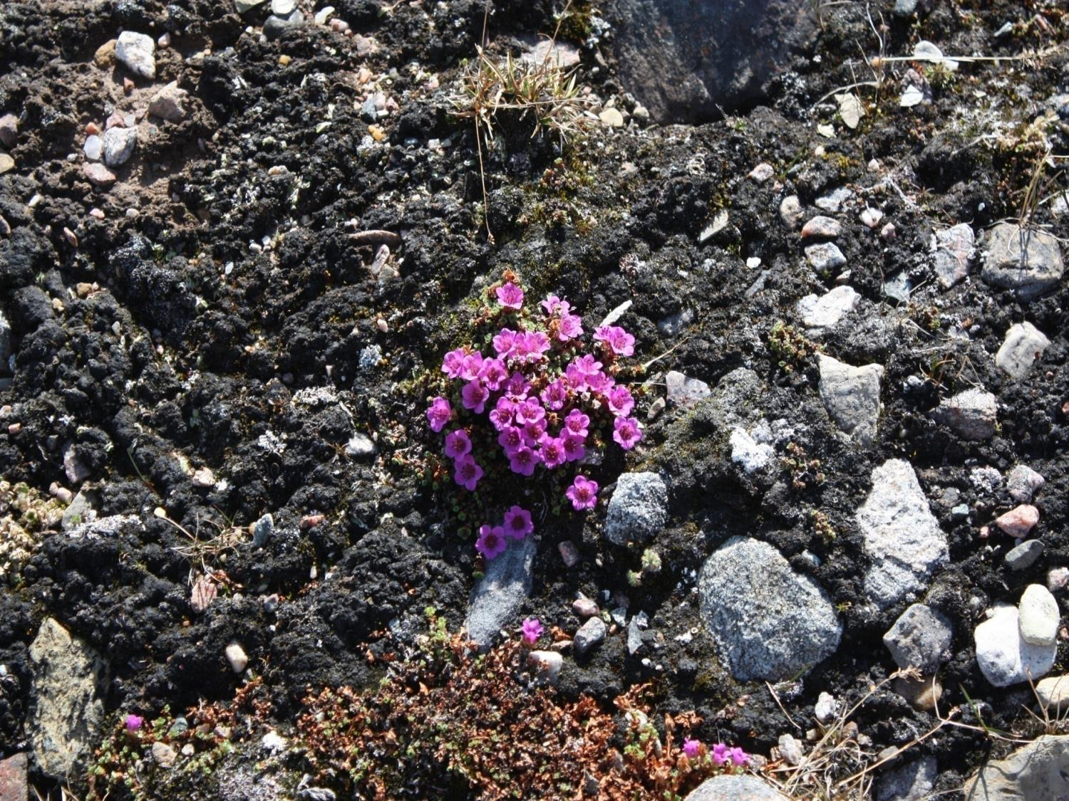
Qujannamiik
Thank you
Merci
ᖁᔭᓐᓇᒦᒃ

