Slide 1

Nunavut Water Board Public Meeting
Water Licence Amendment
Rankin Inlet 3AM-GRA-1015
January 14 2014

Slide 2
Background
In 2009, Elders and community members expressed concern to the hamlet and Department of Community and Government Services that the water levels in Nipissar Lake were dramatically falling.
CGS initiated studies on water usage in Rankin Inlet; these studies indicated that water usage in Rankin Inlet was higher than expected, due to leaks in the water distribution system and additional infrastructure development over the last 10 years.
A review of nearby lakes using bathymetric survey techniques found that First Landing Lake would be suitable to augment the natural recharge of Nipissar Lake via a pipeline system

Slide 3
Background
CGS monitored the levels of Nipissar Lake utilizing field surveys. Collected data indicates that there is no immediate concern about running out of water in Rankin Inlet, but studies determined that the water source may cease to be adequate for the community as early as 2015
CGS contracted with FSC Architects and Engineers in Iqaluit to develop a route and design for the new pipeline and prepare tender documents.
Construction on the pipeline began in December 2011, after freeze-up, in order to minimize damage to the tundra on which it is located.

Slide 4
Background
The pipeline can be used once the consultant secures approval from the Nunavut water Board.
Construction on the pipeline to recharge Nipissar Lake from nearby First Landing Lake was completed Sept. 30, 2012.
The Final Completion Certificate was in January 2013
Stantec is working with Nunavut Water Board to secure an amendment to the existing water license.
Pipeline is not being utilized due to pending approval from the Nunavut Water Board.

Slide 5
Planning
Prior to completing detailed ground surveys, we reviewed the available aerial photography and digital mapping to complete an initial reconnaissance of the possible routing options.
SEASONAL CONSTRAINTS
It is intended that the typical pumping season would extend over a maximum of 3 months each year, from Mid June to Mid September.
While a longer season could possibly be utilized, starting earlier runs into problems with ice cover on Lower Landing Lake, and access to the site itself.
Starting later could run into problems with freeze up of the pipe.

Slide 6
Design Options
From Lower Landing Lake to Nipissar, we considered basically two options.
Option 1 effectively follows the roadway between the two lakes. Option 1 has the disadvantage of going up over a high point of land, and requiring stronger pumps and higher fuel consumption.
Option 2 goes overland from Lower Landing Lake to Nipissar, with the routing selected to minimize elevation changes. In addition, Option 2 is ‘graded’ so that there is only one low point and only two high points along the pipeline, making easier to fill and drain the pipe each year. This greatly simplifies operation of the line.
On September 29 2010 FSC carried out a site meeting with representatives of the Community of Rankin Inlet, and the Government of Nunavut (GN).

Slide 7
RECOMMEDATION
The only concern mentioned, and one which applied to either Option, was that there was a portion of both routes that crossed a primary snowmobile route, near Lower Landing Lake. It was agreed that a portion of the route (centered on where the line crossed the road to the river) should be buried to prevent interference with the pipe by snowmobiles.
It was agreed that Option 2 was the preferred solution. This option formed the basis of the overland pipeline supply.

Slide 8
PUMPHOUSE LOCATION
The pump house as located draws water from the river rather than from the lake itself. Each spring the pump will be set at the abutments for the old bridge location (the bridge itself is now gone). The intake would be into an existing pool on the south side of the river, adjacent to the pump location.
This location is accessible from the old roadway, which is still intact.

Slide 10
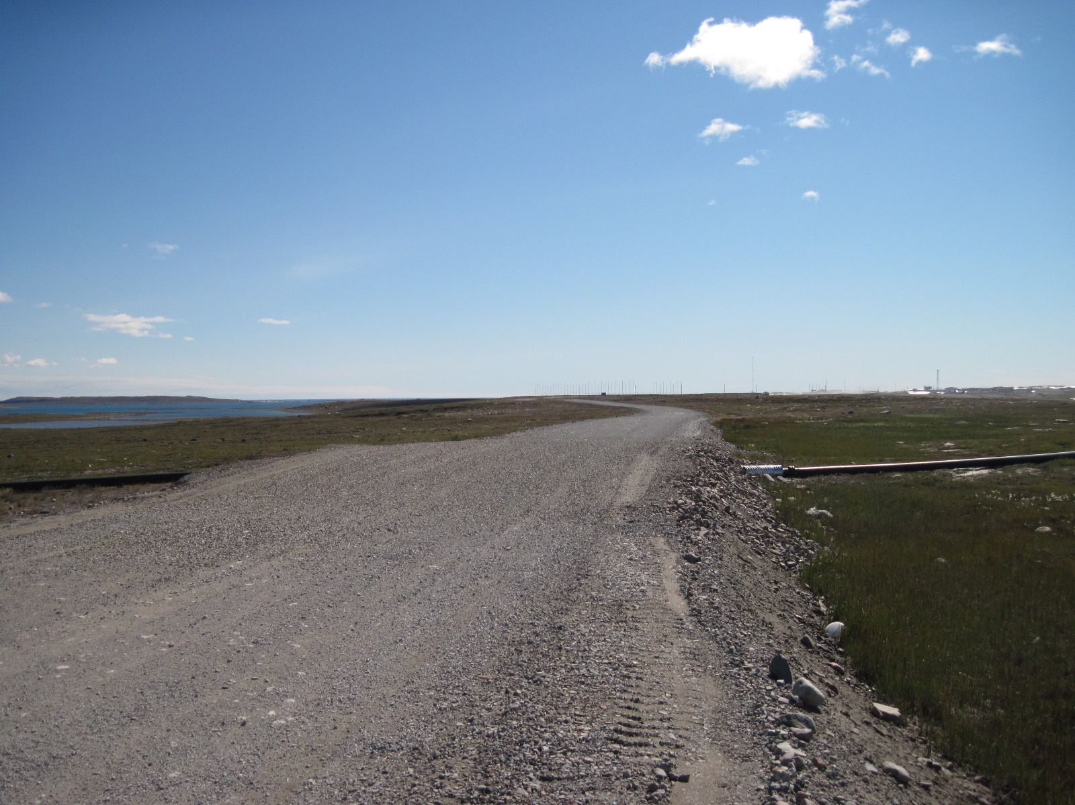

Slide 11
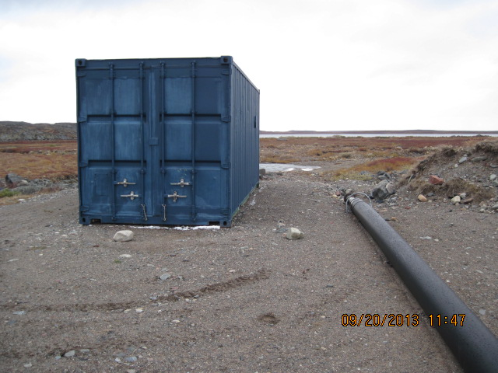

Slide 13
PUMPHOUSE SPECIFICATIONS
A screened intake is connected to a seasonal flexible intake line.
This flexible intake line is installed at the beginning of the spring pumping season and removed at the end of the pumping session. The line is connected to trailer mounted, self-contained diesel powered pump with spill protection. The pump is capable of supplying 770 US Gallons per minute. The system will only operate during the high flow season; it will not operate when the water elevation drops below 0.5m in the Char River in accordance with DFO Guidelines.
The system pumps water through a permanent 10 inch diameter overland pipeline between Char River and Nipissar Lake.

Slide 14
NIPISSAR LAKE DISCHARGE
The pipeline terminates at near the shore of Nipissar Lake as shown.

Slide 15
