Slide 1
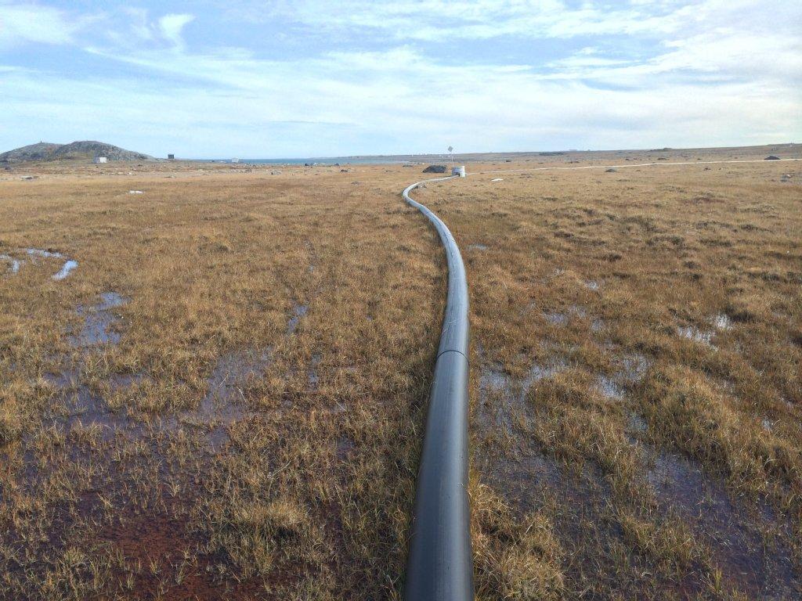

NWB Hearing Presentation
Type A Water License Amendment Application
3AM-GRA1015
Review of the Nipissar Lake Replenishment Project, Rankin Inlet, Nunavut
September 25, 2014

Slide 2
Water License 3AM-GRA1015
Type “A” Water License issued by the NWB June 9, 2010. Activities permitted under this license:
Operation of Water Supply Facilities, Utilidor and Sewage Treatment Facility
Annual withdrawal allowance 850,000 m³ from water source – Nipissar Lake

Slide 3
Water Source Concern
In 2009, GN-CGS contracts Stantec and RMSi to complete the Water Supply Capacity, Consumption and Conservation Study to evaluate causes for the decrease in water level.
Key Findings of Study:
Volume of water in Nipissar Lake dropped by 44,000 m³/year.
Nipissar would be an unsuitable potable water supply source by 2019 (due to low volume).
Natural replenishment of Nipissar Lake was 311,789 L.
Notes:
Due to concern regarding the decreasing volumes in Nipissar Lake,

Slide 4
Water Source Pipeline
In 2010, GN-CGS contracted Stantec to complete the design of a water intake pipeline to replenish Nipissar Lake
In 2012, GN-CGS constructed the 4.05 km pipeline to pump water from the Char River to Nipissar Lake.
In 2014, GN-CGS submitted regulatory applications to NWB, NPC and NIRB to obtain approval to pump water from the Char River

Slide 5
Pipeline Design
Pipeline design features include:
Screened water intake pipeline located in the Char River extending from the intake location to the pump
One 75 horsepower intake pump
One 4.05 km of HDPE pipeline
Two high point releases and one low point drain
One storage container to house intake pipe and pump during the winter

Slide 6
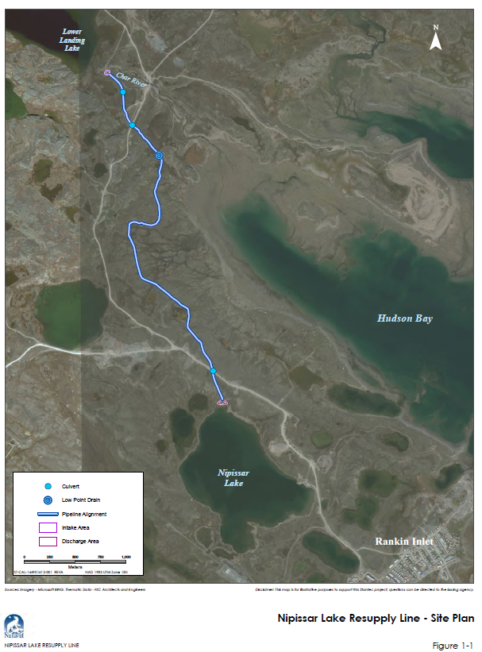

Slide 7
Pipeline Operation
Operated during summer months (June to Sept)
Duration of the pumping is dependent on the:
Population
Consumption rate (344 L/person/day)
Pumping rate of 0.04 m³ /s

Slide 8
Pumping Requirements
2014 | 2030
2014 Population = 2,859 Calculated volume required = 47,187 m³ Total pumping duration = 14 days. | 2030 Population = 4,649 Calculated volume required = 271,924 m³ Total pumping duration = 79 days.
**Operation of the pipeline was initially proposed to commence in the summer of 2014; delayed until summer of 2015.

Slide 9
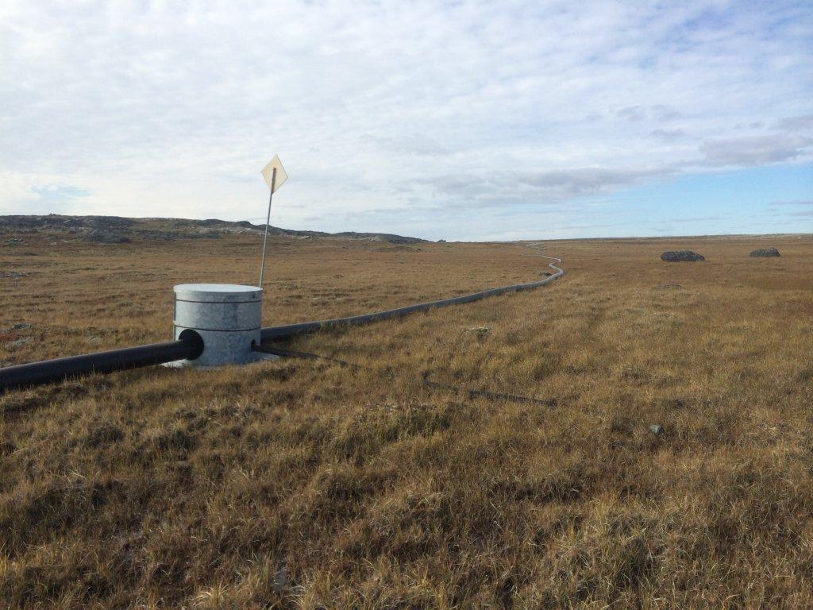
Stages of the Project Evaluated for Environmental Effects
Construction
Operation
Decommissioning

Slide 10
Valued Ecosystem Components Evaluated
Terrain stability and permafrost
Soil quality
Air quality
Water quantity
Water quality
Vegetation, wildlife and avifauna
Fish and fish habitat
Socio-economic
Archaeological and heritage resources

Slide 11
Mitigation Methods – Operation Phase
Air Quality
Follow best practices to reduce vehicle/equipment
exhaust emissions
Implement dust suppression techniques
Water Quantity
Complete regular monitoring of the flow rate of the Char River
Adhere to a maximum withdrawal rate of 10 % of the flow rate. In-stream minimum depth of 0.5 m. Cease pumping if this minimum cannot be maintained.
Complete annual monitoring to ensure natural drainage is not obstructed, etc.,

Slide 12
Mitigation Methods – Operation Phase
Water Quality
Maintain working areas and equipment clean and free of potential deleterious substances
Implement sediment and erosion prevention and control measures
Implement spill prevention and response protocols
Limit surface disturbance, especially near water bodies and riparian areas
Conduct routine equipment inspections
Comply with fuel handling best practices, including personnel training, setbacks and secondary containment

Slide 13
Mitigation Methods – Operation Phase
Vegetation
Use low ground pressure (i.e., ATVs) where off-road travel is required.
Wildlife
Complete regular monitoring of the flow rate of the Char River
Adhere to a maximum withdrawal rate of 10% of the flow rate. In-stream minimum depth of 0.5 m. Cease pumping if this minimum cannot be maintained.
Complete annual monitoring to ensure natural drainage is not obstructed, etc.,
Notes:
Project personnel will not feed, harass, approach
wildlife
• No firearms or hunting and fishing by Project personnel will be allowed
• Only the minimum area required for work to proceed safely was cleared
• Comply with the Nunavut Wildlife Act
• Project equipment and vehicles will not travel at speeds greater than 30 km/h
• All sightings of caribou, wolverine, grizzly bear or polar bear will be reported to the wildlife monitors and their
location recorded; the information will be submitted to the GN Department of Environment (GN-DOE) upon
completion of the Project.
• Reduce Project Footprint.
• All domestic wastes, food, and petroleum-based
chemicals will be kept in secure locations, and/or
disposed off-site

Slide 14
Mitigation Methods
Operational Phase – Hydrological Assessment
Completion of a hydrological study to calculate the instantaneous river flow and stream discharge
Installation of an in-stream staff gauge in the Char River to complete seasonal flow monitoring each year
Limit water withdrawal to 10 % of the instantaneous flow with a 0.5 m in-stream depth minimum to limit impacts to aquatic ecosystems
Periodic monitoring of the community’s water use

Slide 15
Mitigation Methods
Operational Phase – Amended Methods to be Used
If a longer-term alternative water supply source is required, CGS will ensure that there is a safe and secure long-term water supply that is also protective of the natural environment.
We are requesting that a clause be included in the WL stating that if water withdrawal from Lower Landing Lake becomes a preferred option in the future, that CGS be required to prepare and provide a water balance to the NWB at least 6 months prior to pumping to demonstrate that the proposed pumping rate is acceptable.

Slide 16
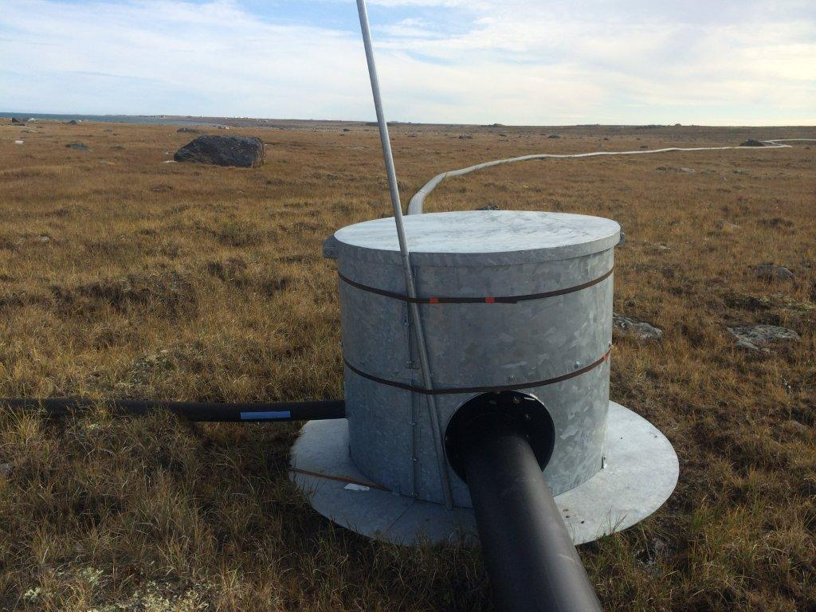
Questions?

