Slide 1

Nunavut Water Board
Public Hearing
Rankin Inlet Type “A” Water Licence Amendment
NWB Licence No. 3AM-GRA1015
September 25, 2014

Slide 2
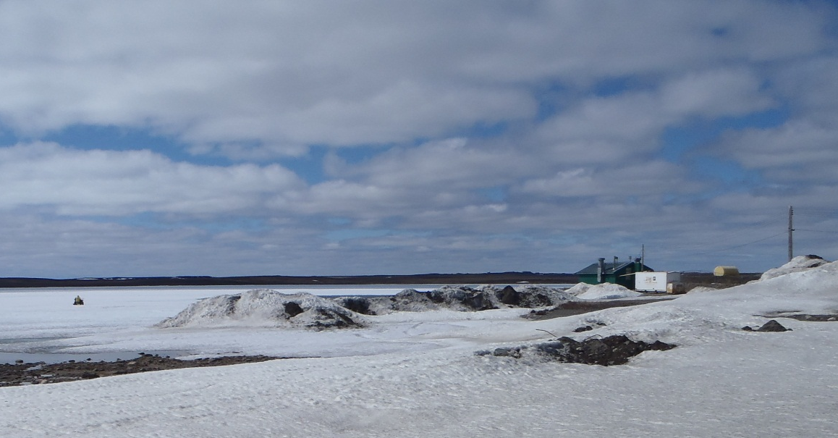
Background
Type “A” Water Licence No. 3AM-GRA1015 is held by the Department of Community and Government of Services, Government of Nunavut (GN-CGS):
  Authorizes water use from Nipissar Lake to supply the Rankin Inlet Utilidor and operation of the Sewage Treatment Facility
  Date of Licence Issuance: June 9, 2010
  Expiry of Licence: May 31, 2015
  Quantity of water use not to exceed 850,000 m³

Slide 3
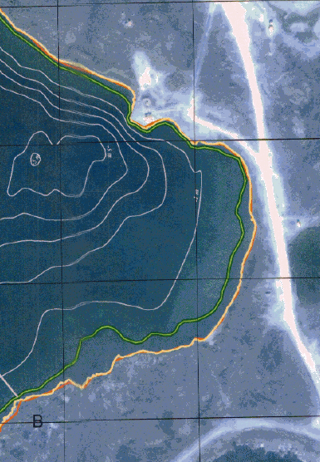
Background
In 2009, Elders and community members expressed concern to the Hamlet and GN-CGS that the water levels in Nipissar Lake were decreasing.
GN-CGS engaged FSC (Stantec) and RMSi to complete the Water Supply Capacity, Consumption and Conservation Study to evaluate causes for decrease in water level.
This study indicated that water usage in Rankin Inlet was higher than expected, due to leaks in the water distribution system and additional infrastructure development over the last 10 years.
Pumphouse
Historical Lake Outline
2009 Lake Outline

Slide 4
Background
In 2010, GN-CGS contracted FSC (Stantec) to complete the design of a water resupply pipeline to replenish Nipissar Lake.
In 2012, GN-CGS constructed the 4.05 km pipeline to pump water from Char River to Nipissar Lake. Construction began after freeze-up to minimize damage to the tundra.
In 2014, GN-CGS, with the assistance of Stantec, submitted regulatory applications to NWB, NPC and NIRB to obtain approval to pump water from the Char River.

Slide 5
Planning
Prior to completing detailed ground surveys, aerial photographs and digital mapping was reviewed for possible routing options.
The typical pumping season would extend over a maximum of 3 months each year, from Mid-June to Mid-September.
Two design options were considered:
  Option 1 followed the roadway between Nipissar Lake and Char River. This option had the disadvantage of going over a high point of land, and requiring stronger pumps and higher fuel consumption.
  Option 2 went overland from Char River to Nipissar Lake, with the routing selected to minimize elevation changes. Option 2 was ‘graded’ so that there is only one low point and only two high points along the pipeline, simplifying operation of the line.

Slide 6
Planning
On September 29, 2010 FSC (Stantec) carried out a site meeting with representatives of the Community of Rankin Inlet and GN-CGS.
The only concern mentioned, which applied to either Option, was that there was a portion of both routes that crossed a primary snowmobile route near Lower Landing Lake. It was agreed that a portion of the route (centered on where the pipeline crossed the road to the river) should be buried to prevent interference by the pipe to snowmobiles.
It was agreed that Option 2 was the preferred solution for the overland pipeline resupply.

Slide 7
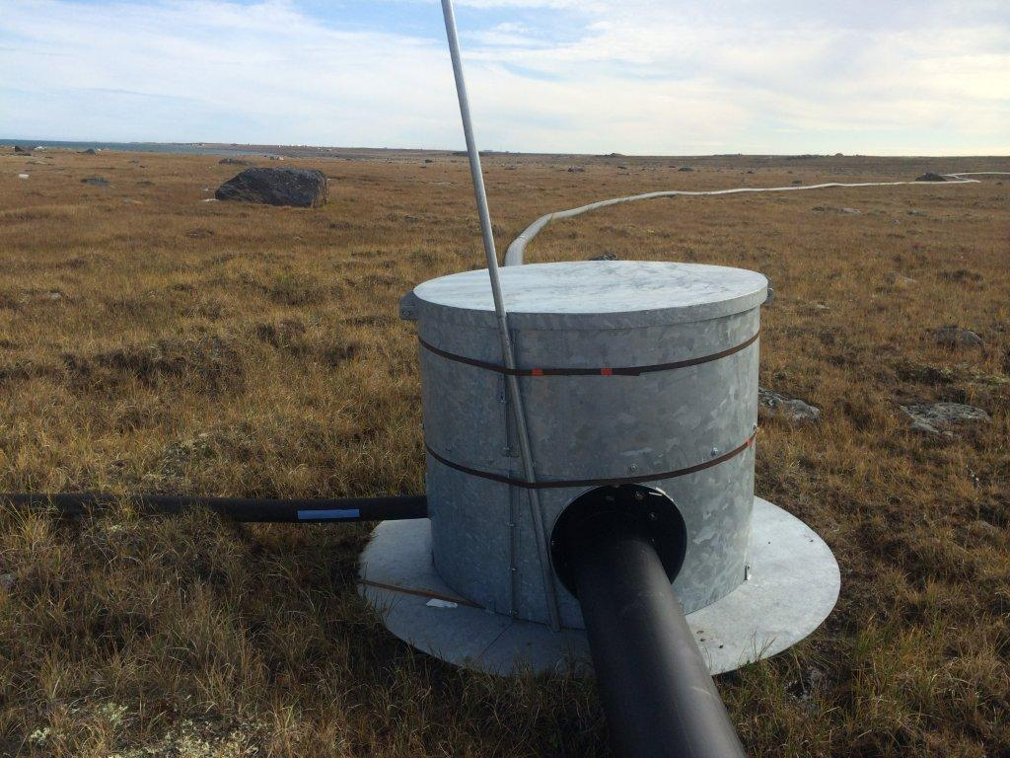
Pipeline Design
Pipeline design features include:
  Screened water intake pipeline located in the Char River extending from the intake location to the pump
  75 horsepower intake pump
  4.05 km of HDPE pipeline
  Two high point releases and one low point drain
  One seacan to house intake pipe and pump during the winter

Slide 8
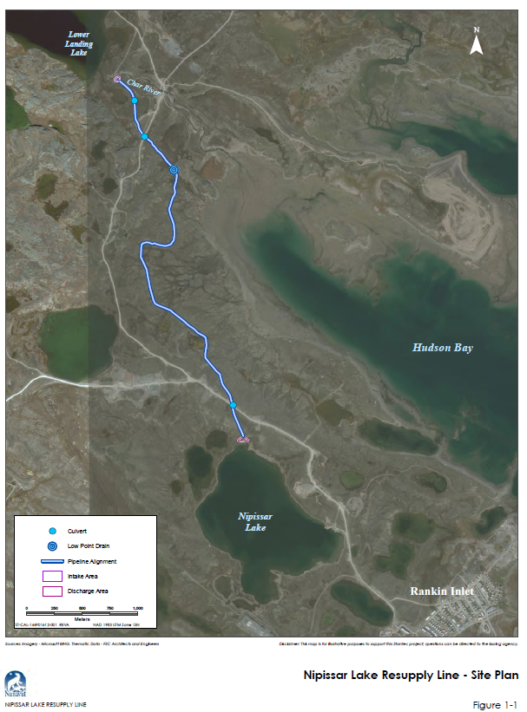

Slide 9
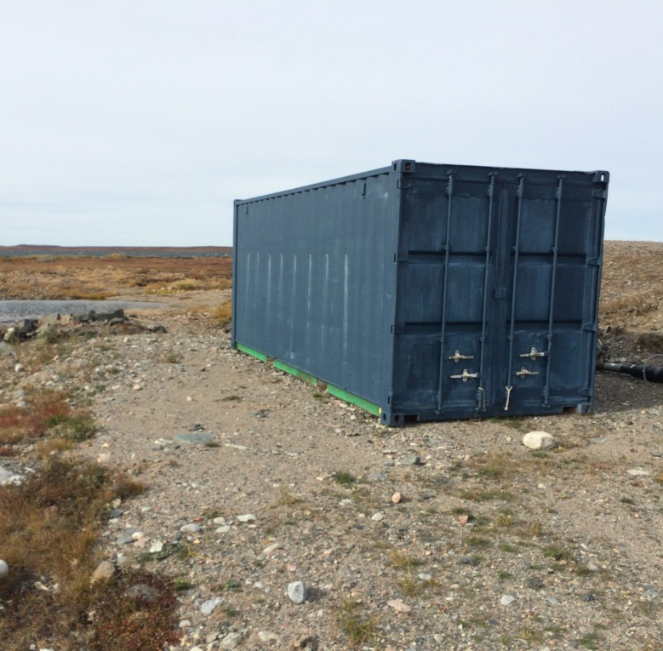
Pipeline Design
The screened intake is connected to a seasonal flexible intake line.
This flexible intake line will be installed at the beginning of the spring pumping season and removed at the end of the pumping session.
The line is connected to trailer mounted, self-contained diesel powered pump with spill protection. The pump is capable of supplying 0.04 m³/s.
The pipeline terminates at near the shore of Nipissar Lake.

Slide 10
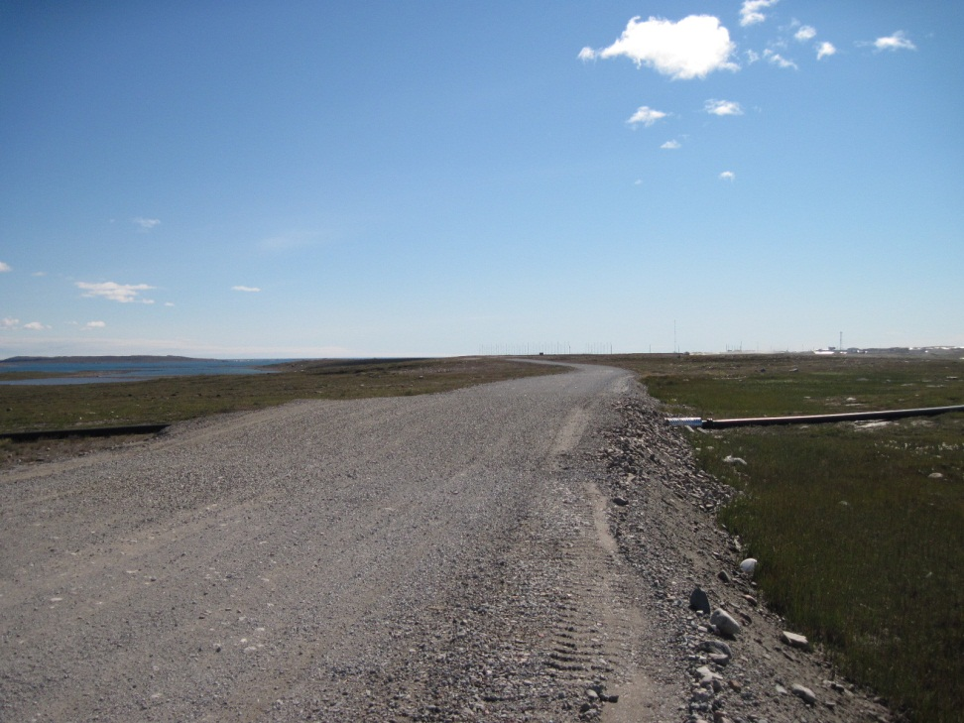
Operation
Regular monitoring of the flow rate of the Char River will take place during operation.
Adhere to a maximum withdrawal rate of 10 % of the flow rate and in-stream minimum depth of 0.5 m. Pumping will cease if this minimum cannot be maintained.
Complete annual monitoring to ensure natural drainage is not obstructed.
Implement sediment and erosion prevention and control measures
Implement spill prevention and response protocols.

Slide 11
Commitments
Completion of a hydrological study to calculate the instantaneous river flow and stream discharge. In the fall of 2014, a theoretical flow rating curve will be developed based on surveys taken of Char River. In 2015, a field hydrologist will visit Char River and calibrate the curve with actual flow data.
In the fall of 2014, a literature review of possible fish species in Char River will be conducted to determine the in-stream minimum flow requirements for environmental protection.
Installation of an in-stream staff gauge in the Char River to complete seasonal flow monitoring each year.
Limit water withdrawal to 10 % of the instantaneous flow with a 0.5 m in-stream depth minimum to limit impacts to aquatic ecosystems.

Slide 12
Commitments
Monitoring of the community’s water use.
Annual water quality sampling of Char River and Nipissar Lake prior to pumping.
If a longer-term alternative water supply source is required, GN-CGS will ensure that there is a safe and secure long-term water supply that is also protective of the natural environment.
We are requesting that a clause be included in the Water Licence Amendment stating that if water withdrawal from Lower Landing Lake becomes a preferred option in the future, that GN-CGS be required to prepare and provide a water balance to the NWB at least 6 months prior to pumping to demonstrate that the proposed pumping rate is acceptable.

Slide 13
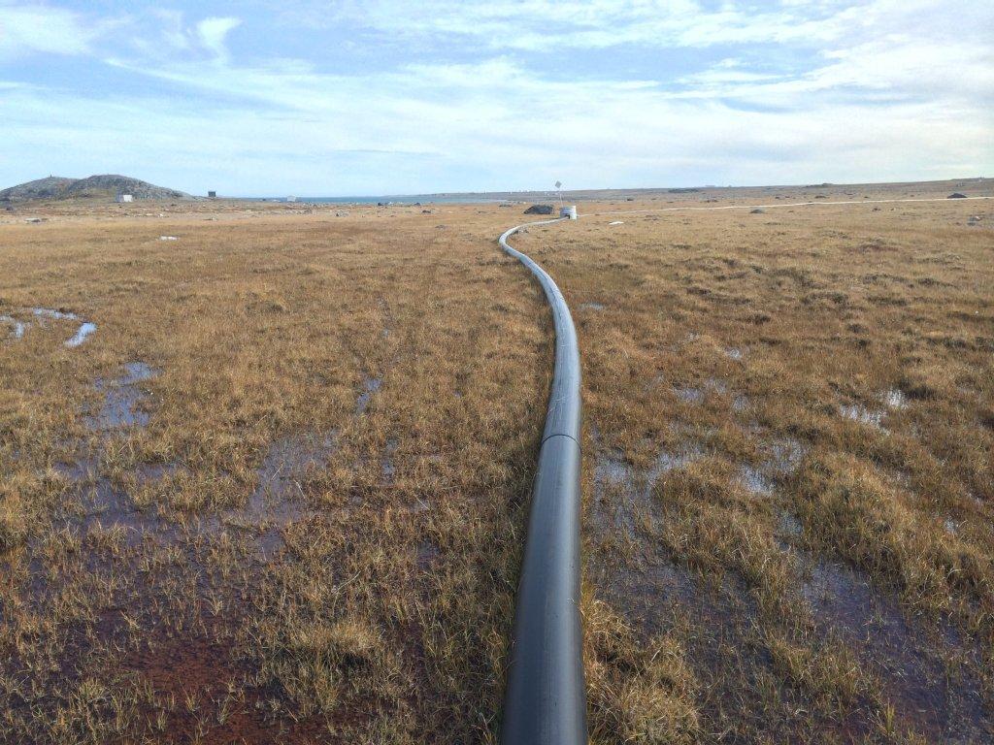
Questions?

