Slide 1

Nunavut Water Board
Public Meeting
Water Licence Amendment
Rankin Inlet 3AM-GRA-1624
February 18, 2021

Slide 2
Water Licence: 3AM-1624
Date of Licence Issuance: May 2, 2016
Expiry of Licence: May 1, 2024
Scope of Licence:
“This Licence allows for the use of Water and operation of the Water Supply Facilities, Utilidor and Sewage Treatment Facility by the Government of Nunavut, Department of Community and Government Services”
Current application is for an amendment to the existing water licence, in relation to the water supply intake location and water transfer quantity.

Slide 3
Background
Nipissar Lake is the domestic water supply for the community of Rankin Inlet, approximate population of 2,842 (2016 Census)
The watershed is frozen for seven to nine months a year; therefore, the lake must be adequately supplied prior to freeze-up each year.
In 2009, Elders and community members expressed concern to the Hamlet and Department of Community and Government Services that the water levels in Nipissar Lake were dramatically falling.
A 2009 study concluded that the water consumption of the community was greater than the natural recharge of Nipissar Lake.
Notes:
A water supply pipeline from the nearby Char River to augment water supplies in Nipissar Lake was consequently constructed; however, concerns regarding the viability of this secondary supply source have been expressed in light of sustainable flow and water depth objectives imposed by the Nunavut Water Board (NWB) and Canada Department of Fisheries and Oceans (DFO).

Slide 4
Background
A water supply line pipeline to Char River was constructed in 2012 to recharge Nipissar Lake, which utilizes a diesel pump that must be refuelled and checked daily.
There have been ongoing concerns of the viability of this source due to flow objectives of the river throughout the pumping season.
The typical pumping season extends over a maximum of 3 months each year, from Mid June to Mid September.
A review of nearby lakes using bathymetric survey techniques found that Lower Landing Lake would be suitable to augment the natural recharge of Nipissar Lake via a pipeline system
Lower Landing Lake feeds Char River which then flows into the Hudson Bay.
Notes:
Lower Landing Lake and Char River are part of the same watershed. Water quality has been annually monitored in both water bodies (GRA‐6, GRA‐7), along with Nipissar Lake (GRA‐1), since 2014.
The water chemistry for Nipissar Lake, Char River and Lower Landing Lake is very similar.
No impacts on the water quality of Nipissar Lake have been apparent or are anticipated.

Slide 5
Water Level Information
Year | *Nipissar Lake Water Levels
2015
2016
2017
2018
2019
2020
3.1464 m
2.9718 m
3.2449 m
2.9972 m
2.7209 m
2.5337 m
*Please note that water levels are measured down from a datum location, therefore larger numbers indicate a lower water level
Golder Associates (2016) displayed constant annual drop within Nipissar Lake dating back to 1994. This trend has continued with use of Char River for Resupply
Notes:
Golder Associates included water level data dating back to 1994 in their 2016 Water Balance Assessment Study, that displaced continual dropping of the water level in Nipissar Lake. This indicated that the natural recharge within the watershed to Nipissar Lake was inadequate to meet the domestic water demand in the community. Water level measurements taken by CGS over the past 5 years continue to display this pattern, even while supplementing using Char River. This is due to the significant challenges associated with pumping from the River, which flows fullest during freshet, and then lessons throughout the season.

Slide 6
Community Water Usage Summary
Year | Water Usage Summary*
2016
2017
2018
2019
2020
650,020m³
713,911m³
732,412m³
690,169m³
776,956m³
*Subject to inconsistencies caused by operational challenges.
Notes:
*May not keep this slide… not really meaningful

Slide 7
Public Health Concerns
The previously approved pumping location and duration at Char River provides inadequate quantities of water to meet the community’s growing demand.
This contributed to the high turbidity that began occurring in the treated water in the spring, leading to boil water advisories and concerns of water shortage in the community prior to spring breakup.
Approved by the CPHO in the summer of 2018 on an emergency basis, the pump from Char River has been moved into Lower Landing Lake for pumping to Nipissar Lake during the open water season
Lower Landing Lake is used for recreational purposes, including fishing, boating and for float planes. This has always posed a level of risk to the drinking water supply, in case of a fuel spill occurring within the watershed.
Notes:
In 2018 an amendment to the licence to move pumping locations was commenced, but then was delayed due to unknown reasons. Extremely low water levels within the lake under the ice, prior to melt, contributed to high turbidity in the drinking water and to concerns of water shortages. The Chief Public Health Officer directed CGS to move the resupply to Lower Landing Lake, and sent a letter to the NWB informing the board on July 24, 2018
- Additional public health concerns include the usage of Lower Landing Lake for recreational purposes, which has always been a risk to the water supply for Rankin Inlet. The use if Lower Landing Lake for float planes and refueling planes and boats may need to be discussed with the Hamlet and with the Public. This has not changed due to the relocation, as the risk was just a significant when Char River was the supply location.

Slide 8
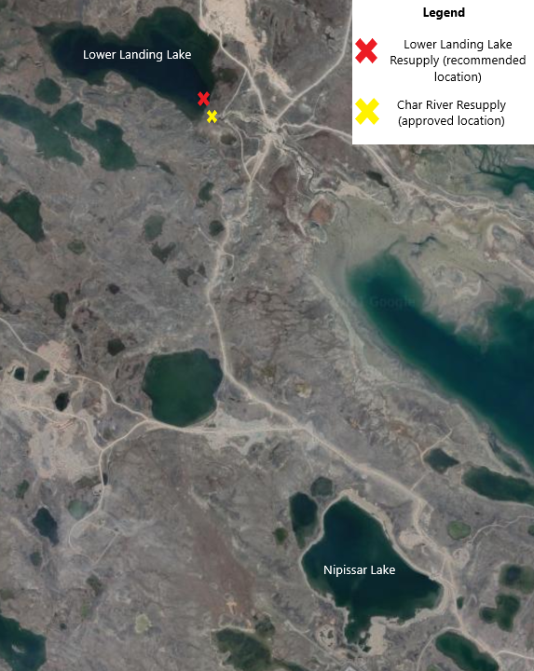
Resupply Location
The authorized Char River pumping location is at the beginning of Char River near Lower Landing Lake.
The new pumping location is approximately 200 m NW, at Lower Landing Lake.
A 12 inch steel carrier pipe was extended across Char River.
The 10 inch resupply pipe is fed through the carrier each year, not impacting the river banks.

Slide 9
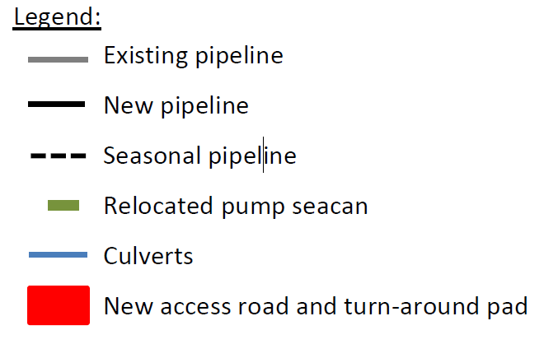
Resupply Location
Notes:
The same equipment is currently used for the seasonal transfer of water from Lower Landing Lake to Nipissar Lake as was used at the Char River location.
The floating intake with fish screen is used along with the same pump and generator within the relocated sea can.
An extension of approximately 200 m to the 4.05 km overland pipeline was installed to bring the pipeline from Char River to Lower Landing Lake.

Slide 10
Water Balance Assessment Recommendations
(Golder and Associates, 2016)
  Recommended water taking limit is 10% of the total annual flow in the Char River, all occurring after freshet
    Allows pumping to be carried out at a steady rate.
    Reduction of water levels in Lower Landing Lake at end of season.
    Allows the spring melt to continue to drive the Char River Hydrograph.
    Recommended water taking limit: 0.202 m³/s (17,452.8 m³/day), taken until freeze-up or Lake is filled.
  Monitor water levels in Lower Landing Lake and Nipissar Lake.
Notes:
The recommended water taking limit is of 10% of the total annual flow in the Char River. Water taking under this approach would take place following the spring freshet and continue until lake freeze up. This option allows water taking to be carried out with a steady pumping rate. Water taking under this second approach would reduce Lower Landing Lake water levels through the end of the open water season, with flow from the following spring melt contributing to fill Lower Landing Lake and drive the spring freshet hydrograph in the Char River.

Slide 11
Requested Amendments to the Water License
Requested Amendment | Justification
Relocate resupply to Lower Landing Lake | Watershed remains the same as in Char River, optimizes pumping season.
Increase the maximum daily pumping volume from 3,485 m³/day to 10,000 m³/day | Water Balance Assessment indicated that a daily maximum of up to 17,452 m³/day is sustainable, and below 10% of the annual flow to Char River; allows for adequate supplementation of Nipissar Lake.
The removal of the quarterly reporting required by the current Water License | Not required.
Notes:
Along with the maximum daily pumping request, CGS is open to an annual limit on pumping volume (700,000 – 800,000). The 10,000 m3/day aims to allow for unplanned challenges such as equipment failures, shortened season due to weather etc. The 10,000 m3/day allows CGS to remain in compliance with the licence, while not impacting the river (as per the water balance assessment) and ensuring Nipissar is adequately supplemented.

Slide 12
Requested Amendments to the Water License
Requested Amendment | Justification
Updated Pumping Plan to be submitted within 6 months, and then only updated when required based on operational or regulatory changes. | Will be based on recommendations from Water Balance Assessment, and field observations.
Removal of compliance point GRA-6 (NWB Monitoring Program Station at Char River) | Water level and quality will be taken within Lower Landing Lake and Nipissar Lake.

Slide 13

The End

