Slide 1
Water Licence
Amendment and Renewal Application for Type “A” Water Licence 3AM-IQA1626
Nunavut Water Board Technical Meeting
and Pre-hearing Conference
August 11-12, 2026

Slide 2
Presentation Outline
Role and Responsibilities
Contributions to the Water Licence Application Review
Technical Review
Conclusion

Slide 3
Roles and Responsibilities
Crown-Indigenous Relations and Northern Affairs Canada’s (CIRNAC) responsibilities, mandate, and obligations are in alignment with the following:
Crown-Indigenous Relations and Northern Affairs Act
Nunavut Agreement
Nunavut Land Claims Agreement Act
Nunavut Waters and Nunavut Surface Rights Tribunal Act and the associated regulations
Nunavut Planning and Project Assessment Act
Territorial Lands Act and the associated regulations
Arctic Waters Pollution Prevention Act

Slide 4
Contributions to Water Licence
Application Review
CIRNAC made the following submissions to the Nunavut Water Board (NWB) regarding the application
February 6, 2026 – CIRNAC’s completeness assessment of the Licence Application
May 15, 2026 – CIRNAC’s response to the Information Request Responses to the NWB
June 17, 2026 – CIRNAC met with the City of Iqaluit to discuss outstanding Information Requests
June 30, 2026 – CIRNAC’s submission of technical review comments

Slide 5
CIRNAC’s Recommendations
Water Source Expansion - Surface Water Quality and Soil Contamination (TR-01 to TR-03)
Key message: The City has made progress addressing comments on the future water source expansion; however, several key items remain dependent on plans, monitoring frameworks, and construction-phase commitments not yet submitted to the NWB for review and approval.
The City has committed to prepare a Construction Phase Water Management and Monitoring Plan, revised Environmental Protection Plan, and additional monitoring programs.
Proposed monitoring parameters, discharge criteria, and adaptive management approaches have been identified, but implementation details and action thresholds remain to be submitted to the NWB for review and approval.
Potential effects related to dewatering, blasting residues, erosion and sediment control, and contaminated soil management have been acknowledged, but supporting analyses and mitigation details are still required.
CIRNAC is seeking assurance that potential effects on water, soil, and the receiving environment are fully characterized and can be effectively managed through clear monitoring requirements, measurable performance criteria, and project-specific mitigation commitments approved by the NWB prior to water source expansion construction initiation.
Partially Resolved

Slide 6
CIRNAC’s Recommendations
Lake Geraldine Dam Safety, Cascading Failure, and Permafrost
(TR-04 to TR-06)
Key message: The City has provided additional information and committed to future studies; however, key dam safety, inundation, permafrost, seepage, and monitoring issues remain - subject to review of technical submissions not yet submitted to the NWB.
The City has confirmed that cascading dam failure from the proposed water source expansion dam is a credible scenario and committed to completing Lake Geraldine Dam inundation and dam breach analyses.
A Dam Safety Inspection/Review Deficiency Action Plan of existing dams has been prepared and commitments have been made to address identified infrastructure and monitoring deficiencies.
Additional information has been provided regarding permafrost conditions, seepage risks, instrumentation, and monitoring; however, performance will ultimately need to be confirmed through detailed design, additional investigations, and long-term monitoring programs.
The City has confirmed several key deliverables remain under development. These must be reviewed to confirm that predicted risks have been adequately assessed and addressed.
CIRNAC is seeking assurance that Lake Geraldine reservoir dam safety, inundation risk, permafrost degradation, seepage, and long-term monitoring requirements are fully assessed, supported by completed technical studies, and incorporated into the project's design, monitoring, and adaptive management framework approved by the NWB before water is transferred into the new water source expansion area.
Partially Resolved

Slide 7
CIRNAC’s Recommendations
Water Balance, Water Availability, and Climate Change (TR-07 to TR-09)
Key message: The City has provided additional technical explanations and supporting rationale; however, uncertainty remains regarding long-term water supply forecasting, water balance modelling, and consideration of climate change over the full project life.
The City has provided clarification regarding hydrologic analyses, withdrawal limits, watershed characterization, and modelling assumptions.
CIRNAC comments remain unresolved regarding long-term water balance forecasting, future climate risk assessment, and demonstration that existing planning tools adequately support long-term water management decisions.
Additional justification or future technical work is required to fully address climate change and water supply forecasting comments.
CIRNAC is seeking confidence that long-term water availability, withdrawal limits, reservoir performance, and climate-related risks have been evaluated by interested parties using sufficiently robust forecasting tools and assumptions to support operation of the water source expansion throughout its design life and approved by the NWB before water is transferred into the new water source expansion area.
Partially Resolved

Slide 8
Status of CIRNAC Technical Comments on
Compliance with Current Water Licence Monitoring and Reporting Terms and Conditions (TR-10 to TR-20)
Key message: the City submitting additional plans, monitoring commitments, and operational clarifications; however, several CIRNAC comments remain unresolved due to incomplete NWB submissions demonstrating compliance with the current water licence monitoring and reporting terms and conditions.
The City has made progress towards resolving sewage lagoon operations, construction runoff criteria, temporary waste management, and WWTP capacity through submitting clarifications.
However, several CIRNAC comments remain unresolved because the City has deferred key details to future monitoring, construction, or management plan documents yet to be submitted to the NWB for approval.
Remaining gaps include seasonal water quality baseline data, performance evaluation criteria, document hierarchy, spill/emergency response details, and follow-up procedures for exceedances and environmental investigation results.
CIRNAC is seeking confidence that the current water licence monitoring and reporting terms and conditions will be complied with in full going forward.
Partially Resolved

Slide 9
CIRNAC’s Recommendations
Monitoring, Reporting, and Management Plans (TR-10 to TR-20)
Specifically, CIRNAC is seeking:
A clear monitoring framework with defined locations, frequencies, methods, performance criteria, action thresholds, corrective actions, and reporting requirements.
Clarification on which monitoring, emergency response, spill contingency, EPP, O&M, and investigation documents govern where requirements overlap.
Demonstration of how monitoring results will be compared against applicable predictions, objectives, guidelines, licence criteria, or other benchmarks.
Defined follow-up procedures for exceedances, contamination findings, and environmental investigation results.
Confirmation on how future submissions will support compliance, mitigation effectiveness, and adaptive management throughout construction and operation.
CIRNAC continues to seek an updated comprehensive monitoring and maintenance plan framework, together with clear evidence that monitoring programs, operational plans, reporting requirements, and follow-up commitments can be consistently implemented and maintained throughout construction and operation - including the water source expansion commitment activities. Updated management plans require approval by the NWB prior to use.
Partially Resolved

Slide 10
Next Steps
CIRNAC is available to work with the City of Iqaluit and the NWB to draft potential terms and conditions for the renewed water licence if issued.
The terms and conditions would provide a way forward to assess and approve the missing information when it becomes available, but before the corresponding activity is initiated.
CIRNAC remains committed to ensuring a robust regulatory regime is in place with continued environmental and freshwater source protections.

Slide 11
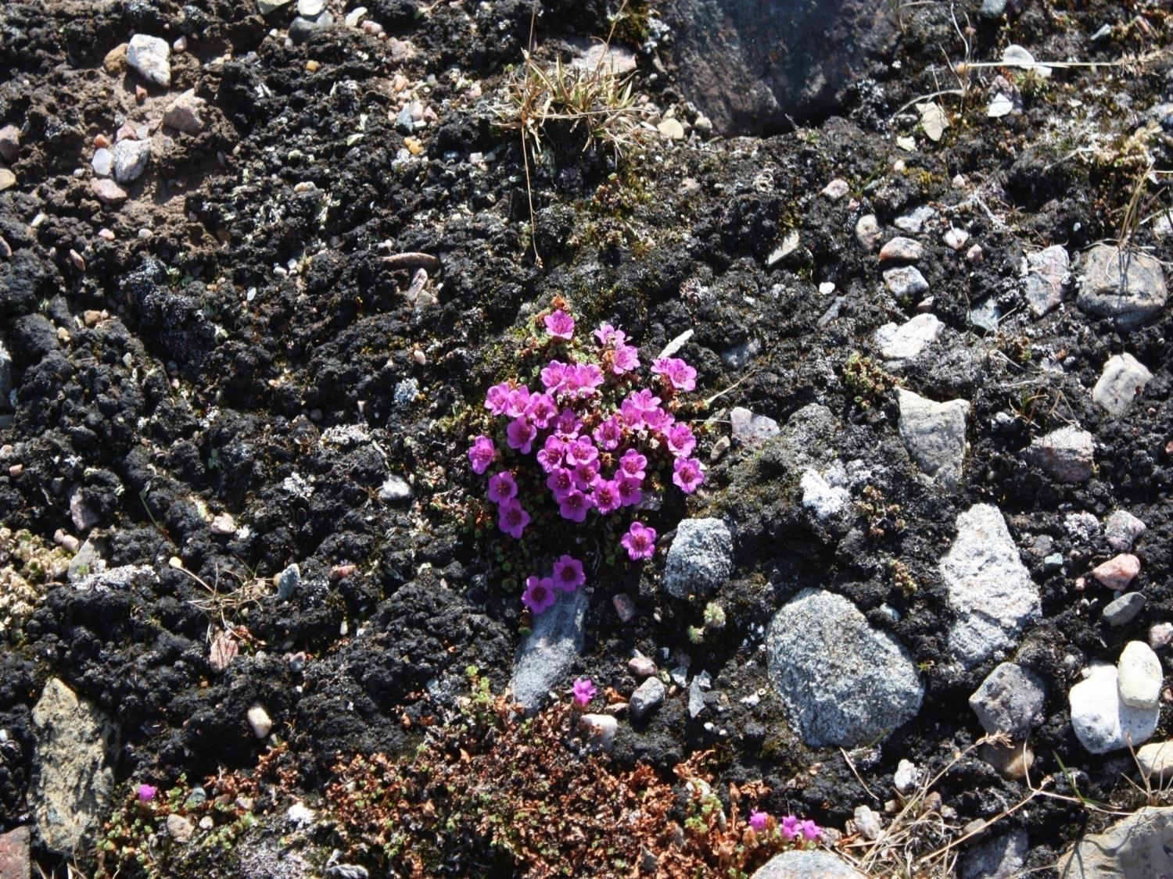
Nakurmiik
Thank you
Merci
ᓇᑯᕐᒦᒃ

