Slide 1
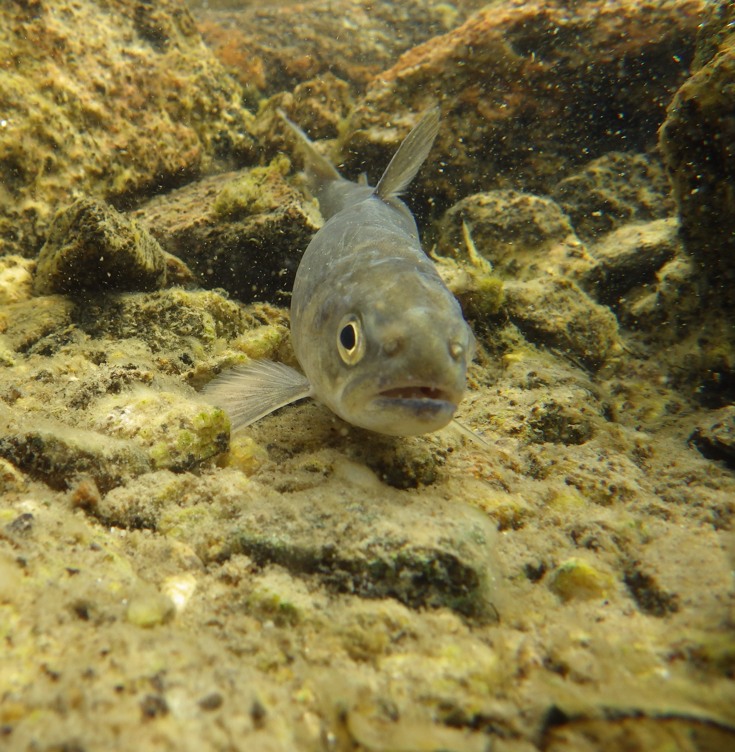
City of Iqaluit Water Licence Renewal
3AM-IQA1626
ᐃᖃᓗᖕᓂ ᓄᓇᓕᐸᐅᔭᒃᑯᑦ ᐃᒪᕐᒧᑦ ᓚᐃᓴᓐᓯᖓ
ᓄᑖᙳᕆᐊᖅᑕᐅᓂᖓ 3-IQA1626
Fisheries and Oceans Canada – Technical Review Comments
ᐃᒪᕐᒥᐅᑕᓕᕆᔨᒃᑯᑦ ᑲᓇᑕᒥ − ᐱᓕᕆᔾᔪᑎᓄᑦ ᕿᒥᕐᕈᔭᐅᔪᑦ ᐅᖃᐅᓯᐅᔪᑦ

Slide 2
Overview of Presentation
ᐅᓂᒃᑲᐅᓯᐅᓂᐊᖅᑐᑦ ᕿᒥᕐᕈᔭᐅᓂᖏᑦ
Fisheries and Oceans Canada (DFO) – Fish and Fish Habitat Protection Program (FFHPP)
    Mandate and Legislation
Assessments and Recommendations
    Blasting
    Water Withdrawal
Conclusion
Questions and Comments
ᐃᖃᓗᐃᑦ ᐊᒻᒪ ᐃᖃᓗᐃᑦ ᓇᔪᒐᖏᑦ ᓴᐳᔾᔭᐅᓯᒪᓂᖏᓐᓄᑦ ᐱᓕᕆᐊᖅ (FFHPP)
    ᑎᓕᓯᔾᔪᑕᐅᓯᒪᔪᑦ ᒪᓕᒐᓕᐊᖑᔪᒪᔪᓪᓗ
ᖃᐅᔨᓴᕈᑏᑦ ᐊᑐᓕᖁᔭᐅᓯᒪᔪᓪᓗ
    ᖄᖅᑎᑦᓯᓂᖅ
    ᐃᒥᖅᑕᕐᓂᖅ
ᐃᓱᓕᓐᓂᖓ
ᐊᐱᖅᑯᑏᑦ ᐊᒻᒪ ᐅᖃᐅᓯᒃᓴᑦ

Slide 3
Mandate and Legislation
ᑎᓕᓯᔾᔪᑕᐅᓯᒪᔪᑦ ᒪᓕᒐᓕᐊᖑᔪᒪᔪᓪᓗ
The mandate of the Fish and Fish Habitat Protection Program is to Protect fish and fish habitat in Canada.
Fisheries Act Sections 34.4 and 35
  Prohibit “death of fish” and “harmful alteration, disruption or destruction” of fish habitat (HADD).
Species at Risk Act – protect, recover, and conserve all listed aquatic species.
ᑐᕌᒐᕆᔭᐅᔪᖅ ᐃᖃᓗᖕᓄᑦ ᐊᒻᒪ ᐃᖃᓗᐃᑦ ᓇᔪᒐᖏᓐᓄᑦ ᓴᐳᔾᔨᓂᕐᒧᑦ ᐱᓕᕆᐊᒧᑦ ᓴᐳᔾᔨᓯᒪᔪᒪᓪᓗᑎᒃ ᐃᖃᓗᖕᓂᒃ, ᐃᖃᓗᖕᓂᒃ ᐃᓂᒋᕙᒃᑕᖏᓐᓂᒡᓗ ᑲᓇᑕᒥ
ᐃᖃᓗᓕᕆᓂᕐᒧᑦ ᐱᖁᔭᖅ ᐃᓚᖓ 34.4 ᐊᒻᒪ 35
  ᓄᖅᑲᖅᑎᑦᓯᓗᑎᒃ "ᐃᖃᓗᐃᑦ ᑐᖁᕋᖅᑕᐅᓂᖏᓐᓂᒃ" ᐊᒻᒪ ᖃᓄᑐᐃᓐᓇᖅ "ᐋᓐᓂᕐᓇᖅᑐᓂᒃ ᐊᓯᙳᖅᑎᑦᓯᔪᓂᒃ, ᐅᓚᕕᓴᖅᑕᐅᔪᓂᒃ, ᐅᕝᕙᓘᓐᓃᑦ ᓱᕋᒃᑎᕆᔪᓂᒃ" ᐃᖃᓗᐃᑦ ᐃᓂᒋᕙᒃᑕᖏᓐᓂᒃ (HADD
ᐆᒪᔪᐃᑦ ᐊᔾᔨᒌᖕᓂᖏᑦ ᐅᓗᕆᐊᓇᖅᑐᒦᓕᖅᑐᓄᑦ ᐱᖁᔭᖅ – ᐃᑲᔪᖅᐸᒃᐳᖅ ᓴᐳᔾᔨᓯᒪᓂᕐᒥᒃ, ᐅᑎᖅᑎᑦᓯᓂᕐᒥᒃ, ᑲᒪᒋᔭᖃᕐᓂᕐᒥᒡᓗ ᑕᒪᐃᓐᓂᑦᓯᐊᖅ ᑎᑎᕋᖅᑕᐅᓯᒪᔪᓂᒃ ᐃᒪᕐᒥᐅᑕᓂᒃ ᓂᕐᔪᑎᓂᒃ

Slide 4
Mandate and Legislation
ᑎᓕᓯᔾᔪᑕᐅᓯᒪᔪᑦ ᒪᓕᒐᓕᐊᖑᔪᒪᔪᓪᓗ
The mandate of the Fish and Fish Habitat Protection Program is to Protect fish and fish habitat in Canada.
Fisheries Act Authorization
  Allows death of fish or HADD (with conditions).
ᑐᕌᒐᕆᔭᐅᔪᖅ ᐃᖃᓗᖕᓄᑦ ᐊᒻᒪ ᐃᖃᓗᐃᑦ ᓇᔪᒐᖏᓐᓄᑦ ᓴᐳᔾᔨᓂᕐᒧᑦ ᐱᓕᕆᐊᒧᑦ ᓴᐳᔾᔨᓯᒪᔪᒪᓪᓗᑎᒃ ᐃᖃᓗᖕᓂᒃ, ᐃᖃᓗᖕᓂᒃ ᐃᓂᒋᕙᒃᑕᖏᓐᓂᒡᓗ ᑲᓇᑕᒥ
ᐃᖃᓗᓕᕆᓂᕐᒧᑦ ᐱᖁᔭᕐᒧᑦ ᐱᔪᓐᓇᖅᑎᑕᐅᓂᖅ
  ᑐᖁᔪᓐᓇᖅᑎᑦᑦᓯᔪᑦ ᐃᖃᓗᖕᓂᒃ ᓱᕋᐃᓗᑎᒡᓘᓐᓃᑦ ᐃᖃᓗᐃᑦ ᐃᓂᒋᕙᒃᑕᖏᓐᓂᒃ (ᒪᓕᒐᖃᖅᓱᑎᒃ).

Slide 5
Introduction – Assessment and Recommendations
ᐱᒋᐊᕐᓂᖓ − ᖃᐅᔨᓴᕈᑕᐅᔪᑦ ᐊᒻᒪ ᐊᑐᓕᖁᔭᐅᔪᑦ
Gaps and recommendations to Nunavut Water Board (NWB) on the use of explosives and the impacts of water withdrawal on Apex River and Lake Qiqitalik.
ᐱᑕᖃᙱᓐᓂᐅᔪᑦ ᐊᑐᓕᖁᔭᐅᓯᒪᔪᓪᓗ ᓄᓇᕗᒻᒥ ᐃᒪᓕᕆᔩᑦ ᑲᑎᒪᔨᖏᓐᓄᑦ (NWB) ᐊᑐᕐᓂᕐᒧᑦ ᖄᖅᑕᔫᓂᒃ ᖃᓄᕐᓗ ᐃᒥᖅᑕᕐᓂᖅ ᐊᒃᑐᖅᓯᕙᖕᒪᖔᑦ ᓂᐊᖁᓐᖒᑉ ᑰᖓᓂᒃ ᑕᓯᕐᒥᒡᓗ ᕿᕿᑕᓕᖕᒥ.

Slide 6
Introduction - Assessment and Recommendations (continued)
ᐱᒋᐊᕐᓂᖓ − ᖃᐅᔨᓴᕈᑕᐅᔪᑦ ᐊᒻᒪ ᐊᑐᓕᖁᔭᐅᔪᑦ (ᑲᔪᓯᔪᖅ)
City of Iqaluit submitted a Request-for-Review to DFO.
Any concerns not addressed through NWB Process can be addressed through DFO’s Regulatory Process.
ᐃᖃᓗᖕᓂ ᓄᓇᓕᐸᐅᔭᒃᑯᑦ ᑐᒃᓯᕋᐅᑎᒥᒃ ᕿᒥᕐᕈᖁᔨᓚᐅᖅᐳᑦ ᐃᒪᕐᒥᐅᑕᓕᕆᔨᒃᑯᓐᓄᑦ DFO.
ᐃᓱᒫᓘᑕᐅᔪᑦ ᑲᒪᒋᔭᐅᙱᑦᑐᑦ ᓄᓇᕗᒻᒥ ᐃᒪᓕᕆᔩᑦ ᑲᑎᒪᔨᖏᑎᒍᑦ ᑲᒪᒋᔭᐅᔪᓐᓇᖅᑐᑦ ᐃᒪᕐᒥᐅᑕᓕᕆᔨᒃᑯᑦ DFO ᒪᓕᒐᓕᕆᔾᔪᓯᖏᑎᒍᑦ.

Slide 7
Introduction - Assessment and Recommendations (continued)
ᐱᒋᐊᕐᓂᖓ − ᖃᐅᔨᓴᕈᑕᐅᔪᑦ ᐊᒻᒪ ᐊᑐᓕᖁᔭᐅᔪᑦ (ᑲᔪᓯᔪᖅ)
If harmful impacts to fish and fish habitat cannot be mitigated, a Fisheries Act Authorization may be required.
ᓱᕋᐃᑦᑕᐃᓕᒪᔪᓐᓇᙱᒃᑯᕕᑦ ᐃᖃᓗᖕᓂᒃ ᐃᓂᒋᕙᒃᑕᖏᓐᓂᒡᓘᓐᓃᑦ, ᐱᔭᕆᐊᖃᑐᐃᓐᓇᕆᐊᖃᖅᐳᑎᑦ ᐃᖃᓗᓕᕆᓂᕐᒧᑦ ᐱᖁᔭᕐᒥ ᐱᔪᓐᓇᐅᑎᒥᒃ.

Slide 8
DFO Comment: Explosives (DFO-TR-01)
DFO ᐃᒪᕐᒥᐅᑕᓕᕆᔨᒃᑯᑦ ᐅᖃᐅᓯᒃᓴᖏᑦ: ᖄᖅᑕᔫᑦ (DFO-TR-01)
Update Preliminary Blast Assessment.
Provide modelling.
If modelling indicates risk, provide supporting information.
Status: Resolved
City of Iqaluit to integrate blasting limits into detailed design
ᓄᑖᙳᕆᐊᖅᑎᓪᓗᒍ ᓯᕗᓪᓕᕐᒥ ᖄᖅᑎᑦᓯᖃᑦᑕᕐᓂᕐᒧᑦ ᖃᐅᔨᓴᕐᓂᖅ.
ᖃᐅᔨᓴᕈᑎᑦ ᐊᑐᐃᓐᓇᐅᑎᓪᓗᒋᑦ.
ᖃᐅᔨᓴᖅᓯᓂᖅ ᑕᑯᒃᓴᐅᑎᑦᑎᒃᐸᑦ ᐊᑦᑕᖅᓇᕈᓐᓇᕐᓂᖓᓂᒃ, ᐃᑲᔪᖅᑐᐃᔪᑦ ᑐᓴᖅᑕᐅᔪᒃᓴᐃᑦ ᒪᓂᒪᑎᑉᐸᒡᓗᒋᑦ.
ᖃᓄᐃᓕᖓᓕᕐᓂᖏᑦ: ᐋᖅᑭᒃᑕᐅᔪᖅ
ᐃᖃᓗᖕᓂ ᓄᓇᓕᐸᐅᔭᒃᑯᑦ ᐃᓚᓕᐅᔾᔨᓂᐊᖅᐳᑦ ᖄᖅᑎᑦᓯᖃᑦᑕᕐᓂᕐᒧᑦ ᑭᒡᓕᒋᑎᑕᐅᔪᓂᒃ ᓇᓗᓇᐃᔭᖅᓯᒪᔪᓂᒃ ᐋᖅᑭᒃᓯᒪᓂᒃᓴᖓᓂᒃ
Notes:
Proposal and Potential Impacts
Blasting is proposed for construction activities
Blasting close to or in aquatic environments can cause harm to fish and their eggs
Explosives can result in physical and/or chemical alterations to fish habitat
DFO Guidance and City of Iqaluit Proposal
DFO recommends thresholds of 50 kPa overpressure and 13 mm/s particle velocity to mitigate impacts to fish and incubating eggs
City of Iqaluit proposed Explosives Management Plan indicates use an overpressure threshold of 100 kPa
City of Iqaluit has committed to staying below DFO's thresholds so that no harm will come to fish (NWB-DFO-02)
DFO Recommendations – City of Iqaluit to:
Update Preliminary Blast Assessment
Provide modelling to demonstrate expected overpressures and ground vibrations at the nearest waterbodies
If modelling indicates risk, provide supporting information:
Minimum setback distances, charge per delay limits
Mitigation measures
Monitoring Plans
Contingency measures

Slide 9
DFO Comment: Water Withdrawal – Apex River (DFO-TR-02)
DFO ᐃᒪᕐᒥᐅᑕᓕᕆᔨᒃᑯᑦ ᐅᖃᐅᓯᒃᓴᖏᑦ: ᐃᒪᖅᑐᕐᓂᖅ ᓂᐊᖁᙴ ᑰᖓᓂ (DFO-TR-02)
Conduct field monitoring during withdrawal periods Update hydraulic modelling Establish contingency measures
ᖃᐅᔨᓴᖅᐸᒡᓗᒋᑦ ᐊᕙᑎᖕᓃᑦᑐᑦ ᐃᒥᖅᑕᖅᑎᓪᓗᑎᑦ ᐃᒥᖅᑕᕆᐊᖃᓕᕌᖓᑦ
ᐃᒪᐅᑉ ᐳᓪᓚᓕᖅᓱᐃᔾᔪᑎᖏᓐᓂᒃ ᖃᐅᔨᓴᕈᑎᑦ ᐃᒥᖅᑕᕆᐊᖃᓕᕌᖓᑦ
ᐋᖅᑭᒃᓯᓗᑎᑦ ᑭᖑᕝᕕᐅᑎᔪᒃᓴᓂᒃ ᐸᕐᓇᐅᑎᓂᒃ
Notes:
Proposal
Water withdrawal activities are necessary for refilling Lake Geraldine water reservoir for municipal use
City of Iqaluit proposes withdrawing up to 20% of Apex River's instantaneous flow when Mean Average Discharge (MAD) >30%
Potential Impacts
Lower water levels resulting in:
Loss of fish habitat
Formation of barriers to migration
Fish stranding
Entrainment and impingement
DFO Guidance and City of Iqaluit’s proposal gaps
Withdraw <10% of instantaneous flow and avoid reducing flows <30% of Mean Annual Discharge (MAD)
Uncertainty about accuracy of modelling results without field monitoring
City of Iqaluit committed to conducting field monitoring during future withdrawal periods
City of Iqaluit committed to establishing contingency measures
DFO Recommendations – City of Iqaluit to:
Conduct field monitoring during withdrawal periods
Update hydraulic modelling
Establish contingency measures

Slide 10
DFO Comment: Water Withdrawal – Apex River (DFO-TR-02)
DFO ᐃᒪᕐᒥᐅᑕᓕᕆᔨᒃᑯᑦ ᐅᖃᐅᓯᒃᓴᖏᑦ: ᐃᒪᖅᑐᕐᓂᖅ ᓂᐊᖁᙴ ᑰᖓᓂ (DFO-TR-02)
Status: Ongoing City of Iqaluit not committed to field monitoring. City of Iqaluit not committed to updating hydraulic models. City of Iqaluit has outlined potential contingency measures.
ᖃᓄᐃᓕᖓᓕᕐᓂᖏᑦ: ᑲᔪᓰᓐᓇᖅᑐᖅ
ᐃᖃᓗᖕᓂ ᓄᓇᓕᐸᐅᔭᒃᑯᑦ ᒫᓐᓇ ᐱᓕᕆᙱᑦᑐᑦ ᖃᐅᔨᓴᖃᑦᑕᕐᓂᕐᒥᒃ
ᐃᖃᓗᓐᓂ ᐸᕐᓇᓯᒪᓐᖏᑦᑐᑦ ᓄᑖᙳᕆᐊᖅᑎᑦᑎᓂᕐᒥᒃ ᐳᓪᓚᓕᖅᓱᐃᔾᔪᑎᖏᓐᓂᒃ
2. ᐃᖃᓗᖕᓂ ᓄᓇᓕᐸᐅᔭᒃᑯᑦ ᓄᑖᙳᕆᐊᖅᑎᑦᓯᔪᒪᙱᑦᑐᑦ ᐳᓪᓚᓕᖕᓄᑦ ᐋᖅᑭᐅᒪᔾᔪᑎᓂᒃ.
ᐃᖃᓗᖕᓂ ᓄᓇᓕᐸᐅᔭᒃᑯᑦ ᐋᖅᑭᒃᓯᓯᒪᕗᑦ ᑭᖑᕝᕕᐅᑎᔪᒃᓴᓂᒃ ᐸᕐᓇᐅᑎᓂᒃ.
Notes:
Proposal
Water withdrawal activities are necessary for refilling Lake Geraldine water reservoir for municipal use
City of Iqaluit proposes withdrawing up to 20% of Apex River's instantaneous flow when Mean Average Discharge (MAD) >30%
Potential Impacts
Lower water levels resulting in:
Loss of fish habitat
Formation of barriers to migration
Fish stranding
Entrainment and impingement
DFO Guidance and City of Iqaluit’s proposal gaps
Withdraw <10% of instantaneous flow and avoid reducing flows <30% of Mean Annual Discharge (MAD)
Uncertainty about accuracy of modelling results without field monitoring
City of Iqaluit committed to conducting field monitoring during future withdrawal periods
City of Iqaluit committed to establishing contingency measures
DFO Recommendations – City of Iqaluit to:
Conduct field monitoring during withdrawal periods
Update hydraulic modelling
Establish contingency measures

Slide 11
DFO Comment: Water Withdrawal – Lake Qiqitalik (DFO-TR-03)
DFO ᐃᒪᕐᒥᐅᑕᓕᕆᔨᒃᑯᑦ ᐅᖃᐅᓯᒃᓴᖏᑦ: ᐃᒪᖅᑐᕐᓂᖅ – ᑕᓯᖅ ᕿᑭᖅᑕᓕᒃ (DFO-TR-03)
Demonstrate water withdrawal will not result in:
  Loss of habitat
  Outflow and downstream changes
  Fish stranding
Monitoring of water taking activities
Establish contingency measures
ᑕᑯᒃᓴᐅᑎᑦᓯᓗᓂ ᐃᒥᖅᑕᕐᓂᖅ ᖃᓄᐃᔾᔪᑕᐅᔾᔮᙱᓐᓂᖓᓂᒃ:
  ᐊᓯᐅᔨᓂᖅ ᐃᓂᒋᕙᒃᑕᖏᓐᓂᒃ
  ᐊᓂᕙᓪᓕᐊᔪᑦ ᐊᒻᒪ ᑰᑉ ᐊᑖᓄᑦ ᐊᓯᔾᔨᖅᐸᓪᓕᐊᔪᑦ
  ᐃᖃᓗᐃᑦ ᐊᔪᖅᓯᓯᒪᔪᑦ
ᐅᔾᔨᖅᓱᑦᑎᐊᕐᓂᖅ ᐃᒪᕐᒥᒃ ᐊᑐᖅᐸᖕᓂᕐᒥᒃ
ᐋᖅᑭᒃᓯᓗᑎᑦ ᑭᖑᕝᕕᐅᑎᔪᒃᓴᓂᒃ ᐸᕐᓇᐅᑎᓂᒃ
Notes:
Proposal
Water withdrawal activities are necessary for refilling Lake Geraldine water reservoir for municipal use
Water withdrawal limited to 20% of the lake's open water volume, capped at 1.1 million m³/year
Potential Impacts
Lower water levels resulting in:
Loss of littoral habitat
Fish stranding
Outflow and downstream changes
Entrainment and impingement
DFO Guidance and City of Iqaluits’s proposal gaps
Guidance does not consider potential effects of lower water levels on littoral habitat loss and outflow/downstream changes
DFO Fish Screen Guidance followed
DFO Recommendation – City of Iqaluit to:
Demonstrate water withdrawal will not result in:
Loss of littoral habitat
Outflow and downstream changes
Fish stranding
Implement monitoring of water withdrawal activities
Establish contingency measures

Slide 12
DFO Comment: Water Withdrawal – Lake Qiqitalik (DFO-TR-03)
DFO ᐃᒪᕐᒥᐅᑕᓕᕆᔨᒃᑯᑦ ᐅᖃᐅᓯᒃᓴᖏᑦ: ᐃᒪᖅᑐᕐᓂᖅ – ᑕᓯᖅ ᕿᑭᖅᑕᓕᒃ (DFO-TR-03)
Status: Ongoing
City of Iqaluit states unlikely fish passage between Lake Qiqitalik and Apex River.
City of Iqaluit did not provide details on habitat alterations.
City of Iqaluit commits to discuss monitoring and contingency measures with DFO.
ᖃᓄᐃᓕᖓᓕᕐᓂᖏᑦ: ᑲᔪᓰᓐᓇᖅᑐᖅ
ᐃᖃᓗᖕᓂ ᓄᓇᓕᐸᐅᔭᒃᑯᑦ ᐅᖃᖅᐳᑦ ᐃᖃᓗᐃᑦ ᕿᕿᑕᓕᐅᑉ ᐊᒻᒪ ᓂᐊᖁᙴᑉ ᑰᖓᑕ ᐊᑯᓐᓂᖓᓄᐊᕈᓐᓇᖅᑰᙱᒻᒪᑕ
ᐃᖃᓗᖕᓂ ᓄᓇᓕᐸᐅᔭᒃᑯᑦ ᓇᓗᓇᐃᖅᓯᓚᐅᙱᑦᑐᑦ ᐊᓯᔾᔨᕐᓂᐊᕐᓂᖏᓐᓂᒃ ᐆᒪᔪᑦ ᓇᔪᒐᖏᑦ.
ᐃᖃᓗᖕᓂ ᓄᓇᓕᐸᐅᔭᒃᑯᑦ ᐅᖃᖃᑎᖃᕐᓂᐊᕐᓂᕋᖅᓯᒪᕗᑦ ᐃᒪᕐᒥᐅᑕᓕᕆᔨᒃᑯᓐᓂ ᓇᐅᑦᑎᖅᓱᖅᓯᓂᕐᒥᒃ ᑭᖑᕝᕕᐅᑎᔪᒃᓴᓂᒡᓗ ᐱᕙᒌᔭᖅᑕᐅᓯᒪᔪᓂᒃ
Notes:
Proposal
Water withdrawal activities are necessary for refilling Lake Geraldine water reservoir for municipal use
Water withdrawal limited to 20% of the lake's open water volume, capped at 1.1 million m³/year
Potential Impacts
Lower water levels resulting in:
Loss of littoral habitat
Fish stranding
Outflow and downstream changes
Entrainment and impingement
DFO Guidance and City of Iqaluits’s proposal gaps
Guidance does not consider potential effects of lower water levels on littoral habitat loss and outflow/downstream changes
DFO Fish Screen Guidance followed
DFO Recommendation – City of Iqaluit to:
Demonstrate water withdrawal will not result in:
Loss of littoral habitat
Outflow and downstream changes
Fish stranding
Implement monitoring of water withdrawal activities
Establish contingency measures

Slide 13
Conclusion
ᐃᓱᓕᓐᓂᖓ
    DFO will continue to work with City of Iqaluit to help facilitate DFO’s review process and ensure that concerns related to in-water works are addressed
    If harmful impacts to fish and fish habitat cannot be mitigated, a Fisheries Act Authorization may be required
    ᐃᒪᕐᒥᐅᑕᓕᕆᔨᒃᑯᑦ ᐱᓕᕆᖃᑎᖃᐃᓐᓇᕐᓂᐊᖅᑐᑦ ᐃᖃᓗᐃᑦ ᓄᓇᓕᐸᐅᔭᒃᑯᖏᓐᓂᒃ ᐃᑲᔪᕐᓗᑎᒃ ᐃᒪᕐᒥᐅᑕᓕᕆᔨᒃᑯᑦ ᕿᒥᕐᕈᔾᔪᓯᖏᓐᓂᒃ ᖃᐅᔨᒪᒋᐊᕐᓗᑎᒡᓗ ᖃᓄᑐᐃᓐᓇᖅ ᐃᓱᒫᓘᑕᐅᔪᑦ ᐃᒪᕐᒦᑦᑐᓄᑦ ᐱᓕᕆᐊᖑᒐᓗᐊᕐᒪᖔᑕ
    ᐃᖃᓗᖕᓂᒃ ᐃᓂᒋᕙᒃᑕᖏᓐᓂᒡᓘᓐᓃᑦ, ᐱᔭᕆᐊᖃᑐᐃᓐᓇᕆᐊᖃᖅᐳᑎᑦ ᐃᖃᓗᓕᕆᓂᕐᒧᑦ ᐱᖁᔭᕐᒥ ᐱᔪᓐᓇᐅᑎᒥᒃ

Slide 14
Thank You
ᖁᔭᓐᓇᒦᒃ
Questions & Feedback
Fisheries and Oceans Canada –Arctic Region
Fish and Fish Habitat Protection Program
Email: Paul.Harper@dfo-mpo.gc.ca
ᐊᐱᖅᑯᑎᒃᓴᑦ ᐊᒻᒪ ᑭᐅᔭᐅᔪᑦ
ᐃᒪᕐᒥᐅᑕᓕᕆᔨᒃᑯᑦ ᑲᓇᑕᒥ – ᐅᑭᐅᖅᑕᖅᑐᖅ
ᐃᖃᓗᐃᑦ ᐊᒻᒪ ᐃᖃᓗᐃᑦ ᓇᔪᒐᖏᑦ ᓴᐳᔾᔭᐅᓯᒪᓂᖏᓐᓄᑦ ᐱᓕᕆᐊᖅ
ᐃᕐᖐᓈᖅᑕᐅᑦ : Paul.Harper@dfo-mpo.gc.ca

