Slide 1
Public Hearing
3AM-PAN-(3BM-PAN1417 renewal), Type “A” Municipal Water Licence-Amendment Application, Hamlet of Pangnirtung, NU
Wastewater Treatment: - Wastewater treatment by a Mechanical Treatment Plant; - The existing Sewage Lagoon; and, - The Fish Plant effluent.
3

Slide 2
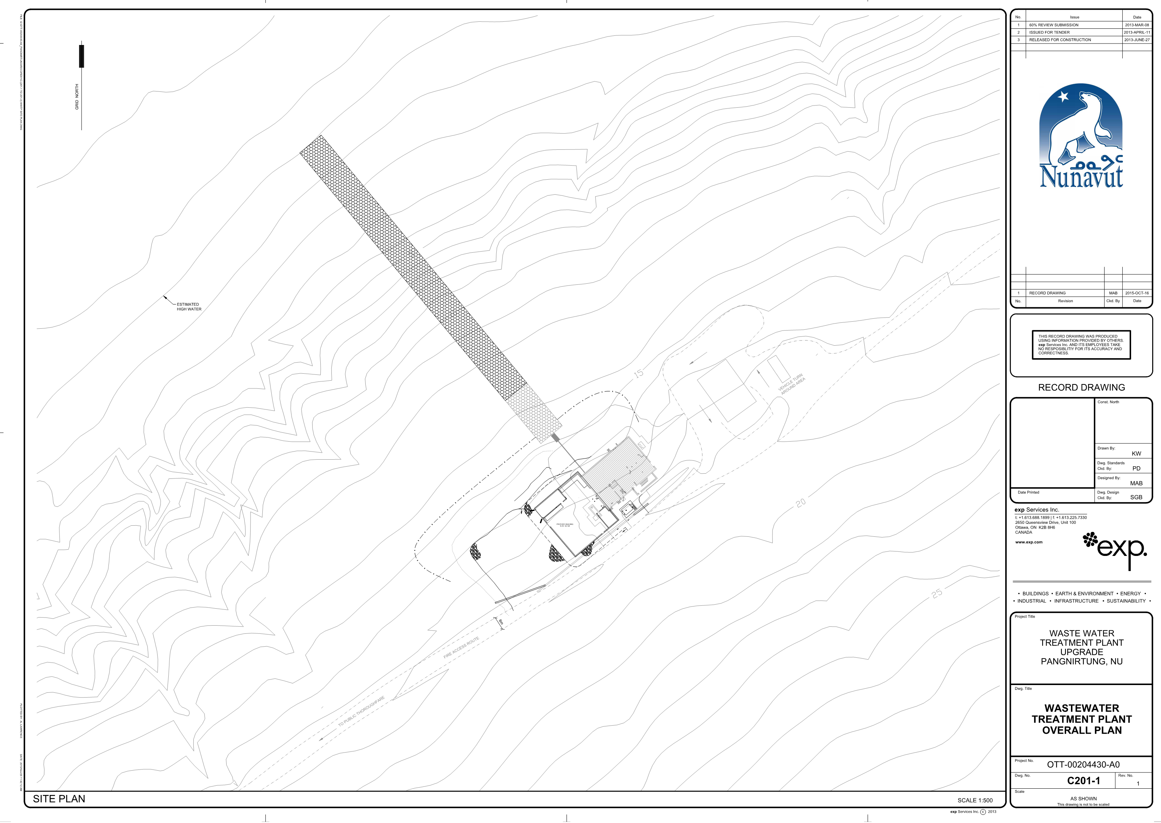

Slide 3
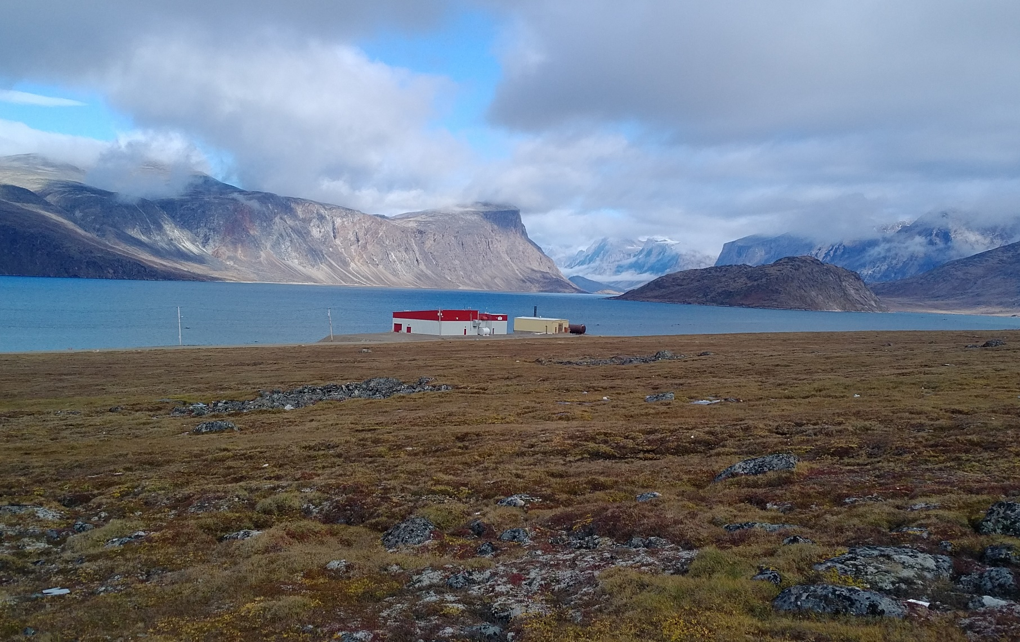
Wastewater Treatment Facility

