Slide 1
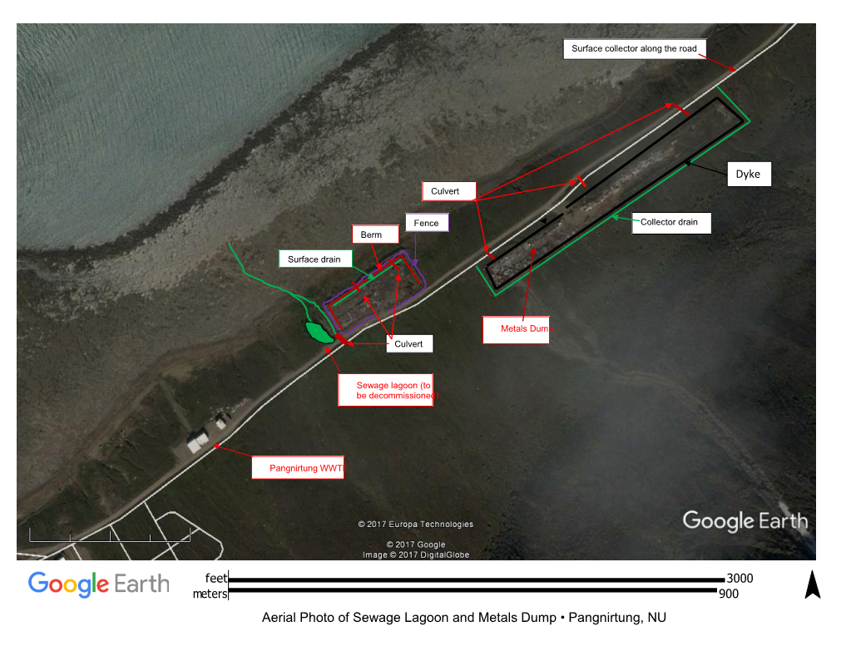

Slide 2
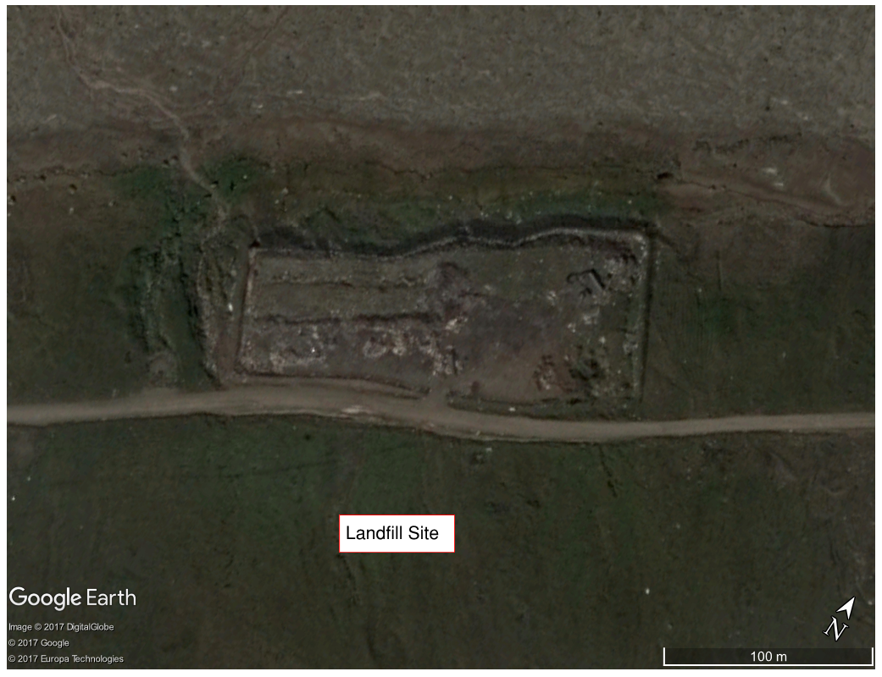

Slide 3
Metal Wastes
Domestic wastes
PAN-4
Sludge wastes
Hills
PAN-6
Fjord
PAN-5
Quarry Road
Surface drainage
Old incinerator
PAN-2
PAN-3
WWTP
Pangnirtung Wastewater Treatment Plant (WWTP), Land fill site (Domestic and sludge ), Metal waste site, old Incinerator building

Slide 4
Environment and Climate Change Canada (ECCC)
ECCC#1 – Quality Assurance and Quality Control Plan ECCC recommends that the Proponent: - Include field blanks rather than trip blanks in its QA/QC program. - Use replicate or split samples for QA/QC on sample analyses. - Append lab sheets that document the lab’s internal QA/QC program. - Include a data reporting protocol. These comments will be incorporated into the QA/QC Plan, INAC had similar comments. ECCC#2 – Toxicity Testing ECCC recommends that: - The Proponent considers limiting the bioassay testing to Rainbow Trout. - The NWB consider including the requirement that effluent be non-acutely toxic in \ Part H: Conditions Applying to the Monitoring Program of the new licence. The bioassay testing will be limited to using Rainbow Trout. ECCC#3 – Solid Waste Facilities – Open Burning ECCC has no recommendations at this time, but encourages the Hamlet to minimize, to whatever extent possible, the non-segregated waste volumes that are open burned until the new facility is available. The Hamlet will attempt to minimize the burning of non-segregated wastes. ECCC#4 – Solid Waste Facilities – Spill Contingency Plan – Off-site Resources ECCC recommends that ECCC’s “emergency” number be removed from the Offsite Resources list. This emergency number will be removed from the Spill Contingency Plan.
3

Slide 5
Department of Fisheries and Oceans (DFO)
The DFO comments dealt with the Duval River hydrogeological assessment, water removal (pumping) rate and intake screen size. The Hamlet is using a Diesel pump to extract water from Duval River and they are still looking for a suitable meter to measure the extraction volume of water. Also, they are planning to attach a screen at the end of the intake pipe (following DFO' s guidelines) during withdrawal operations.
3

Slide 6
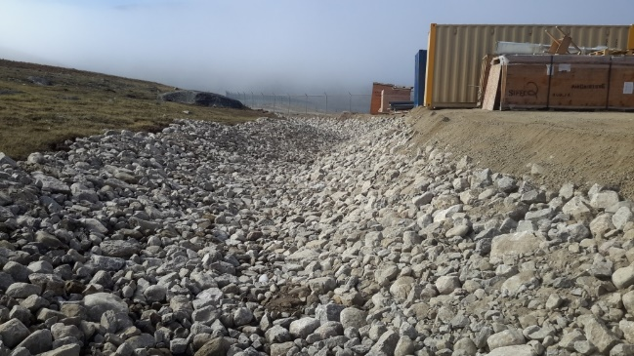
Indigenous and Northern Affairs Canada (INAC)
1.3 - Duval River as water source: INAC recommends that a renewed licence keep the requirement to report daily volume extracted from the Duval River and encourages the Licensee to obtain appropriate equipment. The Hamlet will consider obtaining and using the appropriate flow measuring equipment during water withdrawal. 1.4 - Surface water management around reservoir: A depression in the berm surrounding the reservoir was noted near the northeast corner during the 2016 inspection. INAC wanted to ensure the problem had been repaired and adequate measures are in place to maintain the designed integrity of the structure. INAC considers that this issue requires follow-up and recommends that the applicant be requested to state whether Kudlik completed the work on the secondary cut-off ditch, and propose a timeline for completion if it has not been done yet. The work was completed by Kudlik as shown in the photo below.
3

Slide 7
Indigenous and Northern Affairs Canada (INAC)
1.5 - Reclamation of old truck fill station: Since completion of the new truck fill station, the old one is no longer in use. Its decommissioning is planned for 2019. INAC recommends that the old truck fill station remain in a renewed licence and that a condition for its decommissioning be included. Agreed 1.6 - Operation and Maintenance manuals for water supply: The O&M manual submitted fulfilled a commitment but requires further work: INAC recommends that the Licensee be required to provide an updated water reservoir O&M manual with its first annual report following licence renewal and address several issues: - a comment on annual inspections, - correction of an acronym, - determination of requirements for a fish screen on the intake pipe, and - incorporation of any relevant conditions. The O&M Manual will be revised accordingly and submitted along with 2018 Annual Report in 2019. 2.1 - Wastewater treatment plant bypass contingency plan: INAC was not included in Table 4-2 of agencies having a vested interest in the event of a bypass. INAC considers that this further correction can wait until the next plan revision. Agreed, this change will be made in the next plan revision and submitted along with the 2018 Annual report in 2019. 2.2 - Sewage lagoon: INAC recommends the sewage lagoon remain under a renewed licence until such time as it is decommissioned. Agreed.
3

Slide 8
Indigenous and Northern Affairs Canada (INAC)
3.2 - Surface water management at metal dump: INAC recommends the Licensee be required to state whether the drainage plan implementation was complete before the 2017 inspection. If it was, measures appear inadequate and further measures should be proposed. If it had not, a timeline for completion should be provided. It is expected to be complete in 2020. 3.3 - Runoff/leachate from landfill and metal waste sites: INAC recommends that a renewed licence require the Licensee to collect runoff for characterization before discharge and set effluent criteria for its discharge. A collection site will be identified, samples collected for characterization and effluent criteria determined. 3.4 - Hazardous waste storage area: INAC recommends a renewed licence include the work required to provide adequate fencing as well as contain or control drainage/seepage from the hazardous storage area and its subsequent report as a condition of a renewed licence. INAC would also like to see pictures of both the fencing and drainage/containment arrangements used to isolate the area. It is expected to be completed in 2019.
3

Slide 9
Indigenous and Northern Affairs Canada (INAC)
4.1 - Station PAN-01 – raw water supply intake: INAC recommends that a renewed licence keep the requirement to report daily volume extracted from the Duval River and encourages the Licensee to obtain appropriate equipment to measure the flow in the Duval River during water extraction. The appropriate equipment will be sourced and obtained for use during extraction; the daily extracted volumes will be recorded. It is expected in 2019. 4.5 - Spill contingency plan: INAC recommends the Licensee be required to submit a revised version of the Spill Contingency Plan that includes a topographical map with the next annual report. As well, make corrections to the contact information for the facility supervisor and clarifications on the Spill Kit locations to be consistent with section 11.9 of the O&M Plan for the solid waste facilities. The SCP will be revised and submitted with the next 2018 annual report in 2019 and will include a topographical map plus corrected information as requested. QA/QC Plan: INAC recommends the Licensee be required to submit a revised QA/QC plan addressing two concerns with its next annual report: - The use of intermediate sampling containers should be avoided if possible or ensure proper procedures if their use is required, - Quality control samples: the use of Trip Blanks as well as the inclusion of sample duplicates. The QA/QC Plan will be revised and submitted with the next 2018 annual report in 2019 and will address the above concerns.
3

Slide 10




Questions?
Pangnirtung WWTP, Nunavut

