Slide 1
Environment and Climate Change Canada’s Presentation to the Nunavut Water Board Regarding the Hamlet of Pangnirtung’s Type A Municipal Water Licence Renewal Application submitted by Government of Nunavut – Community Government Services
3AM-PAN----
NWB Public Hearing
Pangnirtung, NU
March 21-22, 2018

Slide 2
ECCC’s Mandate
Preserve and enhance the quality of the natural environment
Conserve Canada’s renewable resources
Conserve and protect Canada’s water resources
Forecast daily weather conditions and warnings
Enforce rules relating to boundary waters
Coordinate environmental policies and programs for the federal government

Slide 3
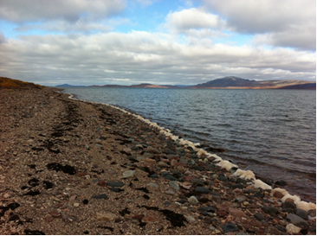
How ECCC Fulfills its Mandate
Relevant acts and regulations:
Department of the Environment Act
Canadian Environmental Protection Act
Fisheries Act – Pollution prevention provisions
Notes:
We left off the SARA and MBCA- since it is a water licence and doesn’t apply in this case.

Slide 4
ECCC#1 – Quality Assurance and Quality Control Plan
ECCC Recommendations
  Including field blanks rather than trip blanks in its Quality Assurance and Quality Control program.
  Use replicate or split samples for Quality Assurance and Quality Control on sample analyses
  Append lab sheets that document the lab’s internal Quality Assurance and Quality Control program
  Include a data reporting protocol
Proponent’s Response
The Proponent has committed to addressing ECCC’s recommendation
ECCC’s Response
This issue to resolved to ECCC’s satisfaction

Slide 5
ECCC#2 – Toxicity Testing
ECCC Recommendations
  The Proponent consider focusing the bioassay testing to Rainbow Trout
  The Nunavut Water Board consider including the requirement that effluent be non-acutely toxic in Part H: Conditions Applying to the Monitoring Program of the new licence.
Proponent’s Response
The Proponent has committed to addressing ECCC’s recommendation
ECCC’s Response
This issue to resolved to ECCC’s satisfaction.

Slide 6
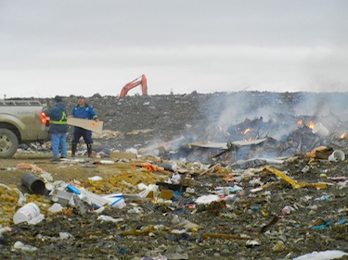
ECCC#3 – Solid Waste Facilities – Open Burning
ECCC Encourages
  The Hamlet to minimize, as possible, the non-segregated waste volumes that are open-burned.
Proponent’s Response
The Hamlet responded that they will attempt to minimize the burning of non-segregated wastes and noted that they are planning a new landfill for 2024, which will not require open-burning.
ECCC’s Response
This issue is resolved to ECCC’s satisfaction.

Slide 7
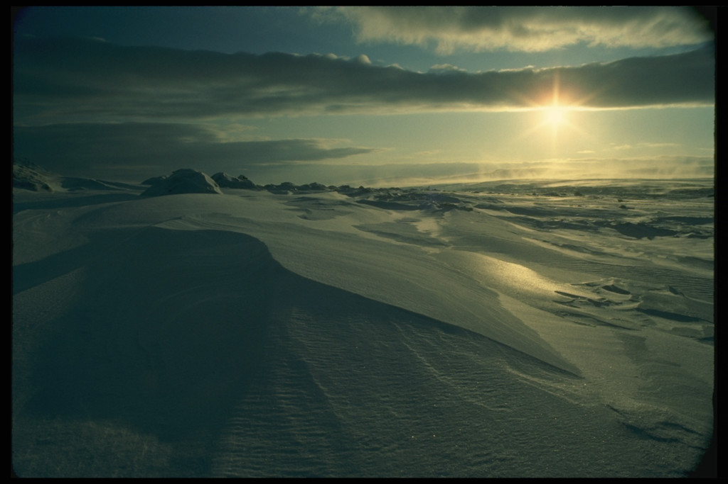
Qujannamiik !
ECCC would like to say thank you for the opportunity to participate in this water licencing process

