Slide 1
ᐊᕙᑎᓕᕆᔨᒃᑯᑦ ᐊᒻᒪᓗ ᓯᓚᐅᑉ ᐅᖂᓂᖓᓄᑦ ᐱᓇᓱᐊᖅᑎᑦ ᑲᓇᑕᒥ ᐅᖃᓪᓚᒋᐊᖅᑐᖅᓯᒪᕗᑦ ᓄᓇᕗᒻᒥ ᐃᒪᓕᕆᔨᒃᑯᑦ ᑲᑎᒪᔨᖏᓐᓄᑦ ᐱᔾᔪᑎᒋᓪᓗᒍ ᕼᐋᒻᓚᒃᑯᑦ ᐸᖕᓂᖅᑑᑉ A ᓄᓇᖓᓂ ᐃᒪᖓᓄ ᓚᐃᓴᓯ ᓄᑖᖑᕆᐊᕐᓂᖓᓄ ᐆᒃᑑᑎᒥᒃ ᑐᓂᔭᐅᔪᖅ ᑖᒃᑯᓇᖓ ᓄᓇᕗᑦ ᒐᕙᒪᒃᑯᑦ - ᓄᓇᓕᖕᓄᑦ ᒐᕙᒪᒃᑯᓄᑦ ᐱᔨᑦᑎᕋᖅᑎᑦ.
ᓄᓇᕗᒻᒥ ᐃᒪᓕᕆᔨᒃᑯᑦ ᑲᑎᒪᔨᖏᑦ ᐃᓄᓕᒫᓂᒃ ᓈᓚᒃᑐᑦ
ᐸᖕᓂᖅᑑᖅ, ᓄᓇᕗᑦ
ᒫᑦᓯ 21-ᒥᑦ 22-ᒧᑦ, 2018

Slide 2
ᐊᕙᑎᓕᕆᔨᒃᑯᑦ ᐊᒻᒪᓗ ᓯᓚᐅᑉ ᐅᖂᓂᖓᓄᑦ ᐱᓇᓱᐊᖅᑎᑦ ᑲᓇᑕᒥ ᑎᓕᔭᐅᓯᒪᕗᑦ
ᓱᕈᖅᑕᐅᔭᑦᑐᓃᖅᑎᓪᓗᒋᑦ ᐊᒻᒪᓗ ᐱᐅᓯᕚᓪᓕᖅᑎᓪᓗᒋᑦ ᖃᓄᕆᑑᓂᒋᑦ ᓄᓇᐅᑉ ᐊᕙᑖ
ᐊᑐᑦᑎᐊᕐᓗᒋᑦ ᑲᓇᑕᐅᑉ ᓄᓇᒥᐅᑕᖏᑦ
ᐊᑐᑦᑎᐊᕐᓗᒋᑦ ᐊᒻᒪᓗ ᓴᐳᒻᒥᓗᒋᑦ ᑲᓇᑕᐅᑉ ᐃᒥᖅᑕᕐᕕᖏᑦ
ᖃᐅᑕᒫᑦ ᓯᓚᓐᓂᐊᖃᑦᑕᕐᓗᑎᒃ ᐊᒻᒪᓗ ᖃᐅᔨᒪᑎᑦᑎᖃᑦᑕᕐᓗᑎᒃ ᓯᓚᓗᖕᓂᐊᖅᑎᓪᓗᒍ
ᒪᓕᒃᑕᐅᑎᑦᑎᓗᑎ ᒪᓕᒋᐊᓕᖕᓂᒃ ᐱᓪᓗᒋᑦ ᐃᒪᐃᑦ
ᑲᒪᒋᓗᒋᑦ ᐊᕙᑎᓕᕆᓂᕐᒧᑦ ᐊᑐᐊᒐᐃᑦ ᐊᒻᒪᓗ ᐱᓕᕆᑎᑦᑎᔾᔪᑕᐅᔪᑦ ᑖᒃᑯᓄᖓᐅᔪᑦ ᒐᕙᒪᑐᖃᒃᑯᓄᑦ.

Slide 3
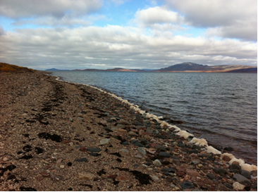
ᖃᓄᖅ ᐊᕙᑎᓕᕆᔨᒃᑯᑦ ᐊᒻᒪᓗ ᓯᓚᐅᑉ ᐅᖂᓂᖓᓄᑦ ᐱᓇᓱᐊᖅᑎᑦ ᑲᓇᑕᒥ ᑎᓕᔭᐅᓯᒪᕙᑦ
ᐊᑑᑎᖃᖅᑐᑦ ᐱᖁᔭᕐᔪᐊᑦ ᐊᒻᒪᓗ ᐱᖁᔭᕋᓛᑦ:
ᐊᐅᓚᑦᓯᕕᖓ ᐊᕙᑎᓕᕆᔨᒃᑯᑦ ᐱᖁᔭᕐᔪᐊᖓ
ᑲᓇᑕᒥ ᐊᕙᑎᒥᒃ ᓴᐳᓐᓂᐊᕐᓂᖅ ᐱᖁᔭᕐᔪᐊᖅ
ᐃᖃᓗᓕᕆᓂᕐᒧᑦ ᐱᖁᔭᕐᔪᐊᖅ - ᓱᕈᖅᓯᖁᓇᒋᑦ ᓴᐳᒻᒥᓂᕐᒧᑦ ᒪᓕᒐᖅ

Slide 4
ECCC#1 – ᐊᔪᖏᑦᑎᐊᕐᓗᑎᒃ ᐃᖏᕐᕋᓂᖏ ᐊᒻᒪᓗ ᖃᓄᕆᑑᔭᕆᐊᖃᕐᓂᖓ ᐊᐅᓚᑦᑕᕆᐊᖃᕐᓂᖓᑕ
ᐊᕙᑎᓕᕆᔨᒃᑯᑦ ᐊᒻᒪᓗ ᓯᓚᐅᑉ ᐅᖂᓂᖓᓄᑦ ᐱᓇᓱᐊᖅᑎᑦ ᑲᓇᑕᒥ ᐊᑐᓕᖁᔭᐅᔪᑦ
ᐃᓚᒋᔭᐅᔪᖅ ᓄᓇᒥ ᐱᓯᒪᔪᑦ ᑕᒪᓐᓇᐅᓇᒍ ᐃᖏᕐᕋᓂᖓᓐᓂᒃ ᐱᓯᒪᔪᑦ ᐊᔪᖏᑦᑎᐊᕐᓗᑎᒃ ᐃᖏᕐᕋᓂᖏ ᐊᒻᒪᓗ ᖃᓄᕆᑑᔭᕆᐊᖃᕐᓂᖓ ᐊᐅᓚᑦᑕᕆᐊᖃᕐᓂᖓᑕ ᐱᓕᕆᑎᑦᑎᔾᔪᑕᐅᔪᓂᑦ.
ᐊᑐᕐᓗᑎᒃ ᐊᔾᔨᒋᓕᖅᑎᓯᒪᔪᓂᒃ ᐅᒡᕙᓘᓐᓃᑦ ᐊᕕᒡᓗᒋᑦ ᖃᐅᔨᓴᕈᑎᑖᑦ ᑕᒪᑐᒧᖓ ᐊᔪᖏᑦᑎᐊᕐᓗᑎᒃ ᐃᖏᕐᕋᓂᖏ ᐊᒻᒪᓗ ᖃᓄᕆᑑᔭᕆᐊᖃᕐᓂᖓ ᐊᐅᓚᑦᑕᕆᐊᖃᕐᓂᖓᑕ ᖃᐅᔨᓴᕈᑎᑖᕐᓂᒃ ᖃᐅᔨᓇᓱᖕᓂᖅ
ᐊᑕᔪᑦ ᖃᐅᔨᓴᕈᑎᑦ ᐊᖕᖏᓇᖅᑐᑎᒍᑦ ᑎᑎᖃᖏᑦ ᐅᑯᐊ ᖃᐅᔨᓴᕐᕕᒃ ᐃᒻᒥᒍᑦ ᐊᔪᖏᑦᑎᐊᕐᓗᑎᒃ ᐃᖏᕐᕋᓂᖓ ᐊᒻᒪᓗ ᖃᓄᕆᑑᔭᕆᐊᖃᕐᓂᖓ ᐊᐅᓚᑦᑕᕆᐊᖃᕐᓂᖓᑕ ᐱᓕᕆᑎᑦᑎᔾᔪᑕᐅᔪᓂᑦ.
ᐃᓚᓯᒪᓗᒍ ᖃᐅᔨᓴᕈᑎᑖᓂᒃ ᐅᖃᐅᓯᐅᔭᕆᐊᖃᕋᔭᖅᑐᓕᒃ
ᑐᒃᓯᕋᖅᑐᖅ ᑭᐅᓯᔪᖅ
ᐅᓇ ᑐᒃᓯᕋᖅᑐᖅ ᐊᖕᖏᖅᓯᒪᑦᑎᐊᖅᑐᖅ ᒪᓕᒡᓗᒋᑦ ᐱᓕᕆᓗᒋᑦ ᐊᕙᑎᓕᕆᔨᒃᑯᑦ ᐊᒻᒪᓗ ᓯᓚᐅᑉ ᐅᖂᓂᖓᓄᑦ ᐱᓇᓱᐊᖅᑎᑦ ᑲᓇᑕᒥ ᐊᑐᓕᖁᔭᖏᑦ
ᐊᕙᑎᓕᕆᔨᒃᑯᑦ ᐊᒻᒪᓗ ᓯᓚᐅᑉ ᐅᖂᓂᖓᓄᑦ ᐱᓇᓱᐊᖅᑎᑦ ᑲᓇᑕᒥ ᑭᐅᓯᕗᑦ
ᐅᓇ ᐱᔾᔪᑕᐅᔪᖅ ᐋᕿᒃᑐᖅ ᐅᑯᐊ ᐊᕙᑎᓕᕆᔨᒃᑯᑦ ᐊᒻᒪᓗ ᓯᓚᐅᑉ ᐅᖂᓂᖓᓄᑦ ᐱᓇᓱᐊᖅᑎᑦ ᑲᓇᑕᒥ ᓈᒪᒋᔭᖏᑦ

Slide 5
ECCC#2 – ᐊᔪᖏᑦᑎᐊᕐᓗᑎᒃ ᐃᖏᕐᕋᓂᖏᑦ ᐊᒻᒪᓗ ᖃᓄᕆᑑᔭᕆᐊᖃᕐᓂᖓ ᐊᐅᓚᑦᑕᕆᐊᖃᕐᓂᖓᑕ ᐸᕐᓇᐅᑎ
ᐊᕙᑎᓕᕆᔨᒃᑯᑦ ᐊᒻᒪᓗ ᓯᓚᐅᑉ ᐅᖂᓂᖓᓄᑦ ᐱᓇᓱᐊᖅᑎᑦ ᑲᓇᑕᒥ ᐊᑐᓕᖁᔭᐅᔪᑦ
ᐅᓇ ᑐᒃᓯᕋᖅᑐᖅ ᐃᓱᒪᒋᑦᑎᐊᕐᓗᒋᑦ ᐊᐅᓪᓗᑎᒋᐊᓕᑦ ᐆᒪᔪᓂ ᖃᐅᔨᓴᕐᓂᖅ ᑖᒃᑯᐊ ᑕᓯᕐᒥᐅᑕᐃᑦ
ᐅᑯᐊ ᓄᓇᕗᒻᒥ ᐃᒪᓕᕆᔨᒃᑯᑦ ᑲᑎᒪᔨᖏᑦ ᐃᓱᒪᒋᓗᒋᑦ ᐃᓚᒋᔭᐅᓗᑎᒃ ᐊᑐᕆᐊᖃᖅᑐᑦ ᐊᑑᑎᖃᑦᑎᐊᖅᑐᑦ ᑐᖁᓐᓇᖅᑐᓂ ᐃᓚᖃᓐᖏᓪᓗᑎᒃ ᑕᐃᑲᓂ ᐃᓚᖓ H: ᒪᓕᒋᐊᖃᖅᑐᑦ ᐊᑑᑎᖃᖅᑐ ᒥᐊᓂᕆᔾᔪᑕᐅᔪᓄ ᐱᓕᕆᑎᑦᑎᔾᔪᑕᐅᔪᑦ ᓄᑖᒥ ᓚᐃᓴᓯᓂ.
ᑐᒃᓯᕋᖅᑐᖅ ᑭᐅᓯᔪᖅ
ᐅᓇ ᑐᒃᓯᕋᖅᑐᖅ ᐊᖕᖏᖅᓯᒪᑦᑎᐊᕐᓗᑎᓂ ᐱᓕᕆᓂᐊᕐᓗᒋᑦ ᐊᕙᑎᓕᕆᔨᒃᑯᑦ ᐊᒻᒪᓗ ᓯᓚᐅᑉ ᐅᖂᓂᖓᓄᑦ ᐱᓇᓱᐊᖅᑎᑦ ᑲᓇᑕᒥ ᐊᑐᓕᖁᔭᖏᑦ
ᐊᕙᑎᓕᕆᔨᒃᑯᑦ ᐊᒻᒪᓗ ᓯᓚᐅᑉ ᐅᖂᓂᖓᓄᑦ ᐱᓇᓱᐊᖅᑎᑦ ᑲᓇᑕᒥ ᑭᐅᓯᕗᑦ
ᐅᓇ ᐱᔾᔪᑕᐅᔪᖅ ᐋᕿᒃᑐᖅ ᐅᑯᐊ ᐊᕙᑎᓕᕆᔨᒃᑯᑦ ᐊᒻᒪᓗ ᓯᓚᐅᑉ ᐅᖂᓂᖓᓄᑦ ᐱᓇᓱᐊᖅᑎᑦ ᑲᓇᑕᒥ ᓈᒪᒋᔭᖏᑦ

Slide 6
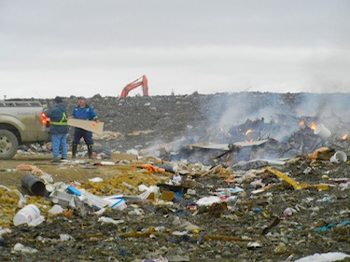
ECCC#3 – ᐊᒃᑕᕐᕖᑦ - ᓯᓚᑐᐃᓐᓇᒥ ᐃᑯᐊᓚᑎᑕᐅᓗᓂ
ᐊᕙᑎᓕᕆᔨᒃᑯᑦ ᐊᒻᒪᓗ ᓯᓚᐅᑉ ᐅᖂᓂᖓᓄᑦ ᐱᓇᓱᐊᖅᑎᑦ ᑲᓇᑕᒥ ᑎᓕᐅᕆᕗᑦ
ᕼᐋᒻᓚᒃᑯᑦ ᐊᒥᓱᐃᖃᑦᑕᓗᐊᓐᖏᓪᓗᑎᒃ, ᐊᔪᕐᓇᓐᖏᒃᑯᓂ, ᐳᖅᑐᓯᔭᑦᑐᑦ ᐊᒃᑕᑯᑦ ᓯᓚᑐᐃᓐᓇᒥ ᐃᑯᐊᓪᓚᒃᑎᑕᐅᓂᖃᑦᑕᕐᓂᖏᑦ.
ᑐᒃᓯᕋᖅᑐᖅ ᑭᐅᓯᔪᖅ
ᕼᐋᒻᓚᒃᑯᑦ ᑭᐅᓯᔪᑦ ᐃᑯᐊᓪᓚᑎᑦᑎᓈᖃᑦᑕᕐᓂᐊᓐᖏᑦᑐᑦ ᑕᒪᒃᑯᓂᖓ ᐊᒃᑕᑯᑐᐃᓐᓇᕆᔭᐅᔪᓂᒃ ᐊᒻᒪᓗ ᖃᐅᔨᒪᓂᐊᖅᑐᑦ ᐸᕐᓇᐃᓯᒪᔪᑦ ᓄᑖᒥᒃ ᓴᐅᓯᕕᒃᓴᒥᒃ 2024-ᒥ, ᐅᓇᓗ ᐃᑯᐊᓪᓚᒃᑎᑦᑎᖃᑦᑕᕆᐊᖃᕐᓂᐊᓐᖏᒻᒪᑕ.
ᐊᕙᑎᓕᕆᔨᒃᑯᑦ ᐊᒻᒪᓗ ᓯᓚᐅᑉ ᐅᖂᓂᖓᓄᑦ ᐱᓇᓱᐊᖅᑎᑦ ᑲᓇᑕᒥ ᑭᐅᓯᕗᑦ
ᐅᓇ ᐱᔾᔪᑕᐅᔪᖅ ᐋᕿᒃᑐᖅ ᐅᑯᐊ ᐊᕙᑎᓕᕆᔨᒃᑯᑦ ᐊᒻᒪᓗ ᓯᓚᐅᑉ ᐅᖂᓂᖓᓄᑦ ᐱᓇᓱᐊᖅᑎᑦ ᑲᓇᑕᒥ ᓈᒪᒋᔭᖏᑦ

Slide 7
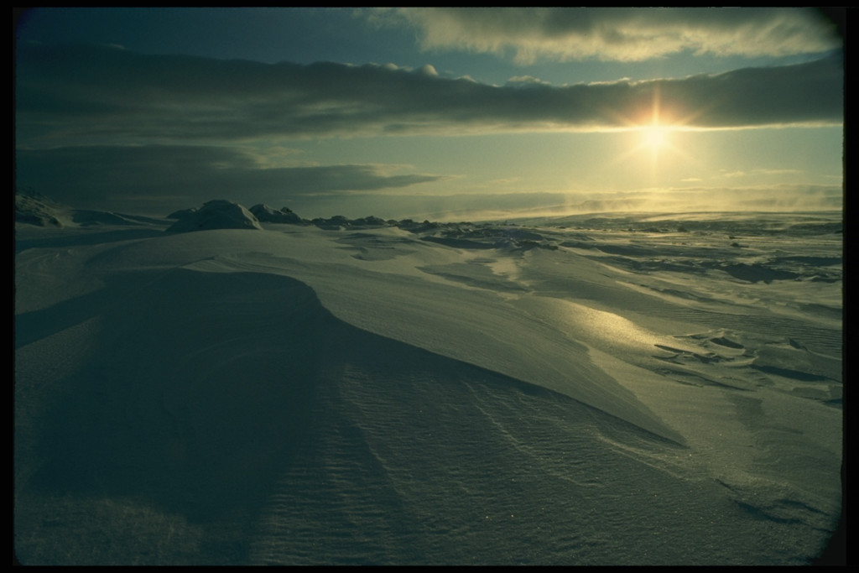
Qujannamiik !
ᐊᕙᑎᓕᕆᔨᒃᑯᑦ ᐊᒻᒪᓗ ᓯᓚᐅᑉ ᐅᖂᓂᖓᓄᑦ ᐱᓇᓱᐊᖅᑎᑦ ᑲᓇᑕᒥ ᖁᔭᓐᓇᒦᖅᐳᑦ ᐱᕕᐊᕐᑎᑕᐅᒐᒥᒃ ᐃᓚᐅᓪᓗᑎᒃ ᑕᒡᕙᓂ ᐃᒪᕐᒥᒃ ᓚᐃᓴᓯᑖᕋᓱᒍᑎᒥᖕᓄᑦ.

