Slide 1
Hamlet of Resolute Bay Utilidor
Renewal Application for
Water Licence 3AM-RUT----
Nunavut Water Board Public Hearing
Resolute Bay, October 27-28, 2020
ᕼᐋᒪᓚᒃᑯᖏᑦ ᖃᐅᓱᐃᑦᑑᑉ ᐃᒪᖃᐅᑦ ᐃᓂᖓᓂᒃ ᓄᑕᐅᓯᕆᐊᕆᒍᒪᓂᕐᒧᑦ ᐃᒥᕐᒧᑦ ᓚᐃᓴ 3AM-RUT----
ᓄᓇᕗᒻᒥ ᐃᒪᓕᕆᓂᕐᒧᑦ ᑲᑎᒪᔩᑦ
ᐃᓄᓗᒃᑖᓂᒃ ᑲᑎᒪᑎᑦᑎᓂᖅ
ᐅᒃᑑᐱᕆ 27-28, 2020

Slide 2
Outline
ᐊᑐᐊᖅᑕᐅᓂᐊᖅᑐᑦ
Role and Responsibilities
Contributions to Application Review
Topics of Technical Review:
Scope & term of licence
Compliance
Water supply
Wastewater treatment
Management plans & reports
Monitoring
Closure & reclamation planning
Conclusion
ᐃᖅᑲᓇᐃᔮᕆᔭᖅ ᐱᔭᒃᓴᕆᔭᐅᔪᓪᓗ
ᐃᓚᓕᐅᑎᔪᑦ ᑐᒃᓯᕋᐅᑕᐅᔪᒧᑦ ᕿᒥᕐᕈᓂᕐᒧᑦ
ᐱᔾᔪᑕᐅᔪᑦ ᐱᓕᕆᐊᕐᒥᑦ ᕿᒥᕐᕈᓂᕐᒧᑦ:
ᖃᓄᐃᑦᑑᓂᖓ ᐊᒻᒪᓗ ᖃᓄᖅ ᐊᑯᓂᐅᑎᒋᓂᖓ ᓚᐃᓴᓐᓯ
ᒪᓕᖕᓂᖅ
ᐃᒪᕆᔭᐅᔪᖅ
ᐊᒃᑕᑰᖅᑕᐅᔪᒥᒃ ᐃᒪᖅ ᐱᓕᕆᐊᖑᓂᖓ
ᐊᐅᓚᑦᑎᓂᕐᒧᑦ ᐸᕐᓇᐅᑏᑦ ᐊᒻᒪᓗ ᐅᓂᑉᑳᑦ
ᖃᐅᔨᓴᐃᓂᖅ
ᐅᒃᑯᐊᖅᐸᓪᓕᐊᓂᖅ ᐊᒻᒪᓗ ᐅᑎᖅᑎᑎᕆᓂᕐᒧᑦ ᐸᕐᓇᐃᓂᖅ
ᐱᐊᓂᒃᐸᓪᓕᐊᓂᖅ

Slide 3
Roles and responsibilities
ᐃᖅᑲᓇᐃᔮᕆᔮᕆᔭᑦ ᐱᔭᒃᓴᕆᔭᐅᔪᓪᓗ
Crown-Indigenous Relations and Northern Affairs Canada’s (CIRNAC) responsibilities, mandate, and obligations stem from with the following:
Department of Crown-Indigenous Relations and Northern Affairs Act
Nunavut Agreement
Nunavut Land Claims Agreement Act
Nunavut Waters and Nunavut Surface Rights Tribunal Act and the associated regulations
Nunavut Planning and Project Assessment Act
Territorial Lands Act and the associated regulations
Arctic Waters Pollution Prevention Act
ᓯᕗᓪᓕᐅᑎᔭᐅᓂᖏᑦ ᒐᕙᒪᑐᖃᒃᑯᓐᓄᑦ − ᓄᓇᖃᖅᑳᖅᓯᒪᔪᓄᑦ ᐊᒻᒪ ᐅᑭᐅᖅᑕᖅᑐᒧᑦ ᑐᕌᖓᔪᓂᑦ ᐱᓕᕆᔪᑦ ᑲᓇᑕᒥ (CIRNAC)−ᑯᑦ ᐱᔭᒃᓴᖏᑦ, ᑎᓕᔭᐅᔾᔪᑎᖓ, ᐊᒻᒪ ᐱᓕᕆᔭᕆᐊᖃᖅᑕᖏᑦ ᐅᑯᓇᙶᖅᓯᒪᔪᑦ:
ᐱᓕᕆᕕᖓ ᓯᕗᓪᓕᐅᑎᔭᐅᓂᖏᑦ ᒐᕙᒪᑐᖃᒃᑯᓐᓄᑦ − ᓄᓇᖃᖅᑳᖅᓯᒪᔪᓄᑦ ᐊᒻᒪ ᐅᑭᐅᖅᑕᖅᑐᒧᑦ ᑐᕌᖓᔪᓂᑦ ᐱᓕᕆᔪᑦ ᑲᓇᑕᒥ ᐱᖁᔭᖓ
ᓄᓇᕘᒧᑦ ᐊᖏᖃᑎᒌᒍᑦ
ᓄᓇᑖᕈᑎᒧᑦ ᐊᖏᖃᑎᒌᒍᑎᒧᑦ ᐱᖁᔭᖅ
ᓄᓇᕗᒻᒥ ᐃᒪᓕᕆᓂᕐᒧᑦ ᐊᒻᒪ
ᓄᓇᕗᒻᒥ ᐃᒪᕐᒧᑦ ᐊᒻᒪ ᓄᓇᕗᒻᒥ ᓄᓇᒧᑦ ᐱᔪᓐᓇᐅᑎᓕᕆᔨᒃᑯᑦ ᐱᖁᔭᖓ ᐊᒻᒪ ᐊᒃᑐᐊᔪᑦ ᑕᒪᑐᒧᖓ ᐊᑐᐊᒐᐃᑦ
ᓄᓇᕗᒻᒧᑦ ᐸᕐᓇᐅᑦ ᐊᒻᒪ ᐱᓕᕆᐊᒧᑦ ᖃᐅᔨᓴᕐᓂᕐᒧᑦ ᐱᖁᔭᖅ
ᓄᓇᐃᑦ ᐊᕕᒃᑐᖅᓯᒪᔪᓄᑦ ᐱᖁᔭᖅ ᐊᒻᒪ ᐊᒃᑐᐊᔪᑦ ᑕᒪᑐᒧᖓ ᐊᑐᐊᒐᐃᑦ
ᐅᑭᐅᖅᑕᖅᑐᒥ ᐃᒪᐃᑦ ᓱᕈᖅᑕᐅᑦᑕᐃᓕᑎᑕᐅᓂᖏᓐᓄᑦ ᐱᖁᔭᖅ

Slide 4
Contributions to Application Review
ᐃᓚᓕᐅᑎᔪᑦ ᑐᒃᓯᕋᐅᑕᐅᔪᒧᑦ ᕿᒥᕐᕈᓂᕐᒧᑦ
CIRNAC made the following contributions to the Nunavut Water Board’s review process:
Completeness assessment with information requests: March 26, 2020
Technical review with recommendations: June 12, 2020
Participation in Technical Meeting and Pre-hearing conference: July 14, 2020
Final written submission: September 24, 2020
CIRNAC-ᑯᑦ ᐃᑲᔪᐃᓚᐅᖅᑐᑦ ᓄᓇᕗᒻᒥ ᐃᒪᓕᕆᔨᒃᑯᑦ ᕿᒥᕐᕈᓂᖓᓐᓄᑦ:
ᐃᖅᑲᓇᐃᖅᑐᖅ ᖃᐅᔨᓴᐅᑦ ᑐᑭᓯᒋᐊᖅᑕᐅᒍᒪᓯᒪᔪᓂᒃ ᐃᓚᖃᖅᖢᓂ: March 26, 2020
ᓇᓗᓇᖅᑐᓂᑦ ᕿᒥᕐᕈᓂᕐᒧᑦ ᐊᑐᓕᖁᔭᐅᔪᓂᓪᓗ ᐃᓚᖃᖅᖢᓂ: ᔫᓂ 12, 2020
ᐃᓚᐅᖃᑕᐅᓂᖅ ᐱᓕᕆᐊᑉ ᒥᒃᓵᓄᑦ ᑲᑎᒪᓂᕐᒥᑦ ᐊᒻᒪᓗ ᓯᕗᓂᐊᒍᑦ ᑲᑎᒪᓂᐅᑉ ᑲᑎᒪᓂᖅ: ᔪᓚᐃ 14, 2020
ᑭᖑᓪᓕᖅᐹᑦ ᑎᑎᕋᖅᑕᐅᔪᓂᒃ ᑐᓂᔭᐅᔪᑦ: ᓯᑎᐱᕆ 24, 2020

Slide 5
Scope & term of licence
ᖃᓄᐃᑦᑑᓂᖓ ᐊᒻᒪᓗ ᖃᓄᖅ ᐊᑯᓂᐅᑎᒋᓂᖓ ᓚᐃᓴᓐᓯᐅᑉ
CIRNAC agrees with scope of licence described in Pre-hearing Conference Decision Report. It includes the new infrastructure and keeps what hasn’t been decommissioned yet.
CIRNAC supports applicant’s request for 20 year licence term.
CIRNAC-ᑯᑦ ᐊᖏᕈᑎᖃᖅᑐᑦ ᖃᓄᐃᑦᑑᓂᖓᓄᑦ ᓚᐃᓴᓐᓯ ᐅᖃᐅᓯᐅᔪᖅ ᓯᕗᓂᐊᒍᑦ ᑲᑎᒪᑎᑦᑎᓂᕐᒧᑦ ᐃᓱᒪᓕᐅᕆᓂᕐᒧᑦ ᐅᓂᑉᑳᑉ. ᐃᓚᐅᔪᑦ ᓄᑖᑦ ᐱᖁᑏᑦ ᐊᒻᒪᓗ ᐱᓯᒪᓗᑎᒃ ᐊᑐᕈᖕᓃᖅᑎᑕᐅᓯᒪᙱᑦᑐᓂᒃ ᓱᓕ.
CIRNAC-ᑯᑦ ᐃᑲᔪᖅᑐᖅᑕᖓᑦ ᑐᒃᓯᕋᐅᓯᐅᖅᑐᑦ 20 ᐅᑭᐅᓅᓂᐊᕐᓗᓂ ᓚᐃᓴᓐᓯ.

Slide 6
Compliance
ᒪᓕᖕᓂᖅ
Conditions in recently expired licence 3BM-RUT1520 which were not realized have either:
Been addressed during renewal application process; or
A commitment was made by the applicant to address them with a fixed timeline.
CIRNAC is satisfied with this effort.
ᖃᓄᐃᖓᓂᐅᔪᑦ ᐊᑐᕈᖕᓃᓵᓚᐅᖅᑐᒥᑦ ᓚᐃᓴᓐᓯᒥᑦ 3BM-RUT1520 ᖃᐅᔨᔭᐅᓚᐅᖏᑦᑐᑦ ᐃᒪᓐᓇᐃᑦᑐᑦ:
ᐱᓕᕆᐊᖑᓚᐅᖅᑐᑦ ᓄᑖᙳᖅᓯᓂᕐᒧᑦ ᑐᒃᓯᕋᐅᑎᓕᕆᑎᓪᓗᒋᑦ;
ᐅᕝᕙᓘᓐᓃᑦ
ᐱᓂᐊᖅᑐᓕᐅᖅᓯᒪᔪᖅ ᑐᒃᓯᕋᐅᓯᐅᖅᑐᖅ ᐱᓕᕆᐊᕆᓂᐊᕐᓗᒋᑦ ᐋᖅᑭᐅᒪᔪᖅ ᖃᖓᒃᑰᖓᔪᖅ ᒪᓕᒡᓗᒍ.
CIRNAC-ᑯᑦ ᓈᒻᒪᒃᓴᖅᑐᑦ ᑕᒪᑐᒥᙵᑦ.

Slide 7
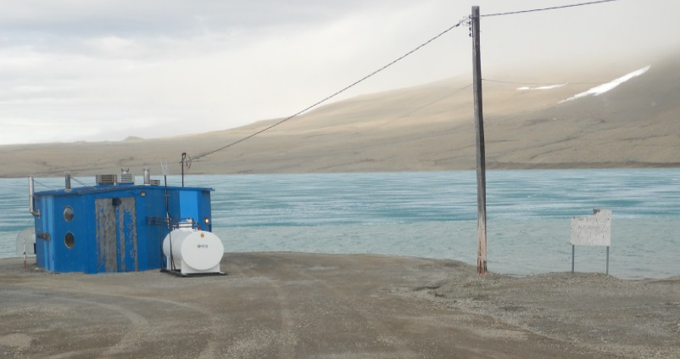
Water supply
ᐃᒪᖃᕐᓂᖅ
Hamlet’s water source is Char Lake and they have requested authorization to use 216 528 m³ of water a year.
CIRNAC’s 3 technical comments have been resolved:
Quantity of water requested
Plans for pump house
Leaks in utilidor
ᕼᐋᒻᓚᒃᑯᑦ ᐃᒪᖅᑖᕐᕕᒋᖃᑦᑕᖅᑕᖏᑦ ᐃᖃᓗᒃᐱᒃ ᑕᓯᖅ ᐊᒻᒪᓗ ᑐᒃᓯᕋᓚᐅᖅᑐᑦ ᐱᔪᖕᓇᖅᑎᑕᐅᓂᕐᒧᑦ ᐊᑐᕐᓂᐊᕐᓗᑎᒃ 216 528 m3-ᓂᒃ ᐃᒪᕐᒥᒃ ᐅᑭᐅᑕᒫᒃᑯᑦ.
CIRNAC-ᑯᑦ ᐱᖓᓱᑦ ᐱᓕᕆᐊᑉ ᒥᒃᓵᓄᑦ ᐅᖃᐅᓯᕆᔭᖏᑦ ᐋᖅᑭᒃᑕᐅᓯᒪᓕᖅᑐᑦ:
ᖃᓄᑎᒋ ᐃᒪᖅ ᑐᒃᓯᕋᐅᑕᐅᔪᖅ
ᐸᕐᓇᐅᑏᑦ ᑯᕕᖅᑕᐃᕝᕕᖕᒧᑦ
ᑯᕕᓃᑦ ᐃᒪᕐᓄᑦ ᐊᑉᖁᑎᒋᔭᐅᔪᓂᑦ
Char Lake and
pump house
ᐃᖃᓗᒃᐱᓕᒃ ᐊᒻᒪᓗ ᐃᒪᓕᕆᕝᕕᒃ

Slide 8
Wastewater treatment
ᐊᒃᑕᑰᖅᑕᐅᔪᒥᒃ ᐃᒪᖅ ᐱᓕᕆᐊᖑᓂᖓ
Currently wastewater collected by utilidor passes through a macerator before being discharged to the ocean. A wastewater treatment plant is planned for 2024.
CIRNAC’s technical comment has been resolved:
applicant’s commitment to provide plans for wastewater treatment plant prior to construction
ᒫᓐᓇᐅᔪᖅ ᐊᒃᑕᑰᖅᑕᐅᔪᖅ ᐃᒪᖅ ᑲᑎᑕᐅᖃᑦᑕᖅᑐᖅ ᐃᒪᕐᓄᑦ ᐊᑉᖁᑎᒃᑯᑦ ᐊᓂᒍᖅᑐᑦ macerator-ᑯᑦ ᑯᕕᑎᑕᐅᓂᐊᓵᖅᖢᓂ ᑕᕆᐅᕐᒧᑦ. ᐊᒃᑕᑰᖅᑕᐅᔪᒥᒃ ᐃᒪᓕᕆᕝᕕᒃ ᐸᕐᓇᐅᑕᐅᔪᖅ 2024-ᒧᑦ.
CIRNAC-ᑯᑦ ᐱᓕᕆᐊᑉ ᒥᒃᓵᓄᑦ ᐅᖃᐅᓯᖏᑦ ᐋᖅᑭᒃᑕᐅᓯᒪᓕᖅᑐᑦ:
ᑐᒃᓯᕋᐅᓯᐅᖅᑑᑉ ᑐᓂᓯᓂᐊᕐᓂᖓ ᐸᕐᓇᐅᑎᓂᒃ ᐊᒃᑕᑰᖅᑕᐅᔪᖅ ᐃᒪᓕᕆᕝᕕᖕᒧᑦ ᓴᓇᔭᐅᓂᐊᓴᖅᑎᓪᓗᒍ

Slide 9
Management plans & reports
ᐊᐅᓚᑦᑎᓂᕐᒧᑦ ᐸᕐᓇᐅᑏᑦ ᐊᒻᒪᓗ ᐅᓂᑉᑳᑦ
Operations & Maintenance Manuals and Plans describe what actions will be taken to make sure things work and water is protected.
CIRNAC’s 3 technical comments have been resolved:
Operations & Maintenance Manuals
Spill Contingency Plan
Quality Assurance / Quality Control Plan
ᐊᐅᓛᖅᑎᑦᑎᔨᒃᑯᑦ ᐊᒻᒪᓗ ᐱᓕᕆᐊᖑᔭᕆᐊᓕᖕᓄᑦ ᒪᓕᒃᑕᐅᔪᒃᓴᐃᑦ ᐊᒻᒪᓗ ᐸᕐᓇᐅᑏᑦ ᐅᖃᐅᓯᐅᔪᑦ ᖃᓄᐃᓕᐅᕈᑕᐅᓂᐊᕐᓂᖏᓐᓄᑦ ᐊᔪᙱᓐᓂᐊᕐᒪᑦ ᐊᒻᒪᓗ ᐃᒪᖅ ᒥᐊᓂᕆᔭᐅᓗᓂ.
CIRNAC-ᑯᑦ ᐱᖓᓱᓂᒃ ᐱᓕᕆᐊᑉ ᒥᒃᓵᓄᑦ ᐅᖃᐅᓯᖏᑦ ᐋᖅᑭᒃᑕᐅᓯᒪᓕᖅᑐᑦ:
ᐋᐅᓛᖅᑎᑦᑎᓂᕐᒧᑦ ᐊᒻᒪᓗ ᐱᓕᕆᐊᖑᓂᕐᒧᑦ ᐊᑐᖅᑕᐅᔪᒃᓴᐃᑦ
ᓂᕆᐅᓇᙱᑦᑐᒃᑯᑦ ᑯᕕᔪᖃᖅᐸᑦ ᐸᕐᓇᐅᑎ
ᖃᓄᐃᖏᓐᓂᕐᒧᑦ ᓇᓗᙱᓐᓂᖅ / ᖃᓄᐃᖏᓐᓂᕐᒧᑦ ᐊᐅᓚᑦᑎᓂᕐᒧᑦ ᐸᕐᓇᐅᑎ

Slide 10
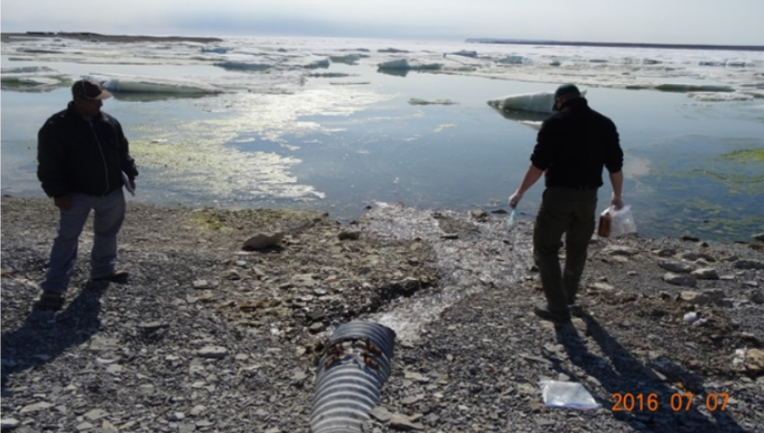
Monitoring
ᖃᐅᔨᓴᐃᓂᖅ
Monitoring involves measuring water flow and quality, and is used to evaluate how well management measures are working.
CIRNAC’s technical comment has been resolved:
Frequency of water quality sampling at sewage outfall
ᖃᐅᔨᓴᐃᓂᕐᒥᑦ ᐃᓚᐅᔪᑦ ᐆᒃᑐᕋᕐᓗᒋᑦ ᐅᒪᐅᑉ ᑯᕕᓂᖓ ᐊᒻᒪᓗ ᖃᓄᐃᓐᓂᖓ, ᐊᒻᒪᓗ ᐊᑐᖅᑕᐅᑉᓗᓂ ᕿᒥᕐᕈᓂᐊᕐᓗᓂ ᖃᓄᖅ ᐱᑦᑕᐅᑎᒋᖕᒪᖔᑦ ᐊᐅᓚᑦᑎᓂᕐᒧᑦ ᐱᓕᕆᐊᖑᔪᑦ ᐊᔪᙱᓐᓂᖏᑦ.
CIRNAC-ᑯᑦ ᐱᓕᕆᐊᑉ ᒥᒃᓵᓄᑦ ᐅᖃᐅᓯᖏᑦ ᐋᖅᑭᒃᑕᐅᓯᒪᓕᖅᑐᑦ:
ᖃᑉᓰᖅᑕᖃᑦᑕᕐᓂᖏᑦ ᐃᒪᐅᑉ ᖃᓄᐃᓐᓂᖓᓄᑦ ᐆᒃᑐᕋᐃᓃᑦ ᖁᕐᕕᖕᒥᙶᖅᑐᒥᑦ ᑯᕕᓯᕝᕕᐅᔪᒥᑦ
Sewage outfall to ocean
ᖁᕐᕕᖕᒥᙶᒻᑐᑦ ᑕᕆᐅᕐᒧᑦ
ᑯᕕᓯᕝᕕᒃ

Slide 11
Closure & reclamation planning
ᐅᒃᑯᐊᖅᐸᓪᓕᐊᓂᕐᒧᑦ ᐊᒻᒪᓗ ᐅᑎᖅᑎᑦᑎᓂᕐᒧᑦ ᐸᕐᓇᐃᓂᖅ
Once the new pump house, water treatment plant and wastewater treatment plant are built, it will be important to reclaim the old buildings.
CIRNAC’s technical comment has been resolved:
Applicant’s commitment to provide Reclamation Plans in advance of work, should it be included as a licence condition
ᓄᑖᖅ ᐃᒪᕐᒥᒃ ᑯᕕᓯᕝᕕᒃ, ᐃᒪᓕᕆᕝᕕᒃ ᐊᒻᒪᓗ ᐊᒃᑕᑰᖅᑕᐅᔪᓂᒃ ᐃᒪᓕᕆᕝᕕᒃ ᓴᓇᔭᐅᓯᒪᓕᖅᐸᑕ, ᐱᒻᒪᕆᐅᓂᐊᖅᑐᖅ ᐅᑎᖅᑎᑎᕐᓗᒋᑦ ᓄᑕᐅᖏᑦᑐᑦ ᐃᒡᓗᕐᔪᐊᑦ.
CIRNAC-ᑯᑦ ᐱᓕᕆᐊᑉ ᒥᒃᓵᓄᑦ ᐅᖃᐅᓯᖏᑦ ᐋᖅᑭᒃᑕᐅᓯᒪᓕᖅᑐᑦ:
ᑐᒃᓯᕋᐅᓯᐅᖅᑐᑉ ᐱᓂᐊᕐᓂᖓ ᑐᓂᓯᓂᐊᕐᓗᓂ ᐅᑎᖅᑎᑎᕆᓂᕐᒧᑦ ᐸᕐᓇᐅᑎᓂᒃ ᓯᕗᓂᐊᒍᑦ ᐱᓕᕆᒋᐊᕐᓂᐅᑉ ᐃᓚᐅᓂᐊᖅᐸᑦ ᓚᐃᓴᓐᓯᒥᑦ ᖃᓄᐃᓕᖓᔭᕆᐊᖃᕐᓂᕐᒥᑦ

Slide 12
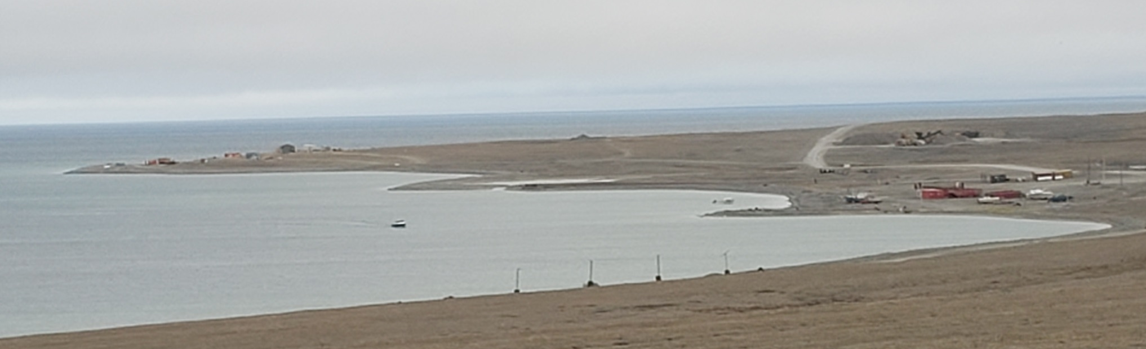
Conclusion
ᓄᖅᑲᐅᓯᕐᓂᖅ
CIRNAC supports the Government of Nunavut’s renewal application and recommends it be accepted with due consideration given to our comments
CIRNAC-ᑯᑦ ᐃᑲᔪᖅᑐᖅᑐᑦ ᓄᓇᕗᒻᒥ ᒐᕙᒪᒃᑯᑦ ᓄᑖᙳᖅᓯᓂᕐᒧᑦ ᑐᒃᓯᕋᐅᑎ ᐊᒻᒪᓗ ᓈᒻᒪᒋᔭᐅᖁᔭᖓᑦ ᐃᓱᒪᒋᔭᐅᑦᑎᐊᕐᓗᑎᒃ ᐅᖃᐅᓯᕆᔭᕗᑦ

Slide 13
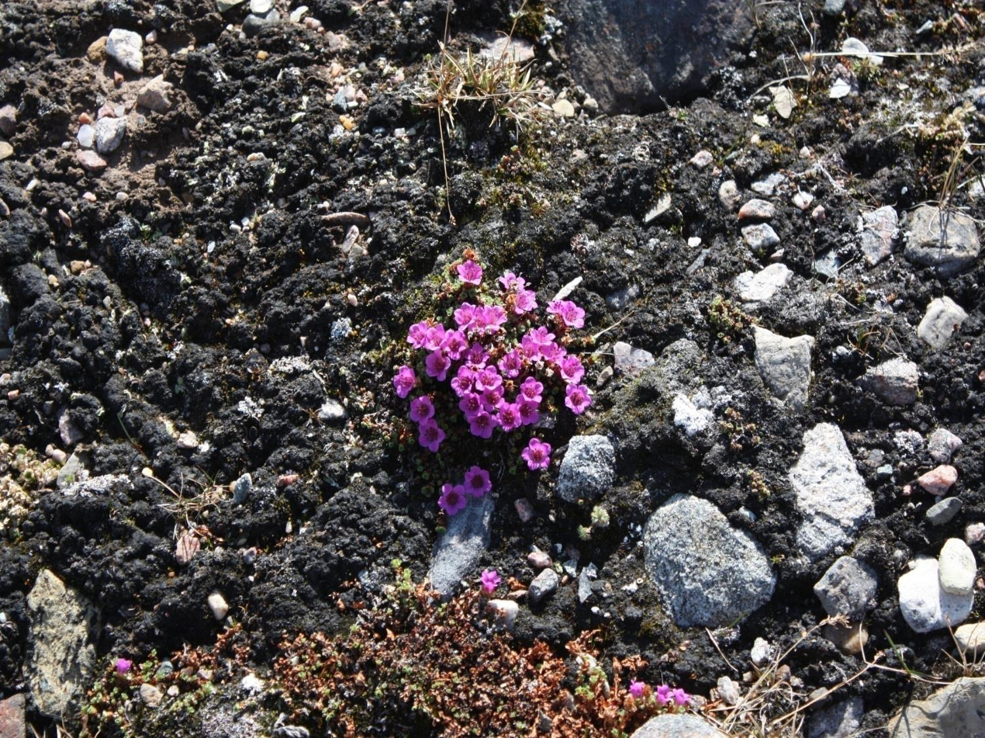
Qujannamiik
Thank you
Merci
ᖁᔭᓐᓇᒦᒃ

