Slide 1
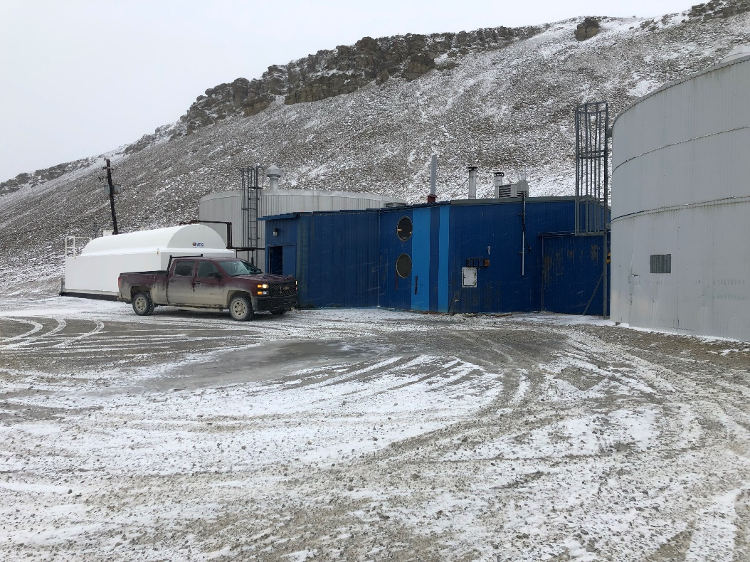
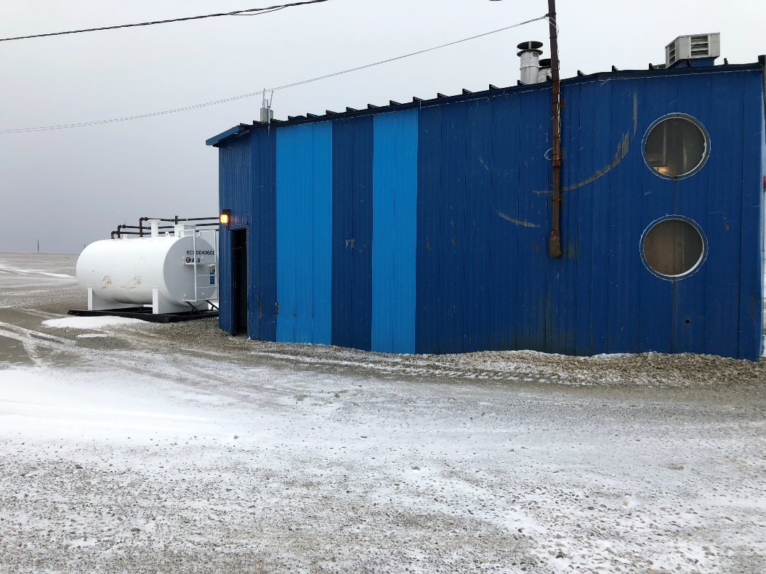
PRESENTATION FOR THE TYPE A WATER LICENCE APPLICATION OF THE RESOLUTE BAY UTILIDOR SYSTEM
NWB PUBLIC HEARING
OCTOBER 27 & 28, 2020
PRESENTED BY:
BHABESH ROY, M.A.Sc., P.Eng.
MUNICIPAL PLANNING ENGINEER
COMMUNITY GOVERNMENT SERVICES
GOVERNMENT OF NUNAVUT
BAFFIN REGION, POND INLET
BOX 379, X0A 0S0, NUNAVUT
Office: 867-899-7314
Cell: 867-899-1345

Slide 2


PARTICIPANTS FOR THE PUBLIC HEARING
GN LICENCE REPRESENTATIVE:
BHABESH ROY, M.A.Sc., P.Eng., MUNICIPAL PLANNING ENGINEER, BAFFIN REGION, POND INLET
Phone: 867-899-7314, cell: 867-899-1345 and email: broy@gov.nu.ca
Assisted by: Janise Idlout, Municipal Technical Officer, Baffin Region, Pond Inlet
Phone: 867-899-7315, e-mail: jidlout3@gov.nu.ca
MUNICIPALITY OF RESOLUTE BAY:
STEVE PIERCEY, CAO, phone: 867-252-3832 and email: sao@resolute.ca
CONSULTANT - EXP SERVICES INC:
TONY WHALEN, P.Eng., Project Manager and Sr. Water & Wastewater Engineer
Phone: 506-999-6284 and email: tony.whalen@exp.com
DARYL BURKE, M.Sc.E., P.Eng., Process Engineer – Water and Wastewater Services
Phone: 506-440-8394 and email: daryl.burke@exp.com
ERIC BELL, P.Eng., Senior Process Engineer - Water and Wastewater Services
Phone: 506-461-3984 and email: eric.bell@exp.com

Slide 3
MUNICIPALITY OF RESOLUTE BAY
In the early 1970s, the settlement was moved to the present location at N 74⁰43’01’’ and W 94⁰58’10”. The relocated community, the Municipality of Resolute Bay, was designed to accommodate 1,500 people.
The current (2020) Town population is 290. During the summer, due to Military presence for training, the population of the Town increases to approximately 800.
The town is divided into two distinct sections:
The Town where water is supplied by the Utilidor system; and
The Airport area (about 7km away) where water is supplied by truck.
NWB has issued three (3) Water Licences for different Community Environmental Facilities.
The Water Licence of the Utilidor System #3BM-RUT1012, Type B issued on March 30, 2015 to the Department of Community Government Services of the Government of Nunavut;
The Water Licence of the Solid Waste facilities #3BM-RES 2025, Type B issued on March 30, 2020 to the Municipality of Resolute Bay; and
The Water Licence of the Airport Sewage Lagoon #3BM-YRB 1621, Type B was issued on December 16, 2016 to the Department of Economic Development and Transportation of the Government of Nunavut.

Slide 4
OPERATIONAL MODE OF THE UTILIDOR SYTEM
The Asset Management section of the Pond Inlet Infrastructure Division of the Government of Nunavut is Responsible for the Utilidor system. Day-to-Day operation of the facilities are contracted out to ATCO.
Char Lake is the potable water source and the pump station is adjacent to the lake. A new pump station about 60m away from the existing pump station is currently under construction and will be completed in 2021. The flow meter located at the existing pump station records water extraction volume from Char Lake. The new pump station will also have a flow meter.
The Water Treatment Plant (WTP) is located at the Signal Hill and a 500m³ Storage Tank is adjacent to the WTP.
The Water Truck is filled directly at the WTP for distribution to the Airport facilities.
The water distribution system must have a circulation pattern that is independent of and unaltered by demands, other than fire flows. The system is controlled from the WTP.
Chlorine is only the reagent to disinfect water inside of the WTP prior to distribution.

Slide 5
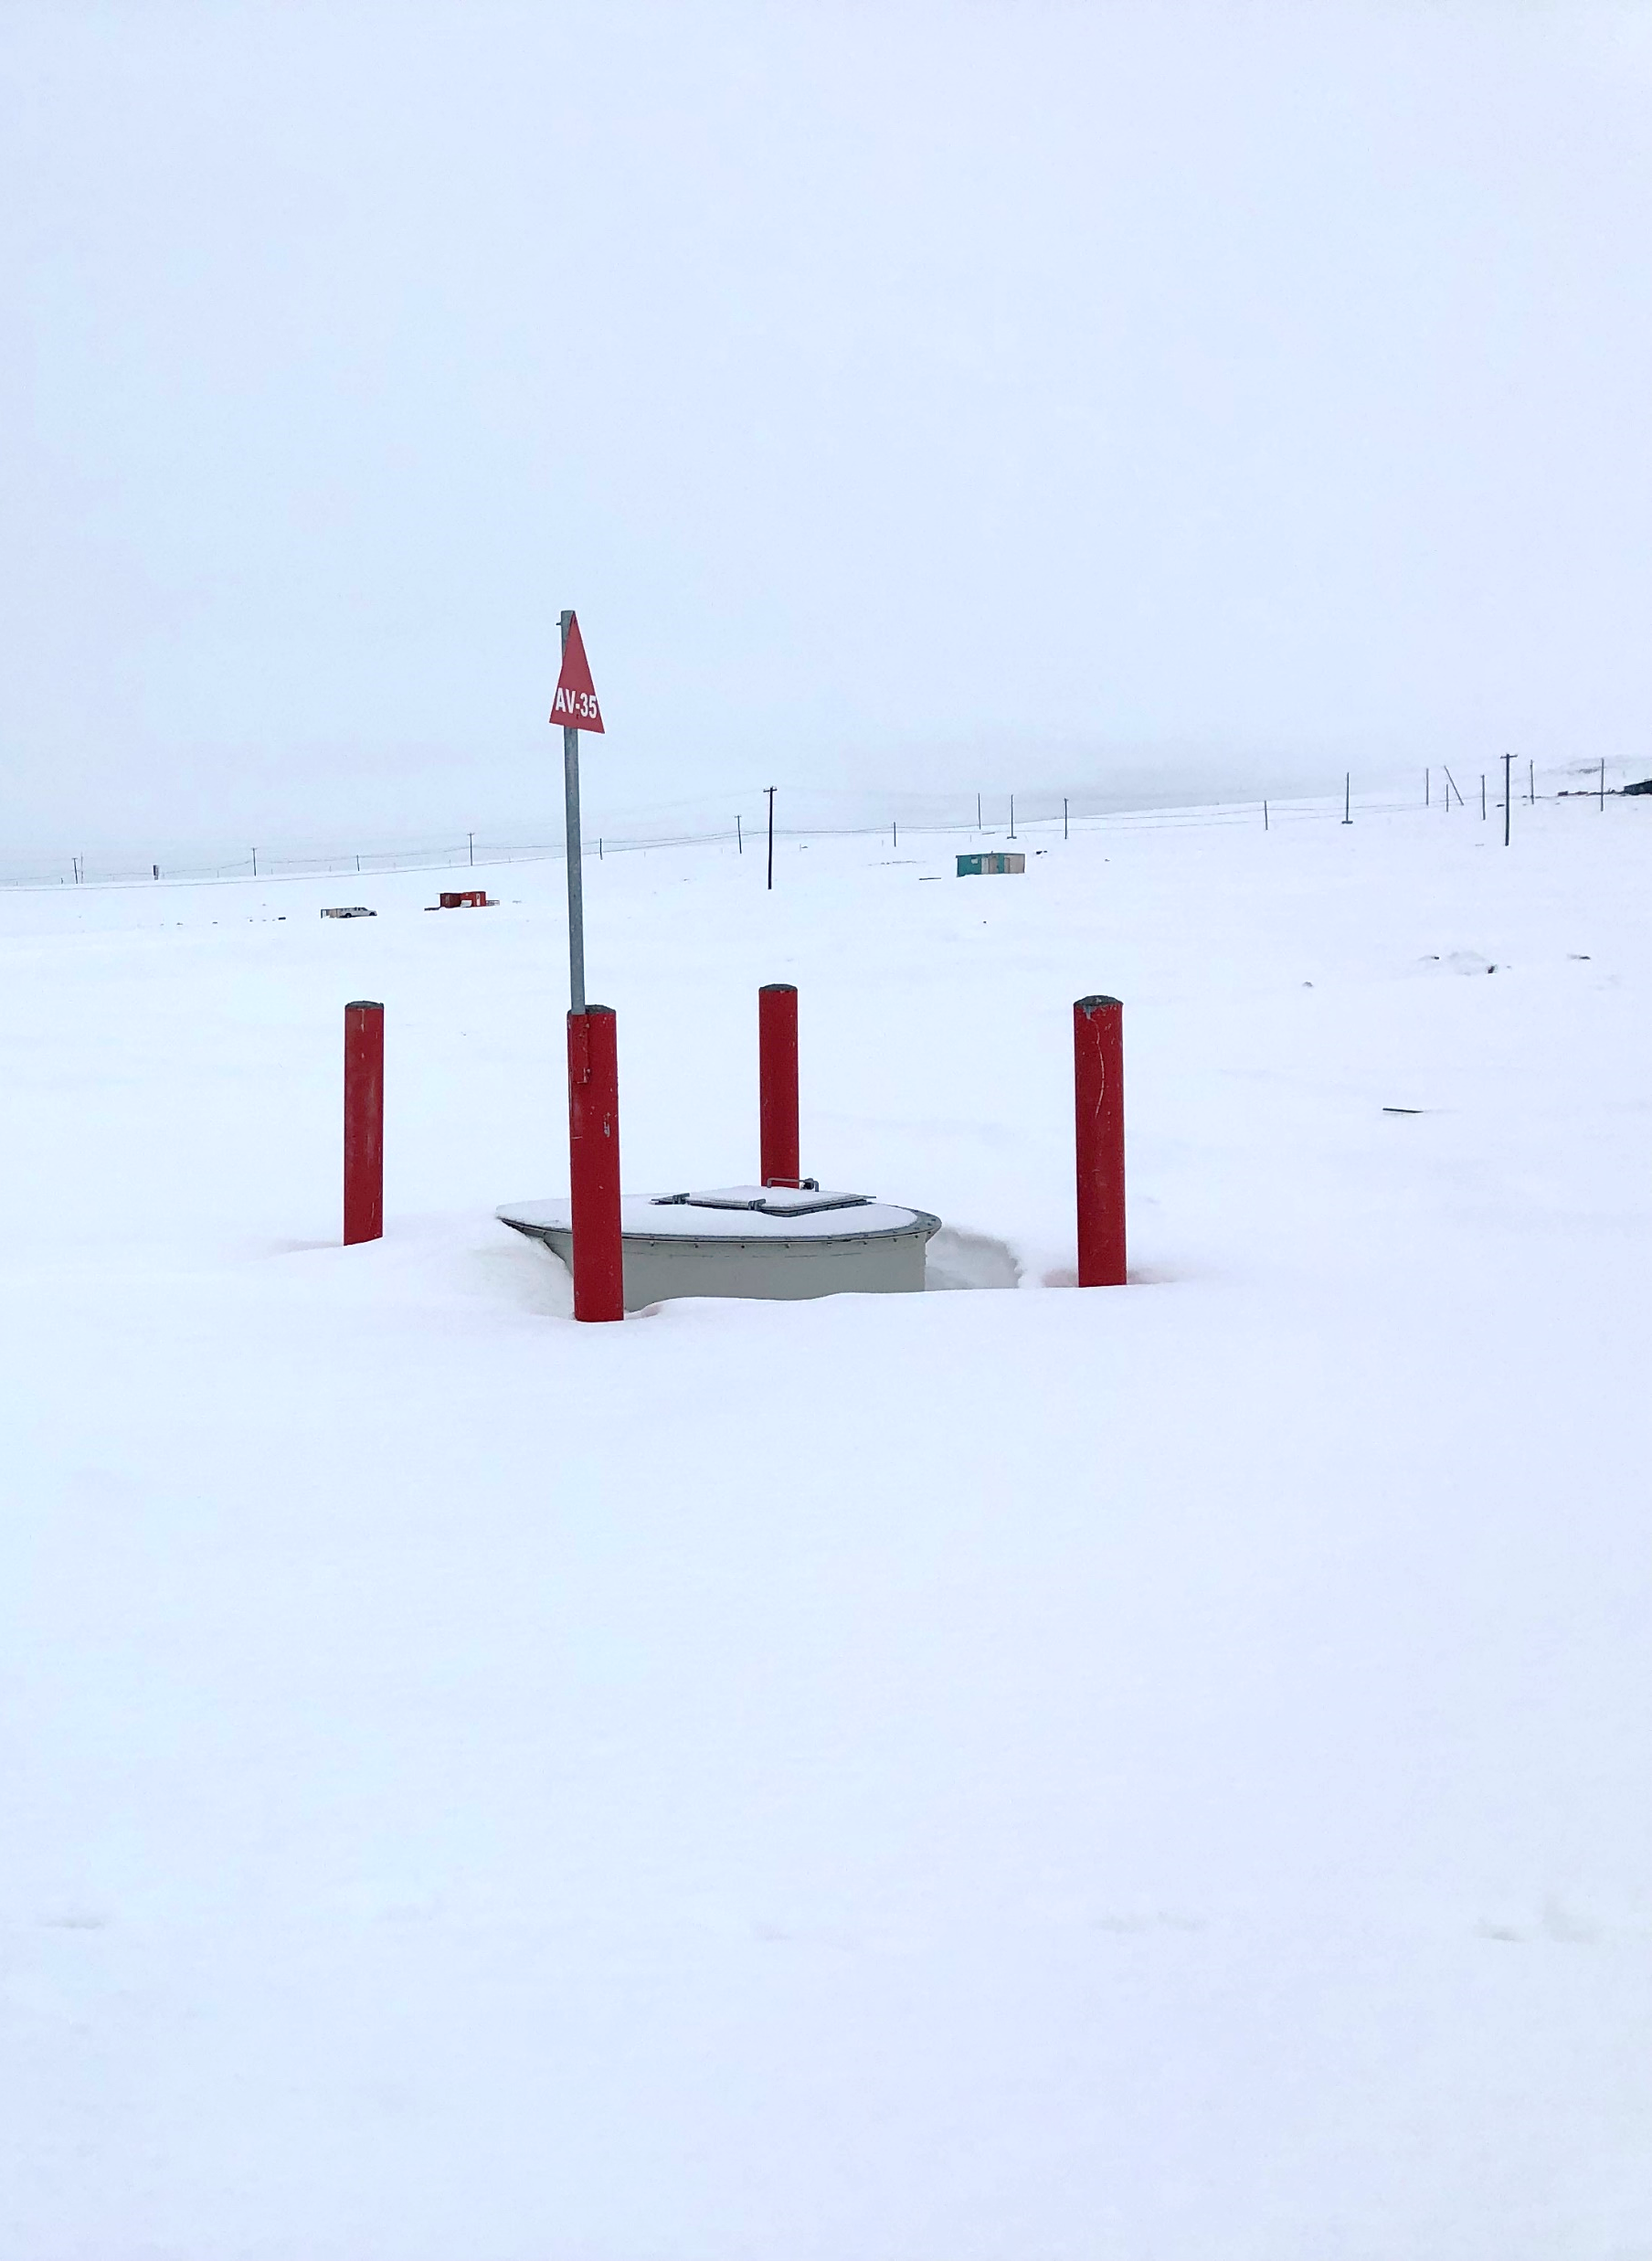
OPERATIONAL MODE OF THE UTILIDOR SYSTEM
The linear length of the Utilidor system is about 4 km.
The Utilidor system consists of buried water and sewer lines.
The diameter of the water line is 150mm (6”) and sewer line is 200mm (8”).
The water line is a recirculation process and works under about 100 psig pressure system; whereas the sewer line is completely under gravity system adding bleedwater.
The estimated bleedwater is roughly 227 liters per day or 82,855 liters annually.
The Utilidor system consists of 36 access vaults and 23 fire hydrants.
There is a water meter at each building to record water consumption.
The sewer line passes through the Macerator unit where suspended solids are reduced in size prior to discharge to the sea.
A new wastewater treatment plant (WWTP) is proposed to be built adjacent to the existing Macerator unit. This Macerator unit will be decommissioned soon after the new WWTP is commissioned.
The future WWTP will receive Truck Sewage and a mixture of the both types of sewage will be treated at the new WWTP.
The CBOD and TSS of the future WWTP effluent are recommended to be 25mg/L and 25mg/L respectively.

Slide 6
O&M MANUAL FOR THE UTILIDOR SYSTEM
The Operation &Maintenance manual was located and submitted.
The manual includes operation and maintenance information for major utilidor water and wastewater equipment components such as access vaults, watermains, sewer mains, and hydrants.

Slide 7
TYPE A WATER LICENCE APPLICATION OF THE MUNICIPALITY OF RESOLUTE BAY UTILITOR SYTEM
STATUS OF THE EXISTING WATER LICENCE:
EXISTING WATER LICENCE # 3BM-RUT 1012
LICENSEE: COMMUNITY GOVERNMENT SERVICES OF THE GOVERNMENT OF NUNAVUT
TYPE: TYPE B
DATE OF ISSUSE: MARCH 30, 2015
DATE OF EXPIRE: MARCH 29, 2020
DURATION: 5 YRS
WATER PERMIT VOLUME: 126,020 CUBIC METERS
STATUS OF THE PROPOSED WATER LICENCE
PROPOSED WATER LICENCE # 3AM-RUT--------
LICENSEE: COMMUNITY GOVERNMENT SERVICES OF THE GOVERNMENT OF NUNAVUT
PROPOSED TYPE: TYPE A
PROPOSED DURATION: 20 YEARS
PROPOSED WATER PERMIT VOLUME: SEE CONSUMPTION TABLE FOR 2020-2047

Slide 8
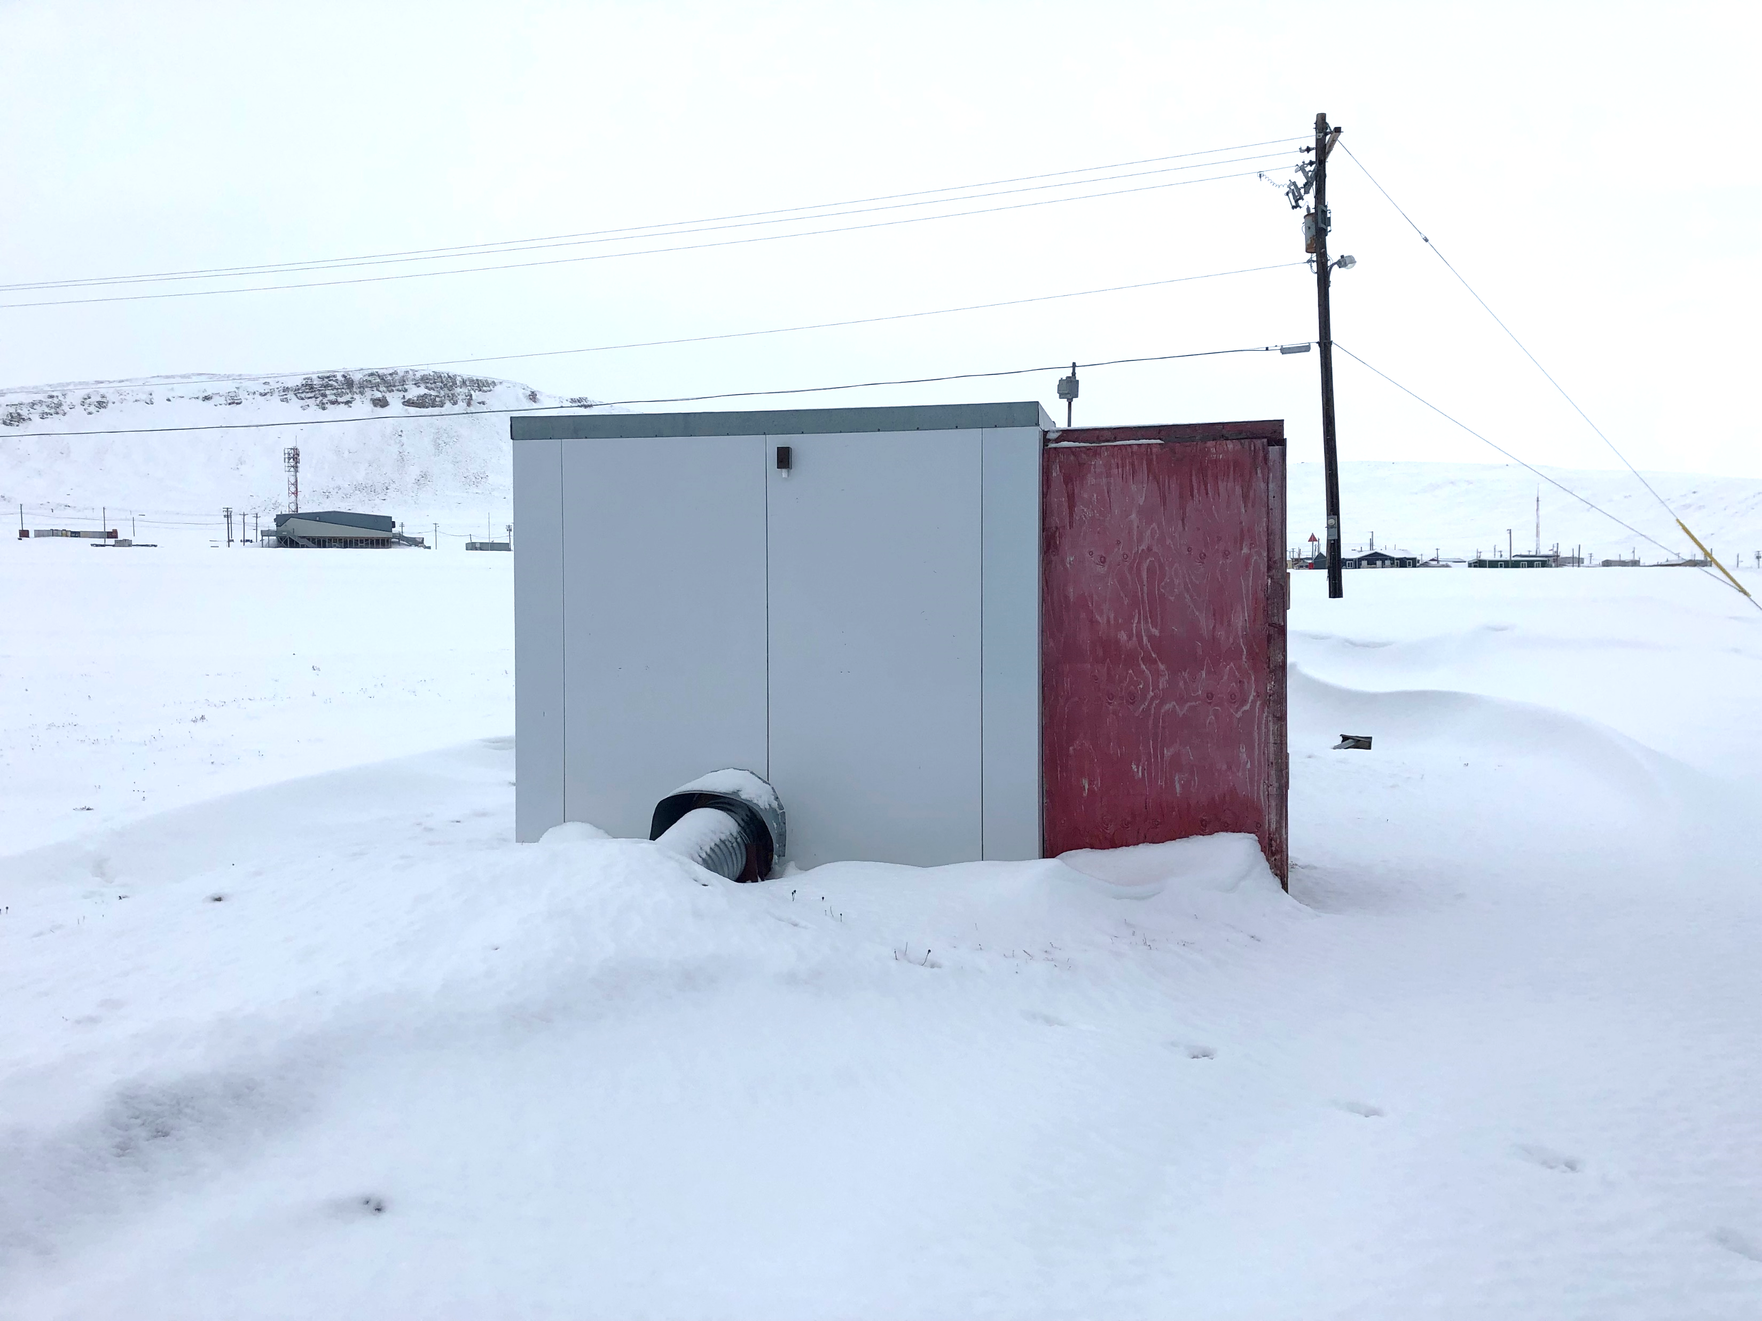
COMPONENTS OF THE UTILIDOR SYTEM
4KM OF BURIED WATER AND SEWER LINES
23 FIRE HYDRANTS
36 ACCESS VAULTS
A PUMP STATION AT CHAR LAKE
A 500 m³ WATER STORAGE TANK AT SIGNAL HILL
A WATER TREATMENT PLANT AT SIGNAL HILL
MACERATOR UNIT (WITH NO FLOW METER)
A 150 MM (6”) DIAMETER WATER INTKE LINE FROM CHAR LAKE TO THE PUMP STATION
A 150 MM (6”) DIAMETER WATER INTAKE LINE FROM PUMP STATION TO SIGNAL HILL WTP
A 200 MM (8”) DIAMETER OUTFALL LINE FROM MACERATOR UNIT TO SEA
THE ORIGINAL UTILIDOR SYSTEM WAS BUILT IN 1978 AND UPGRADED IN 2014

Slide 9
COMPONENTS OF THE FUTURE UTILIDOR SYSTEM
STATUS
THE MAIN BURIED WATER AND SEWER LINES (Main Utilidor System): UPGRADED in 2014
VAULTS: UPGRADED in 2014
FIRE HYDRANTS: UPGRADED in 2014
AN INTKE FROM THE CHAR LAKE TO NEW PUMP STATION: UNDER CONSTRUCTION 2020/2021
FISH SCREEN WILL BE PROVIED AT THE END OF THE INTAKE: 2020-2021
A NEW PUMP STATION AT SIGNAL HILL: UNDER CONSTRUCTION :2020/2021
A STANDARD FLOW METER WILL BE INSTALLED AT THE NEW PUMP STATION :2020-2021
INTAKE FROM NEW PUMP STATION TO SIGNAL HILL WATER TREATMENT PLANT: CONSTRUCTED
A STORAGE TANK AT SIGNAL HILL: CONSTRUCTED
Rehabilitation of the Existing Water Treatment Plant: Under construction in 2020-2021
A NEW WASTEWATER TREATMENT PLANT: FUTURE CONSTRUCTION (Anticipated 2024)
A NEW OUTFALL FROM WWTP TO THE SEA: FUTURE CONSTRUCTION (Anticipated 2024)
A COLLECTION POINT AT WWTP TO RECEIVE TRUCK SEWAGE: FUTURE CONSTRUCTION (Anticipated 2024)
THE OLD PUMP STATION, MACERATOR UNIT, OUTFALL LINE AND OLD WWTP BUILDING: FUTURE DECOMMISSIONING (Anticipated 2024)

Slide 10
THE UTILIDOR SYSTEM OF THE MUNICIPALITY OF RESOLUTE BAY
New Pump House
Storage tank
Char Lake
New Intake(Pressure pipe)
SIGNAL HILL
Water Treatment Plant
Existing intake (Pressure Pipe)
Existing Pump Station
Water Distribution and Sewer Line
Compliance Point
Macerator Unit
MUNICIPALITY OF RESOLUTE BAY
SEA
Outfall line (Sewer line under Gravity)
New compliance point
Proposed New Wastewater Treatment Plant
Truck Disposal Point

Slide 11
HISTORICAL WATER EXTRACTION VOLUME
Trucking to
Year Utilidor System (liters) Airport Facilities (liters) Total Extraction (liters)
2019 191,355,032 5,454,865 197,809,897
2018 152,062,035 5,139,821 157,201,856
2017 127,669,936 5,351, 523 123,121, 459
2016 326,439,020 5,351,523 331,790, 543
2015 424,262,506 4,210,285 428,472,791
2014 110,202,314 4,749,032 114,951,346
Permit Volume in Water Licence annually = 126,020 cubic metres = 126,020,000 liters.
Daily extraction exceeds 300 cubic meters per day. Therefore, the type of the new Water
Licence is recommended as TYPE A.

Slide 12
FLOW RATE INFORMATION FOR CHAR LAKE & SIGNAL HILL
The design flow rate from the water source to the new pump station at Char Lake is 720 L/m.
There are 3 submersible pumps, each with its own intake pipe and a capacity of 360 L/m.
Each intake has a fish screen with a 0.090” (~2.3mm) wire width.
The Char Lake pump station flow meter will have a range of 0 to 900 L/m.
The design flow rate from the Char Lake pump station to the Signal Hill WTP is 720 L/m.
The gravity sewage flow rate from the Macerator unit to the sea is estimated at 280 L/m.

Slide 13
TURBIDITY AND DISINFECTION
We are aware of the new turbidity rules approved by the CPHO on May 13, 2020.
With filtration, normal operations will occur as long as the treated water turbidity remains less than or equal to 1 NTU.
With dual filtration at the WTP plant, which includes 1st stage multimedia filters (which will remove larger turbidity particles and Giardia) and 2nd stage 1 micron cartridge filters (which will remove smaller particles and Crypto), there should be no issues with meeting turbidity limits as long as filters are functioning properly.
3-Log (99.9%) inactivation of pathogens in achieved with a 2-log credit with filtration and an addition 1-log credit for Calcium Hypochlorite disinfection.

Slide 14
QUANTITY OF WATER REQUESTED
Annual water extraction from Char Lake has been calculated from 2020 to 2047.

Slide 15
QUANTITY OF WATER REQUESTED
Total extracted water accounts for use within the community, the airport, and bleedwater.
Annual consumption for 2020 is calculated at 160,502 m³ up to 236,137 m³ in 2047 with population increases, per capita consumptions increases and increased bleedwater usage.
Char Lake’s replenishment capacity is sufficient up to about 2040 to supply water for the community.
It is recommended that additional technologies be investigated (such as mechanical lifting systems, heat tracing, etc.) to replace the bleedwater system to prevent water from freezing since Char Lake cannot sustain supply in this fashion past 2040.

Slide 16
VERIFICATION OF CONSUMPTION
CGS is requesting water measurement confirmation from Char Lake.
For the purposes of measuring water quantity being withdrawn on a consistent basis from Char Lake, a flow totalizing flowmeter is the desired technology.
A turbine flow meter is a widely used technology for totalizing the amount of water that flows through the pipe.
The service conditions and the congestion that exists in the existing Char Lake pump house does not seem to provide options for the installation of a flow totalizer.
Ideally, there would be a straight run of pipe at least 1m long that would permit the install of a flow totalizer (flanges and unions).
The flow totalizer itself is 0.58m in length.
This is not available in the Char Lake building.
From Char Lake, a dedicated 150mm (6”) line is utilized to connect to Signal Hill WTP.
It is proposed that the flow totalizer be installed on the inlet from Char Lake just as the pipe enters the Signal Hill WTP. There will be no other flow measured on the line, only the withdrawal water that is from Char Lake.
EXP has prepared flow meter specifications and are currently arranging delivery and subsequent installation in late October/early November 2020.

Slide 17
PLANS FOR THE CHAR LAKE PUMPHOUSE
Both an Environmental Management Plan (EMP) and Decommissioning & Remediation Plan have been submitted.
The EMP assists with implementing measures to protect the environment and minimize environmental impacts during construction at both the Char Lake Pumphouse and Signal Hill WTP sites.
The EMP outlines requirements and procedures to minimize surface water and fish habitat impacts by controlling erosion and drainage with sedimentation control.
Pollution controls and procedures are also implemented to reduce dust and particulate matter.
It also spells out procedures for management of hazardous materials during decommissioning.
Spill response procedures are also outlined for spills on land, snow and water.
And finally, it describes in detail the reporting requirements of any spill that may occur.

Slide 18
PLANS FOR THE CHAR LAKE PUMPHOUSE
Additional details are provided in the decommissioning and remediation plan and the spill contingency plan discussed later.
The decommissioning plan assists with implementing specific work procedures and measures to protect human health and minimize environmental impacts during decommissioning of the Char Lake Pumphouse.
Due to the proximity of the pumphouse to Char Lake, control measures must be implemented to prevent movement of contaminants into the water caused by disturbing the soils and structure dismantling.
The above-ground fuel tank must be safely removed, cleaned and washing using a vacuum truck, and the metal must be disposed at the community metal land field.
Hazardous materials such as lead-based paints, mercury-containing florescent light tubes and PCB-containing light fixture ballasts must be securely removed and disposed to recycling facilities.

Slide 19
CHAR LAKE PUMPHOUSE DESIGN & CONSTRUCTION
The scope for the new pump house and remediation of the site of the new facility involves the following activities:
  site works including access and a power line;
  provision of a new building including electrical and mechanical systems;
  provision of new intakes into Char Lake; a new transmission watermain interconnecting the pump house with the water treatment plant; and
  remediation of petroleum contamination of the existing site and management of the contaminated soil.
The design flow rate from the water source to the new pump station at Char Lake is 720 L/m.
The site selected is approximately 60 m east of the existing facility and meets the required criteria.

Slide 20
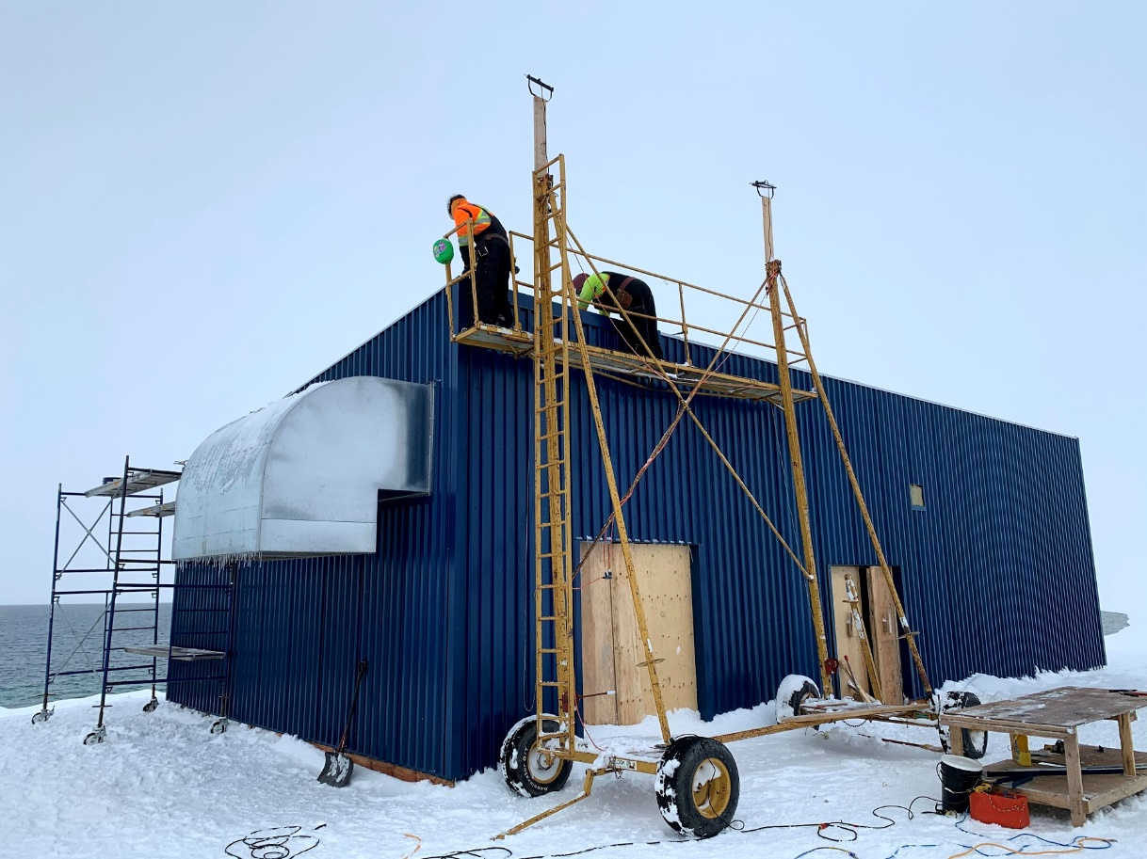
CHAR LAKE PUMPHOUSE DESIGN & CONSTRUCTION
A significant amount of work has been completed during the 2020 construction season at the Char Lake site that includes installation of silt fencing around the work site, excavation for the new pump house, concrete pours for foundations and pads, a new pumphouse building was constructed, boiler, glycol pipes and pumps were installed, bedding materials imported, and gravel bedding material was placed in Char Lake (with a turbidity curtain in place to prevent particulate matter from entering the raw water supply) for the new intakes to be placed during the 2021 construction season.

Slide 21
SIGNAL HILL WTP DESIGN & CONSTRUCTION
The recommended water treatment process includes multiple filtration steps and disinfection with Calcium Hypochlorite.
The filtration will provide for the suitable protection for microorganism removal and any small amounts of TSS that may get picked up by the Char Lake pumps.
The chlorine addition will protect against viruses and microorganisms from the water source and provide protection for any cross contamination that may occur in the distribution system.
The first stage filters are to be a duplex backwashable media filter.
A media filter typically removes particles down to a 7 to 10 micron size which is suitable for larger turbidity particles and Giardia Cysts.
The secondary proposed filters will be disposable polymer-based filters that will filter down to nominal 1 micron size which is suitable from further removal of smaller particles and Cryptosporidium.
The disinfection method to be employed will be Calcium Hypochlorite.
This will be delivered to site in a dry format and prepared for a 24-hour period in a mix tank.

Slide 22
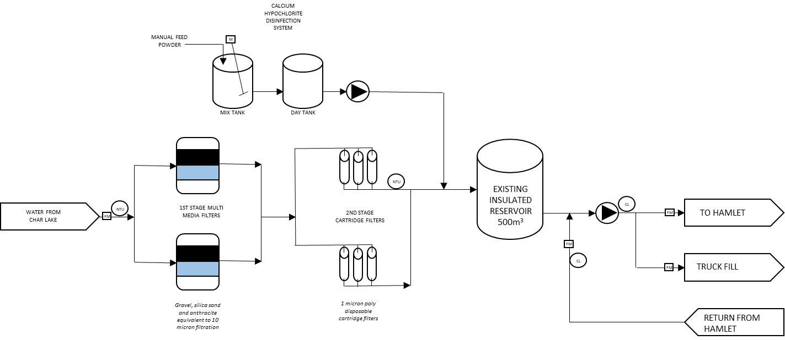
SIGNAL HILL WTP DESIGN & CONSTRUCTION

Slide 23
SIGNAL HILL WTP DESIGN & CONSTRUCTION
The upgrade to the WTP on Signal Hill examines the requirements for water treatment as outlined by the Canadian Drinking Water Guidelines.
This includes the upgrade of disinfection equipment and the inclusion of filtration equipment.
Capital costs as well as operational needs for a 30-year operating life were considered.
The upgraded water treatment plant will be in the same building but will incorporate filtration equipment, new disinfection equipment, new circulation pumps, washroom facilities, storage area, laboratory area and maintenance area.

Slide 24
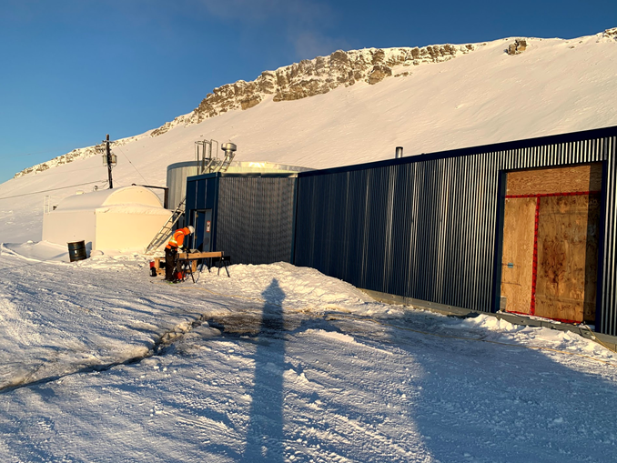
SIGNAL HILL WTP DESIGN & CONSTRUCTION
The unused reservoir tank will be removed, and the building will be expanded in an easterly direction.
A significant amount of work has been completed during the 2020 construction season at the Signal Hill site that includes site grading, concrete demolition work, building addition work including concrete, walls, roof and cladding, and obsolete equipment and materials were removed.

Slide 25
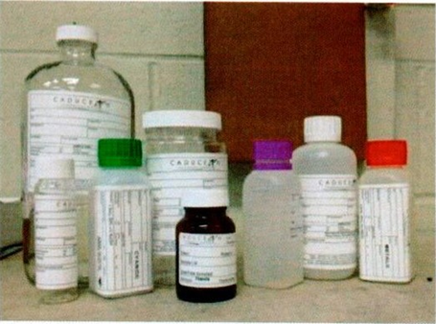
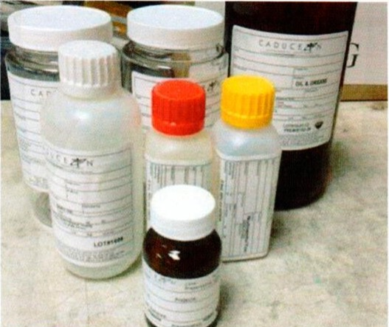
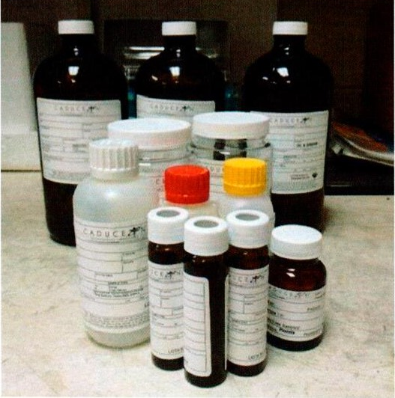
QUALITY ASSURANCE / QUALITY CONTROL
The QA/QC program is used to maintain standards in the monitoring programs for the wastewater treatment and disposal, water supply and treatment, and solid waste disposal described in the respective O&M manuals.
The program describes QA and QC processes and procedures applied during field activities to accurately reflect the attributes of the water, wastewater, and leachate being tested.
Field QC addresses cross contamination as a common source of error in sampling procedures, sample handling, and storage and shipping.
Field QC samples may include field blanks labelled as such to trace sources of artificially introduced contamination, or blind duplicates not labelled as such to ensure analytical precision.
Laboratory QC is applied by laboratories after the samples have been received from the field to enable the laboratory produce accurate and reproducible results on an ongoing basis.
The samples are collected in laboratory-supplied bottles and jars and analyzed at a laboratory certified by the Canadian Association for Laboratory Accreditation (CALA).
All analytical reports are to include QA/QC reports. This Hamlet has been using the services of the accredited lab in Ottawa named Caduceon Environmental Laboratories.

Slide 26
SPILL CONTINGENCY PLAN
The SCP is used to address the proper responses to the anticipated types of spills that may occur during the routine operation and maintenance activities of the Hamlet’s facilities associated with wastewater treatment and disposal, water supply and treatment, and solid waste disposal.
The SCP presents potential contaminants and spill scenarios, existing preventative measures, and response organization.
The SCP action plan includes potential impacts from and procedures for containing chemical spills such as sodium hypochlorite used to treat the water, and petroleum spills such as diesel fuel used to power equipment.
The SCP provides contact information in case of spill, spill kit locations and spill reporting procedures.
The SCP also includes the standard spill kit requirements.

Slide 27
WASTEWATER TREATMENT PLANT
A number of technical issues and concerns regarding the current and future wastewater treatment have been raised by stakeholders.
As such, EXP have prepared and submitted a technical memo addressing recommended fecal coliform limits, a O&M plan for the existing macerator building, a technical memo addressing ammonia for the new WWTP and a technical memo that reviews the 2012 and 2020 WWTP designs.
The calculated Fecal Coliform values were determined based on linear regression of data collected from 2016 to 2020, which included 18 results.
For flows greater than 600 Lcd and TSS of 80 mg/L, the calculated Fecal Coliform value was determined to be 157,929 cfu/100mL.
For flows between 150 Lcd and 600 Lcd and TSS of 80 mg/L, the calculated Fecal Coliform value was determined to be 183,167 cfu/100mL.

Slide 28
WASTEWATER TREATMENT PLANT
EXP had previously noted that the building macerator unit is open flow, and that the heater has an exposed heating element, including thermostat, the fan is completely blocked off with insulation.
There is not much smell at all (flow is diluted), but it was noted to the GN that this is a hazard (explosion to operators) as there is a ventilation issue.
As such, health and safety risks from these hazards should be mitigated.
The identified issues associated with the building are: not ventilated; has one man-door (entry/exit) flush to exterior grade; vent is not operational and closed; electrical equipment is not explosion proof; and does not have any hazardous gas sensors.
EXP have recommended a number of procedures that should be followed when entering the macerator building. It may also be useful to investigate short-term options until the new WWTP is constructed and commissioned. These may include things such as acquisition of a gas detector and replacement of the heating, lighting, fan, plugs, and disconnects with explosion proof units.

Slide 29
WASTEWATER TREATMENT PLANT
The current trends in wastewater regulations indicate that effluent ammonia is likely to become a parameter of concern throughout Nunavut (and specifically the Hamlet of Resolute Bay) in the future.
There are currently no regulations currently in place in Nunavut or the Hamlet of Resolute Bay that would require biological nitrification to meet an effluent ammonia discharge objective.
However, it is anticipated that there will be future regulatory changes for the far north that could include new guidance on ammonia.
With the uncertainty of the future regulatory changes, the Hamlet of Resolute Bay will be well served by installing a biological-mechanical treatment system in accordance with EXP’s updated pre-design report (2020).
The proposed process technology could be designed for ammonia removal to meet the current WSER performance standards in effect throughout Canada.

Slide 30
WASTEWATER TREATMENT PLANT
There were a number of key design factors that remained very similar or unchanged between the 2012 and 2020 designs completed by EXP.
The most significant difference was the process technology with the intent to better balance the treatment performance requirements with the economic challenges.
This will result in a more cost competitive system that is still capable of providing a high-quality effluent.

Slide 31
ECCC RECOMMENDED WASTEWATER EFFLUENT COMPLIANCY
Average Carbonaceous Biochemical Oxygen Demand (CBOD) should be less than or equal to 25mg/L.
Average concentration of suspended solids should be less than or equal to 25mg/L.
Average Concentration of the Total residual chlorine should be less than or equal to 0.02mg/L.
Maximum concentration of un-ionized ammonia should be less than 1.25mg/L expressed as Nitrogen (N), at 15⁰C +/- 1⁰C.
Be non-accurately lethal effluent.

Slide 32
PARTICIPANTS FOR THE PUBLIC HEARING
GN LICENCE REPRESENTATIVE:
BHABESH ROY, M.A.Sc., P.Eng., MUNICIPAL PLANNING ENGINEER, BAFFIN REGION, POND INLET
Phone: 867-899-7314, cell: 867-899-1345 and email: broy@gov.nu.ca
Assisted by: Janise Idlout, Municipal Technical Officer, Baffin Region, Pond Inlet.
Phone: 867-899-7315, e-mail: jidlout@gov.nu.ca
MUNICIPALITY OF RESOLUTE BAY:
STEVE PIERCEY, CAO, phone: 867-252-3832 and email: sao@resolute.ca
CONSULTANT - EXP SERVICES INC:
TONY WHALEN, P.Eng., Project Manager and Sr. Water & Wastewater Engineer
Phone: 506-999-6284 and email: tony.whalen@exp.com
DARYL BURKE, M.Sc.E., P.Eng., Process Engineer – Water and Wastewater Services
Phone: 506-440-8394 and email: daryl.burke@exp.com
ERIC BELL, P.Eng., Senior Process Engineer - Water and Wastewater Services
Phone: 506-461-3984 and email: eric.bell@exp.com

