Slide 1
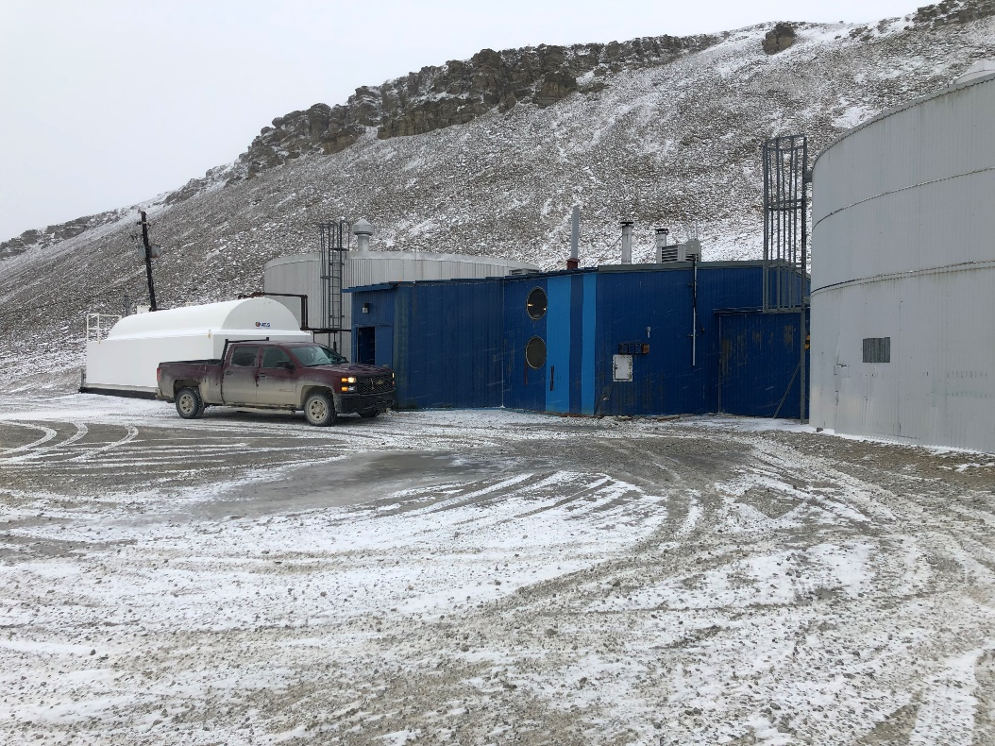
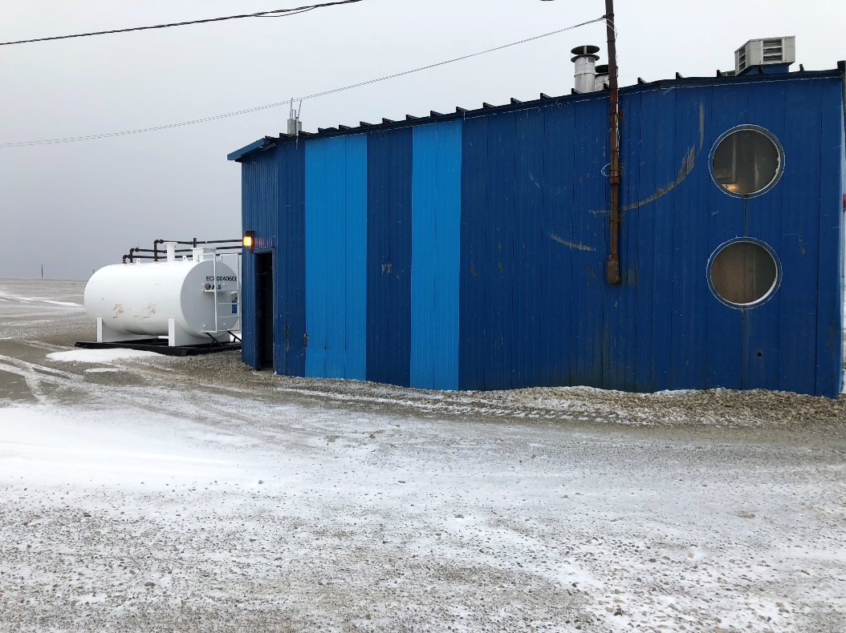
PRESENTATION FOR THE TYPE A WATER LICENCE APPLICATION OF THE RESOLUTE BAY UTILIDOR SYSTEM NWB PUBLIC HEARING OCTOBER 27 & 28, 2020 PRESENTED BY: BHABESH ROY, M.A.Sc., P.Eng. MUNICIPAL PLANNING ENGINEER COMMUNITY GOVERNMENT SERVICES GOVERNMENT OF NUNAVUT BAFFIN REGION, POND INLET BOX 379, X0A 0S0, NUNAVUT Office: 867-899-7314 Cell: 867-899-1345

Slide 2


PARTICIPANTS FOR THE PUBLIC HEARING
GN LICENCE REPRESENTATIVE:
BHABESH ROY, M.A.Sc., P.Eng., MUNICIPAL PLANNING ENGINEER, BAFFIN REGION, POND INLET
Phone: 867-899-7314, cell: 867-899-1345 and email: broy@gov.nu.ca
Assisted by: Janise Idlout, Municipal Technical Officer, Baffin Region, Pond Inlet
Phone: 867-899-7315, e-mail: jidlout3@gov.nu.ca
MUNICIPALITY OF RESOLUTE BAY:
STEVE PIERCEY, CAO, phone: 867-252-3832 and email: sao@resolute.ca
CONSULTANT - EXP SERVICES INC:
TONY WHALEN, P.Eng., Project Manager and Sr. Water & Wastewater Engineer
Phone: 506-999-6284 and email: tony.whalen@exp.com
DARYL BURKE, M.Sc.E., P.Eng., Process Engineer – Water and Wastewater Services
Phone: 506-440-8394 and email: daryl.burke@exp.com
ERIC BELL, P.Eng., Senior Process Engineer - Water and Wastewater Services
Phone: 506-461-3984 and email: eric.bell@exp.com

Slide 3
MUNICIPALITY OF RESOLUTE BAY
In the early 1970s, the settlement was moved to the present location at N 74⁰43’01’’ and W 94⁰58’10”. The relocated community, the Municipality of Resolute Bay, was designed to accommodate 1,500 people.
The current (2020) Town population is 290. During the summer, due to Military presence for training, the population of the Town increases to approximately 800.
The town is divided into two distinct sections:
The Town where water is supplied by the Utilidor system; and
The Airport area (about 7km away) where water is supplied by truck.
NWB has issued three (3) Water Licences for different Community Environmental Facilities.
The Water Licence of the Utilidor System #3BM-RUT1012, Type B issued on March 30, 2015 to the Department of Community Government Services of the Government of Nunavut;
The Water Licence of the Solid Waste facilities #3BM-RES 2025, Type B issued on March 30, 2020 to the Municipality of Resolute Bay; and
The Water Licence of the Airport Sewage Lagoon #3BM-YRB 1621, Type B was issued on December 16, 2016 to the Department of Economic Development and Transportation of the Government of Nunavut.

Slide 4
TYPE A WATER LICENCE APPLICATION OF THE MUNICIPALITY OF RESOLUTE BAY UTILITOR SYTEM
STATUS OF THE EXISTING WATER LICENCE:
EXISTING WATER LICENCE # 3BM-RUT 1012
LICENSEE: COMMUNITY GOVERNMENT SERVICES OF THE GOVERNMENT OF NUNAVUT
TYPE: TYPE B
DATE OF ISSUSE: MARCH 30, 2015
DATE OF EXPIRE: MARCH 29, 2020
DURATION: 5 YRS
WATER PERMIT VOLUME: 126,020 CUBIC METERS
STATUS OF THE PROPOSED WATER LICENCE
PROPOSED WATER LICENCE # 3AM-RUT--------
LICENSEE: COMMUNITY GOVERNMENT SERVICES OF THE GOVERNMENT OF NUNAVUT
PROPOSED TYPE: TYPE A
PROPOSED DURATION: 20 YEARS
PROPOSED WATER PERMIT VOLUME: 216,528 cubic meters(216,528,000 litres).

Slide 5
HISTORICAL WATER EXTRACTION VOLUME
Trucking to
Year Utilidor System (liters) Airport Facilities (liters) Total Extraction (liters)
2019 191,355,032 5,454,865 197,809,897
2018 152,062,035 5,139,821 157,201,856
2017 127,669,936 5,351, 523 123,121, 459
2016 326,439,020 5,351,523 331,790, 543
2015 424,262,506 4,210,285 428,472,791
2014 110,202,314 4,749,032 114,951,346
Permit Volume in Water Licence annually = 126,020 cubic metres = 126,020,000 liters.
Daily extraction exceeds 300 cubic meters per day. Therefore, the type of the new Water
Licence is recommended as TYPE A.

Slide 6
COMPONENTS OF THE FUTURE UTILIDOR SYSTEM
STATUS
THE MAIN BURIED WATER AND SEWER LINES (Main Utilidor System): UPGRADED in 2014
VAULTS: UPGRADED in 2014
FIRE HYDRANTS: UPGRADED in 2014
AN INTKE FROM THE CHAR LAKE TO NEW PUMP STATION: UNDER CONSTRUCTION 2020/2021
FISH SCREEN WILL BE PROVIED AT THE END OF THE INTAKE: 2020-2021
A NEW PUMP STATION AT SIGNAL HILL: UNDER CONSTRUCTION :2020/2021
A STANDARD FLOW METER WILL BE INSTALLED AT THE NEW PUMP STATION :2020-2021
INTAKE FROM NEW PUMP STATION TO SIGNAL HILL WATER TREATMENT PLANT: CONSTRUCTED
A STORAGE TANK AT SIGNAL HILL: CONSTRUCTED
Rehabilitation of the Existing Water Treatment Plant: Under construction in 2020-2021
A NEW WASTEWATER TREATMENT PLANT: FUTURE CONSTRUCTION (Anticipated 2024)
A NEW OUTFALL FROM WWTP TO THE SEA: FUTURE CONSTRUCTION (Anticipated 2024)
A COLLECTION POINT AT WWTP TO RECEIVE TRUCK SEWAGE: FUTURE CONSTRUCTION (Anticipated 2024)
THE OLD PUMP STATION, MACERATOR UNIT, OUTFALL LINE AND OLD WWTP BUILDING: FUTURE DECOMMISSIONING (Anticipated 2024)

Slide 7
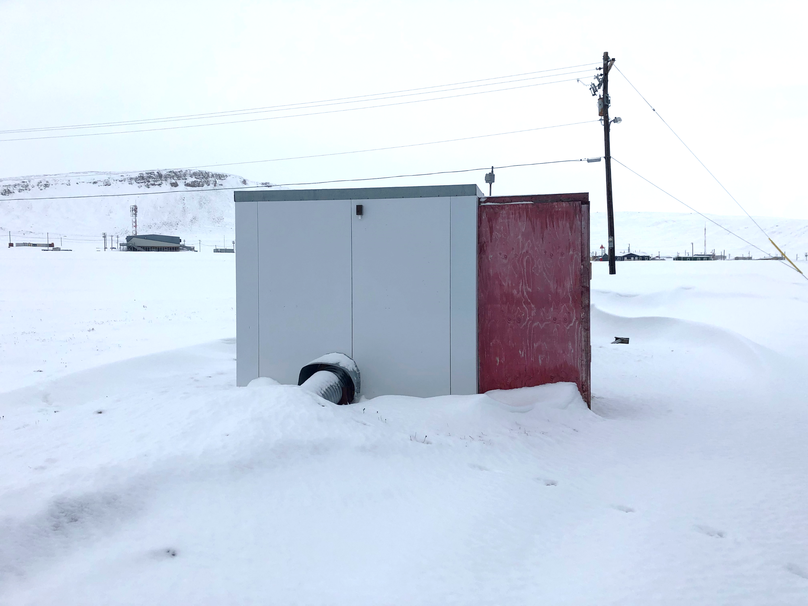
COMPONENTS OF THE UTILIDOR SYTEM
4KM OF BURIED WATER AND SEWER LINES
23 FIRE HYDRANTS
36 ACCESS VAULTS
A PUMP STATION AT CHAR LAKE
A 500 m³ WATER STORAGE TANK AT SIGNAL HILL
A WATER TREATMENT PLANT AT SIGNAL HILL
MACERATOR UNIT (WITH NO FLOW METER)
A 150 MM (6”) DIAMETER WATER INTKE LINE FROM CHAR LAKE TO THE PUMP STATION
A 150 MM (6”) DIAMETER WATER INTAKE LINE FROM PUMP STATION TO SIGNAL HILL WTP
A 200 MM (8”) DIAMETER OUTFALL LINE FROM MACERATOR UNIT TO SEA
THE ORIGINAL UTILIDOR SYSTEM WAS BUILT IN 1978 AND UPGRADED IN 2014

Slide 8
THE UTILIDOR SYSTEM OF THE MUNICIPALITY OF RESOLUTE BAY
New Pump House
Storage tank
Char Lake
New Intake(Pressure pipe)
SIGNAL HILL
Water Treatment Plant
Existing intake (Pressure Pipe)
Existing Pump Station
Water Distribution and Sewer Line
Compliance Point
Macerator Unit
MUNICIPALITY OF RESOLUTE BAY
SEA
Outfall line (Sewer line under Gravity)
New compliance point
Proposed New Wastewater Treatment Plant
Truck Disposal Point

Slide 9
QUANTITY OF WATER REQUESTED
Annual water extraction from Char Lake has been calculated from 2020 to 2047.

Slide 10
QUANTITY OF WATER REQUESTED
Total extracted water accounts for use within the community, the airport, and bleedwater.
Annual consumption for 2020 is calculated at 160,502 m³ up to 236,137 m³ in 2047 with population increases, per capita consumptions increases and increased bleedwater usage.
Char Lake’s replenishment capacity is sufficient up to about 2040 to supply water for the community.
It is recommended that additional technologies be investigated (such as mechanical lifting systems, heat tracing, etc.) to replace the bleedwater system to prevent water from freezing since Char Lake cannot sustain supply in this fashion past 2040.
Water permit 216,528 cubic metres ( 216,528,000 litres) is requested for the new Type A Water Licence for 20 yrs. term and this will expire on 2040.

Slide 11
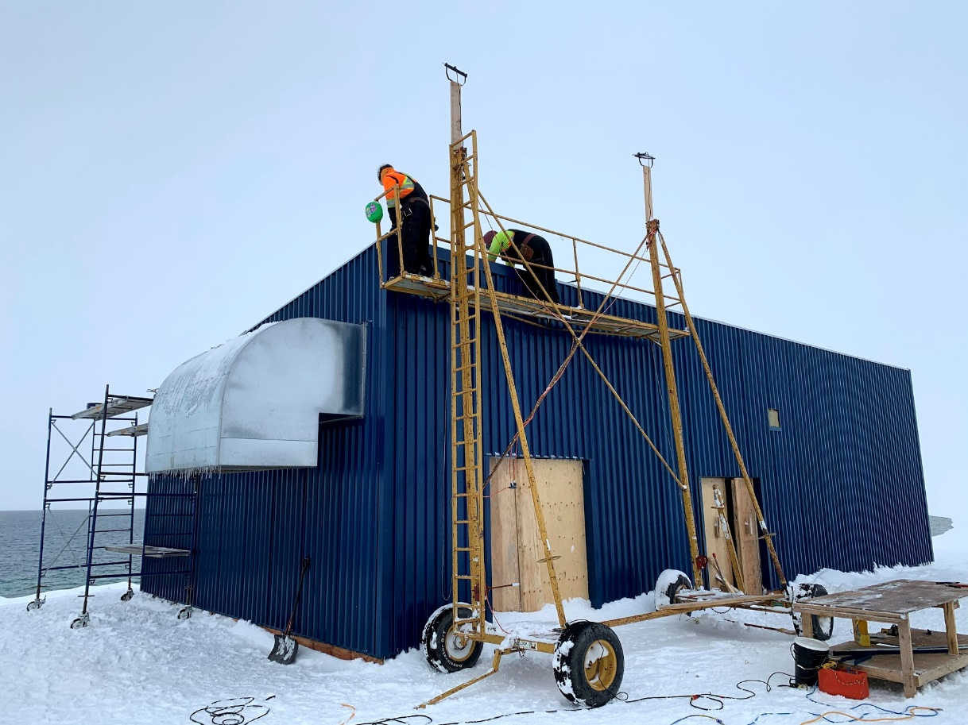
CHAR LAKE PUMPHOUSE DESIGN & CONSTRUCTION
A significant amount of work has been completed during the 2020 construction season at the Char Lake site that includes installation of silt fencing around the work site, excavation for the new pump house, concrete pours for foundations and pads, a new pumphouse building was constructed, boiler, glycol pipes and pumps were installed, bedding materials imported, and gravel bedding material was placed in Char Lake (with a turbidity curtain in place to prevent particulate matter from entering the raw water supply) for the new intakes to be placed during the 2021 construction season.

Slide 12
SIGNAL HILL WTP DESIGN & CONSTRUCTION
The recommended water treatment process includes multiple filtration steps and disinfection with Calcium Hypochlorite.
The filtration will provide for the suitable protection for microorganism removal and any small amounts of TSS that may get picked up by the Char Lake pumps.
The chlorine addition will protect against viruses and microorganisms from the water source and provide protection for any cross contamination that may occur in the distribution system.
The first stage filters are to be a duplex backwashable media filter.
A media filter typically removes particles down to a 7 to 10 micron size which is suitable for larger turbidity particles and Giardia Cysts.
The secondary proposed filters will be disposable polymer-based filters that will filter down to nominal 1 micron size which is suitable from further removal of smaller particles and Cryptosporidium.
The disinfection method to be employed will be Calcium Hypochlorite.
This will be delivered to site in a dry format and prepared for a 24-hour period in a mix tank.

Slide 13
SIGNAL HILL WTP DESIGN & CONSTRUCTION
The upgrade to the WTP on Signal Hill examines the requirements for water treatment as outlined by the Canadian Drinking Water Guidelines.
This includes the upgrade of disinfection equipment and the inclusion of filtration equipment.
Capital costs as well as operational needs for a 30-year operating life were considered.
The upgraded water treatment plant will be in the same building but will incorporate filtration equipment, new disinfection equipment, new circulation pumps, washroom facilities, storage area, laboratory area and maintenance area.

Slide 14
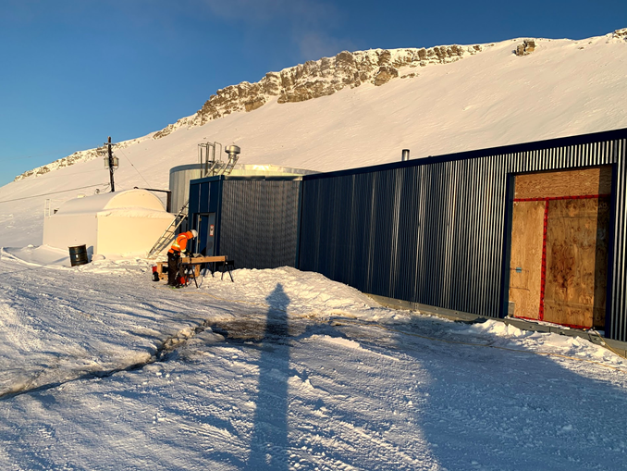
SIGNAL HILL WTP DESIGN & CONSTRUCTION
The unused reservoir tank will be removed, and the building will be expanded in an easterly direction.
A significant amount of work has been completed during the 2020 construction season at the Signal Hill site that includes site grading, concrete demolition work, building addition work including concrete, walls, roof and cladding, and obsolete equipment and materials were removed.

Slide 15
SPILL CONTINGENCY PLAN
The SCP is used to address the proper responses to the anticipated types of spills that may occur during the routine operation and maintenance activities of the Hamlet’s facilities associated with wastewater treatment and disposal, water supply and treatment, and solid waste disposal.
The SCP presents potential contaminants and spill scenarios, existing preventative measures, and response organization.
The SCP action plan includes potential impacts from and procedures for containing chemical spills such as sodium hypochlorite used to treat the water, and petroleum spills such as diesel fuel used to power equipment.
The SCP provides contact information in case of spill, spill kit locations and spill reporting procedures.
The SCP also includes the standard spill kit requirements.

Slide 16
WASTEWATER TREATMENT PLANT
A number of technical issues and concerns regarding the current and future wastewater treatment have been raised by stakeholders.
As such, EXP have prepared and submitted a technical memo addressing recommended fecal coliform limits, a O&M plan for the existing macerator building, a technical memo addressing ammonia for the new WWTP and a technical memo that reviews the 2012 and 2020 WWTP designs.
The calculated Fecal Coliform values were determined based on linear regression of data collected from 2016 to 2020, which included 18 results.
For flows greater than 600 Lcd and TSS of 80 mg/L, the calculated Fecal Coliform value was determined to be 157,929 cfu/100mL.
For flows between 150 Lcd and 600 Lcd and TSS of 80 mg/L, the calculated Fecal Coliform value was determined to be 183,167 cfu/100mL.

Slide 17
WASTEWATER TREATMENT PLANT
There were a number of key design factors that remained very similar or unchanged between the 2012 and 2020 designs completed by EXP.
The most significant difference was the process technology with the intent to better balance the treatment performance requirements with the economic challenges.
This will result in a more cost competitive system that is still capable of providing a high-quality effluent.

Slide 18
ECCC RECOMMENDED WASTEWATER EFFLUENT COMPLIANCY
Average Carbonaceous Biochemical Oxygen Demand (CBOD) should be less than or equal to 25mg/L.
Average concentration of suspended solids should be less than or equal to 25mg/L.
Average Concentration of the Total residual chlorine should be less than or equal to 0.02mg/L.
Maximum concentration of un-ionized ammonia should be less than 1.25mg/L expressed as Nitrogen (N), at 15⁰C +/- 1⁰C.
Be non-accurately lethal effluent.

