Slide 1
RECLAIM Version 8.0
(Working Draft)
Nunavut Mining Symposium
April 09, 2025

Slide 2
Technical Working Team
The technical working team consisted of subject matter experts in the fields of mine closure planning and cost estimating. Key contributors include:
CIRNAC
Government of Northwest Territories (GNWT)
Brodie Consulting Ltd.
AtkinsRéalis

Slide 3
History of RECLAIM​
Originally developed in 1993 collaboratively by CIRNAC, the GNWT and the Lands and Waters Boards of the Mackenzie Valley;
Updated in 2014 (Mining Version 7.0)
The RECLAIM model is a standardized tool used to estimate the financial security required for mine reclamation and closure.
Last update to the unit rates was in 2017.
RECLAIM v.8.0 is an update of the cost model, prepared on behalf of GNWT and CIRNAC.

Slide 4
Purpose of this Presentation
Technical Working Team updated RECLAIM V8 and the purpose of this presentation is for key users of the Tool:
To be informed of the changes made to the working version of the User Manual and Tool.
Provide high level summary of comments / recommendations
The Technical Working Team will be providing key users the continued opportunity to review the working draft and provide feedback prior to finalizing the Tool
Notes:
Not going to get into sub bullets

Slide 5
Purpose of RECLAIM​
PURPOSE: To ensure mining operations do not have residual environmental or human health risks or leave a financial burden on Canadian taxpayers.
“Estimates of reclamation costs, for the purposes of financial security, should be based on the cost of having the necessary work done by a third-party contractor if the operator defaults. The estimates should also include contingency factors appropriate to the particular work to be undertaken.”

Slide 6
RECLAIM Tool​
Changes to RECLAIM
Calculation for Future Values​
Mobilization moved to Capital Costs​
Post Closure Activities moved to Capital Costs​
Owners Representative added to Indirect Costs​
Engagement and Regulatory Compliance added to Indirect Costs​
Increased indirect default percentages:
ICM sheet includes default percentages for:
Finalizing the Closure and Reclamation Plan (CRP) (4%*);
Completion of a Human Health and Ecological Risk Assessment (HHERA) (3%*).
* Of capital costs less post closure and ICM

Slide 7
RECLAIM Tool​
Increased Default Percentages for In-directs based on industry standards and to reflect actuals at other sites
In-Direct | Old % | New %
ENGINEERING DESIGN | 5% | 8%
PROJECT MANAGEMENT | 5% | 10%
HEALTH AND SAFETY PLANS/MONITORING & QC | 1% | 1%
BONDING/INSURANCE | 1% | 3%
ENGAGEMENT AND REGULATORY COMPLIANCE | N/A | 3%
CONTINGENCY | 20% | 25%
OWNERS REPRESENTATIVE | N/A | 8%

Slide 8
RECLAIM Tool​
Post Closure Worksheet now includes a cell for users to input the number of years post closure activities are planned to occur at the site - used to calculate the future value of this work on the Summary Page.
Removed discount rate and present value calculation.

Slide 9
RECLAIM Tool​
Water Treatment Worksheet now separated into ICM, Closure Activities and Post Closure
Also includes a cells for users to input the number of years water treatment is planned to occur at the site. In the case of long-term water treatment which is included as part of Post Closure Activities, this is used to calculate the future value of this work.
Added in a line item for water treatment facility construction cost and annual operation cost.

Slide 10
RECLAIM Tool​
Unit Rate Worksheet was updated based on First Principles, databases and corporate experience.
Unit rates are based on Q2 2024 Canadian dollar values and reflect third-party contractor work in Nunavut and Northwest Territories.
A calculation was added to allow the unit rates to be updated annually using Canadian Consumer Price Index (CPI) numbers for Nunavut, Northwest Territories, or a User Specific input. The tool updates automatically as it is linked to the CPI webpage.

Slide 11
19 Contributors of Comments/Recommendations
B2Gold
NWT&NU Chamber of Mines
Qikiqtani Inuit Association
Baffinland
Agnico Eagle
Kivalliq Inuit Association
Teck Metals Ltd.
Pine Point Mining Limited
Arctic Canadian Diamond Company Ltd.
Independent Environmental Monitoring Agency
Diavik Diamond Mines
Fisheries and Oceans Canada (DFO)
A member of the public (Todd Slack)
WLWB
Imperial Oil Resources NWT Ltd
De Beers Canada Inc. – Gahcho Kue
Environmental Monitoring Advisory Board
Tlicho Government
Burgundy Diamond Mines Ltd

Slide 12
Comment Tracker: March 31, 2025 Submission
Notes:
Walk through of Excel File

Slide 13
Conclusion
CIRNAC and the GNWT look forward to additional input and review comments from the key users of RECLAIM
Next Steps:
Technical Working Team to review and compile comments and recommendations and post onto the Public Registries
Engagement Session #2 in Yellowknife on May 14, 2025

Slide 14
Questions and Answers
?

Slide 15
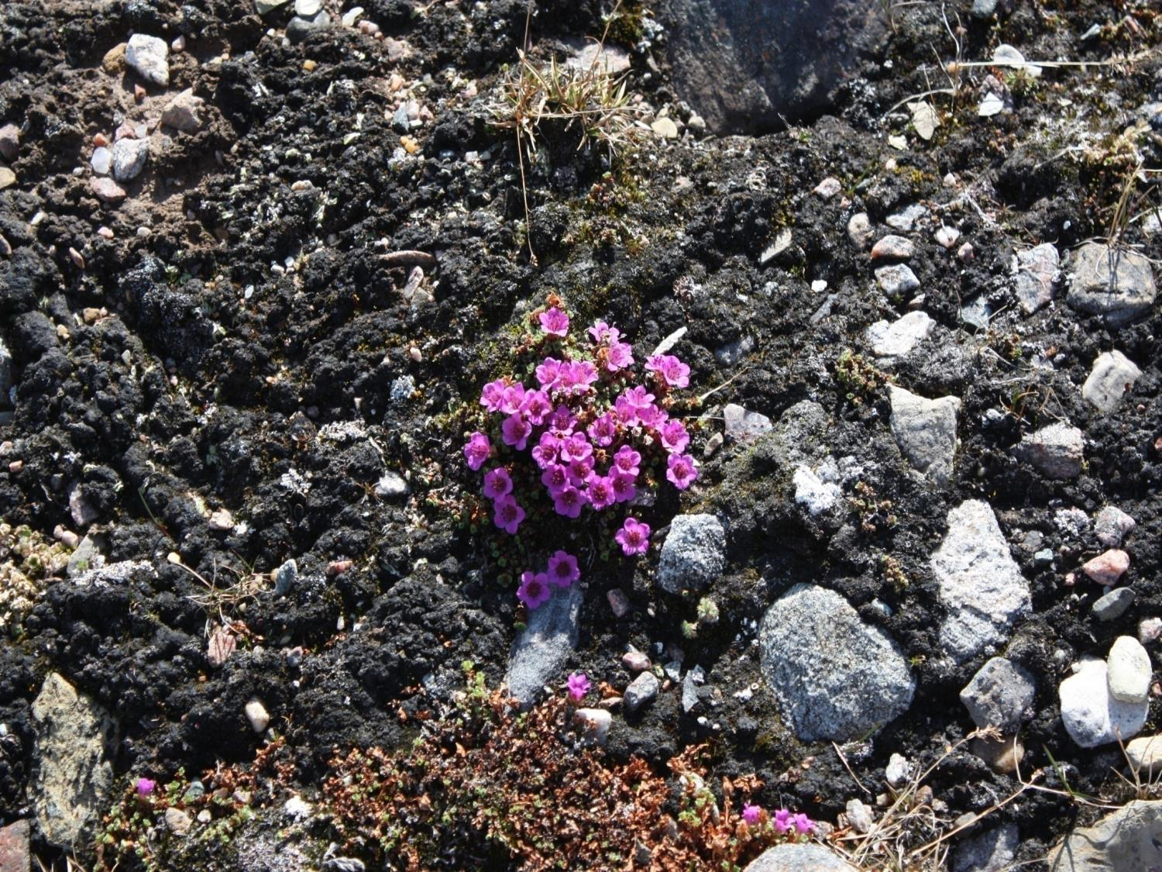
Thank you
Merci

